Slide 1
Play the Right Way
Notes:
Audience – pupils, teachers, support staff

Slide 2
Which are your favourite team sports?
Do you play football?
Do you support a football team?

Slide 3
Do you live the
Premier League values?
Be connected!
Be inspired!
Be ambitious!
Be fair!
Notes:
Be connected! – do you work well in a team? Listen to others and encourage everyone on the pitch.
Be inspired! – do you set a good example for other players? Work hard, don’t argue, stay positive.
Be ambitious! – do you always aim to do better? This can be in performance and attitude.
Be fair! – do you include everyone in your games? Don’t cheat, don’t discriminate.

Slide 4
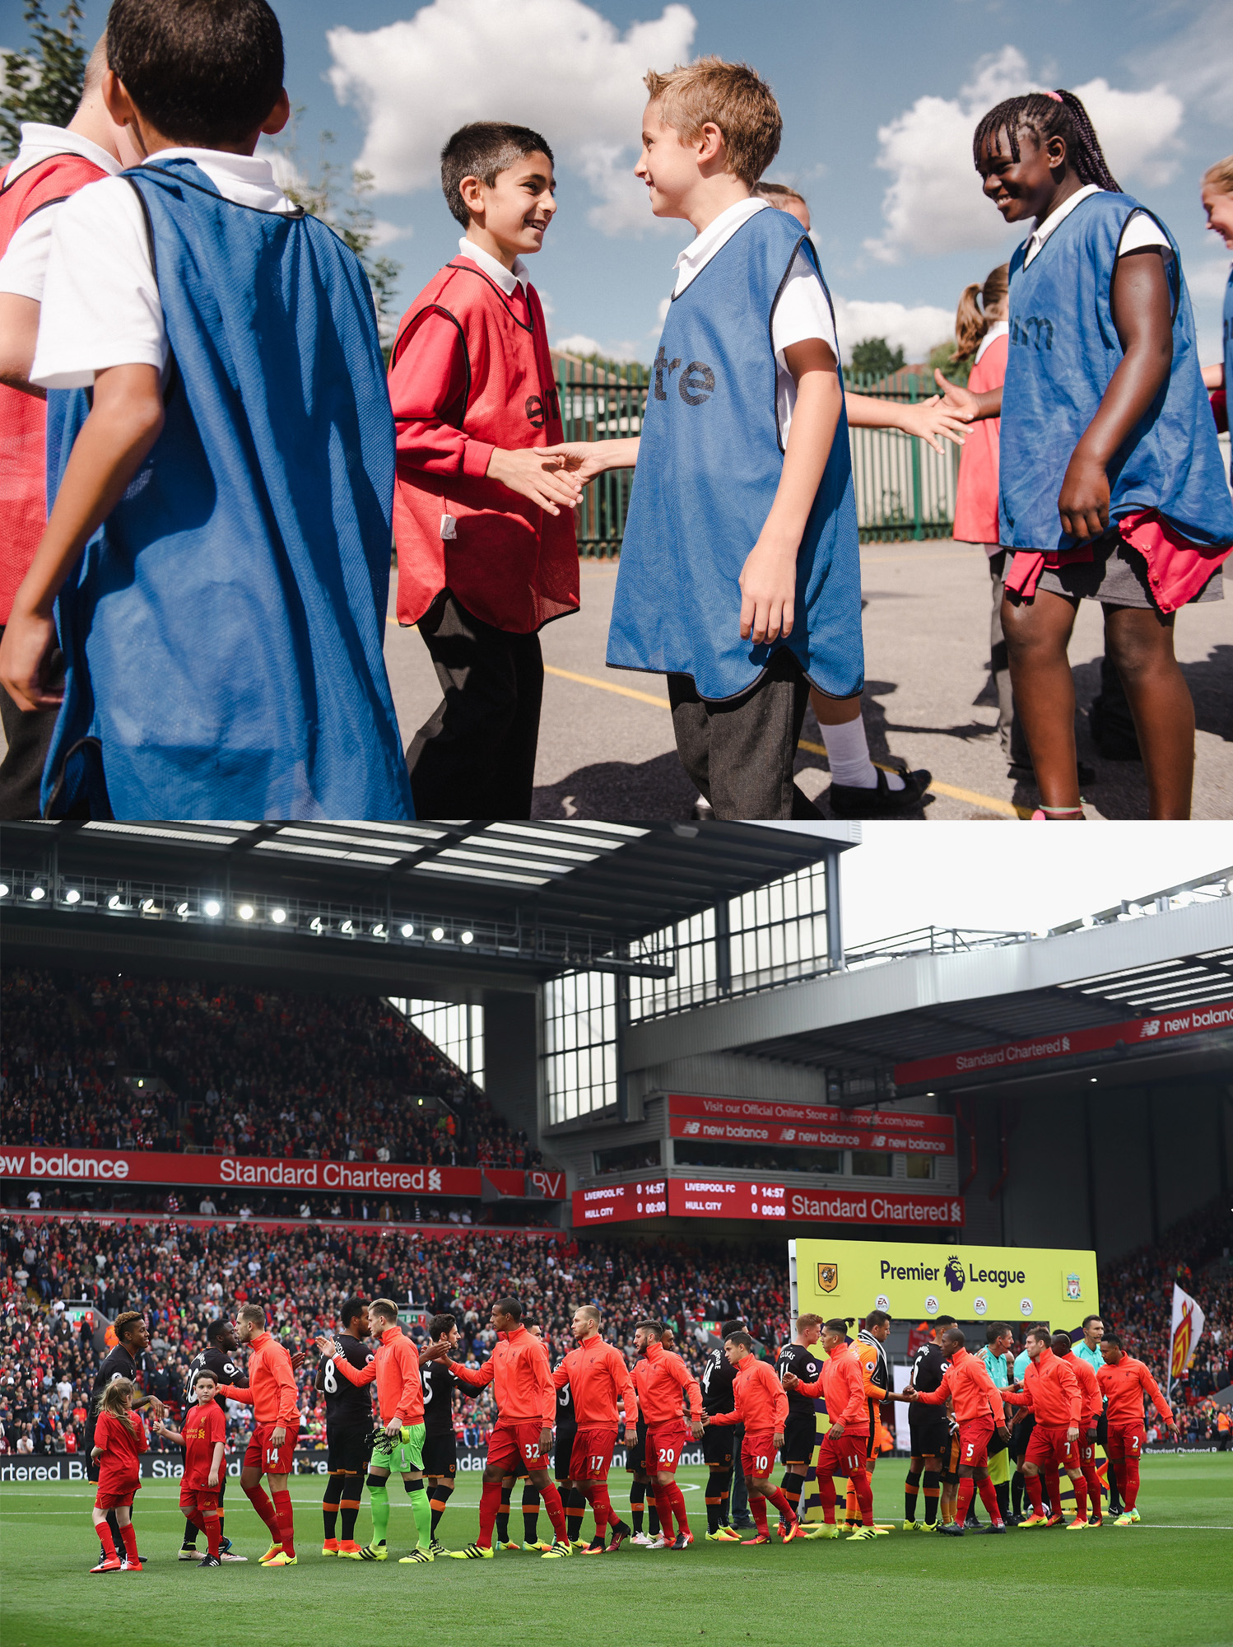
Premier League Primary Stars helps teach and inspire children and young people to adopt positive attitudes and behaviours when playing and following football.

Slide 5
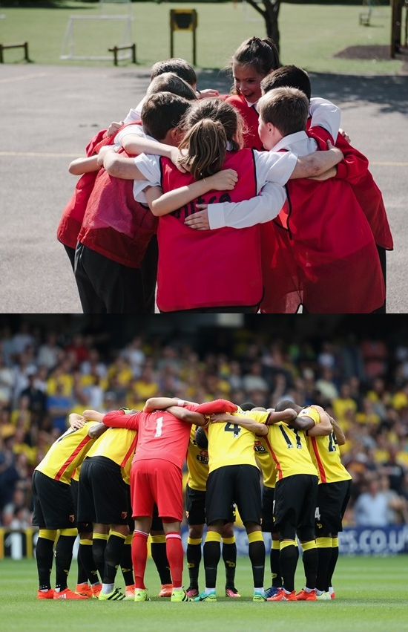
Do you… Play the Right Way?
What sorts of positive attitudes and behaviour do we see at our school when pupils play sports like football?
How would you describe attitudes and behaviour which are not so positive?
Notes:
“We want to ensure our playground is a fun and supportive place for all children to come and play.”

Slide 6
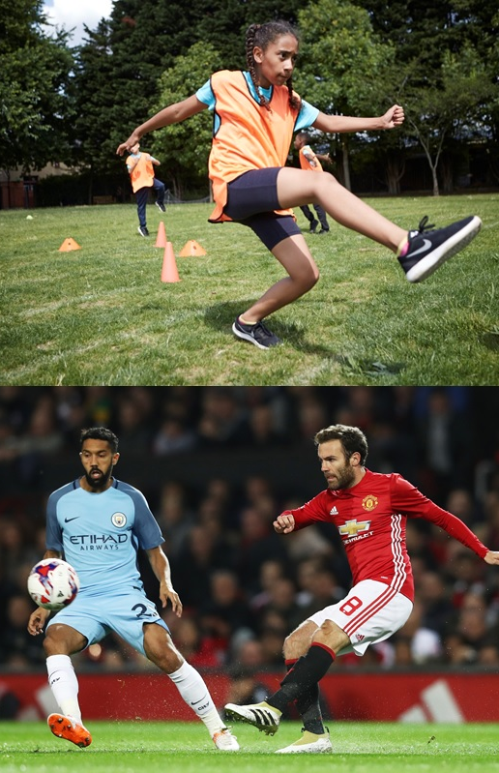
Making sure our playground is a positive place to play.
Notes:
Ask your child if they can give an example of negative behaviour they’ve seen in the playground.
How would this behaviour make them feel? – sad, unwelcome, not good enough…
“We don’t believe anyone means to upset other pupils in the school. So what behaviours could make our playground an even more fun place to be?”
What attitudes and behaviour do we expect in the playground?

Slide 7
Play the Right Way
Pick teams fairly
Respectfully shake hands before and after the game
Accept the match official or leader’s decision
Give praise and positive encouragement
Support all players
Follow the rules
Be honest
If you can’t agree, start afresh
Lose gracefully – accept and learn from the outcome
Win with humility – celebrate, but be mindful of your opposition’s feelings
Notes:
What behaviour do we expect in the playground? – this could be amended by the school to reflect their code of conduct.

Slide 8
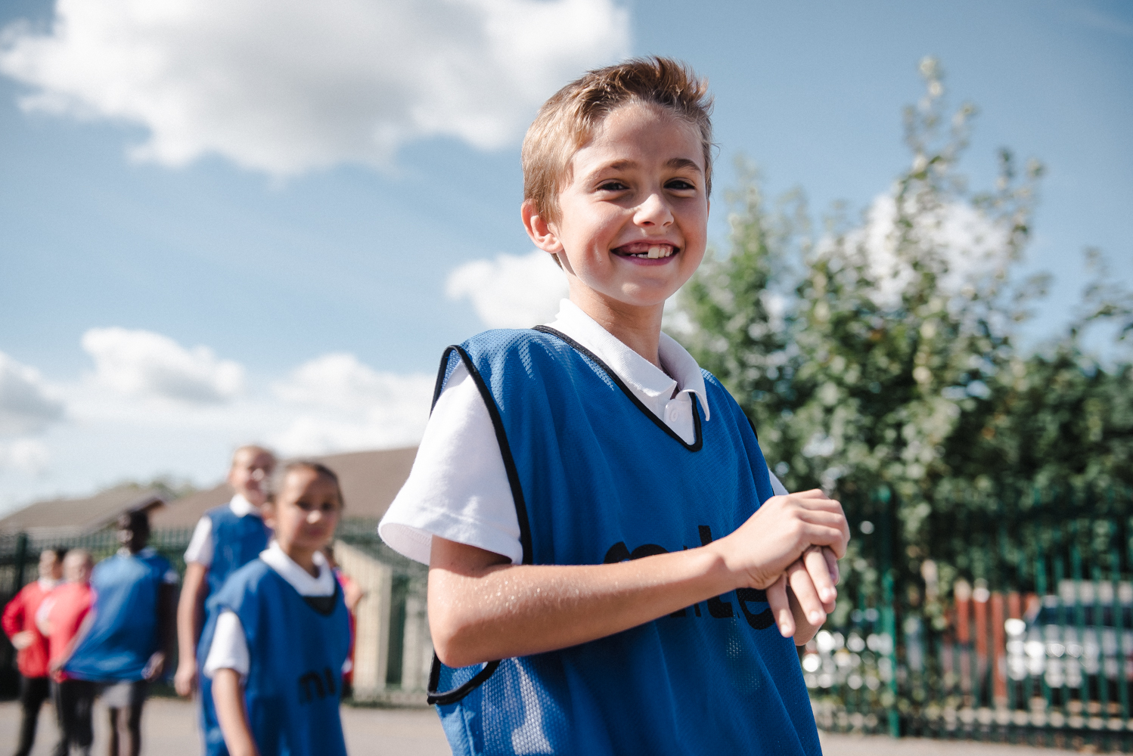
Making sure our playground is a positive place to play.

