Slide 1
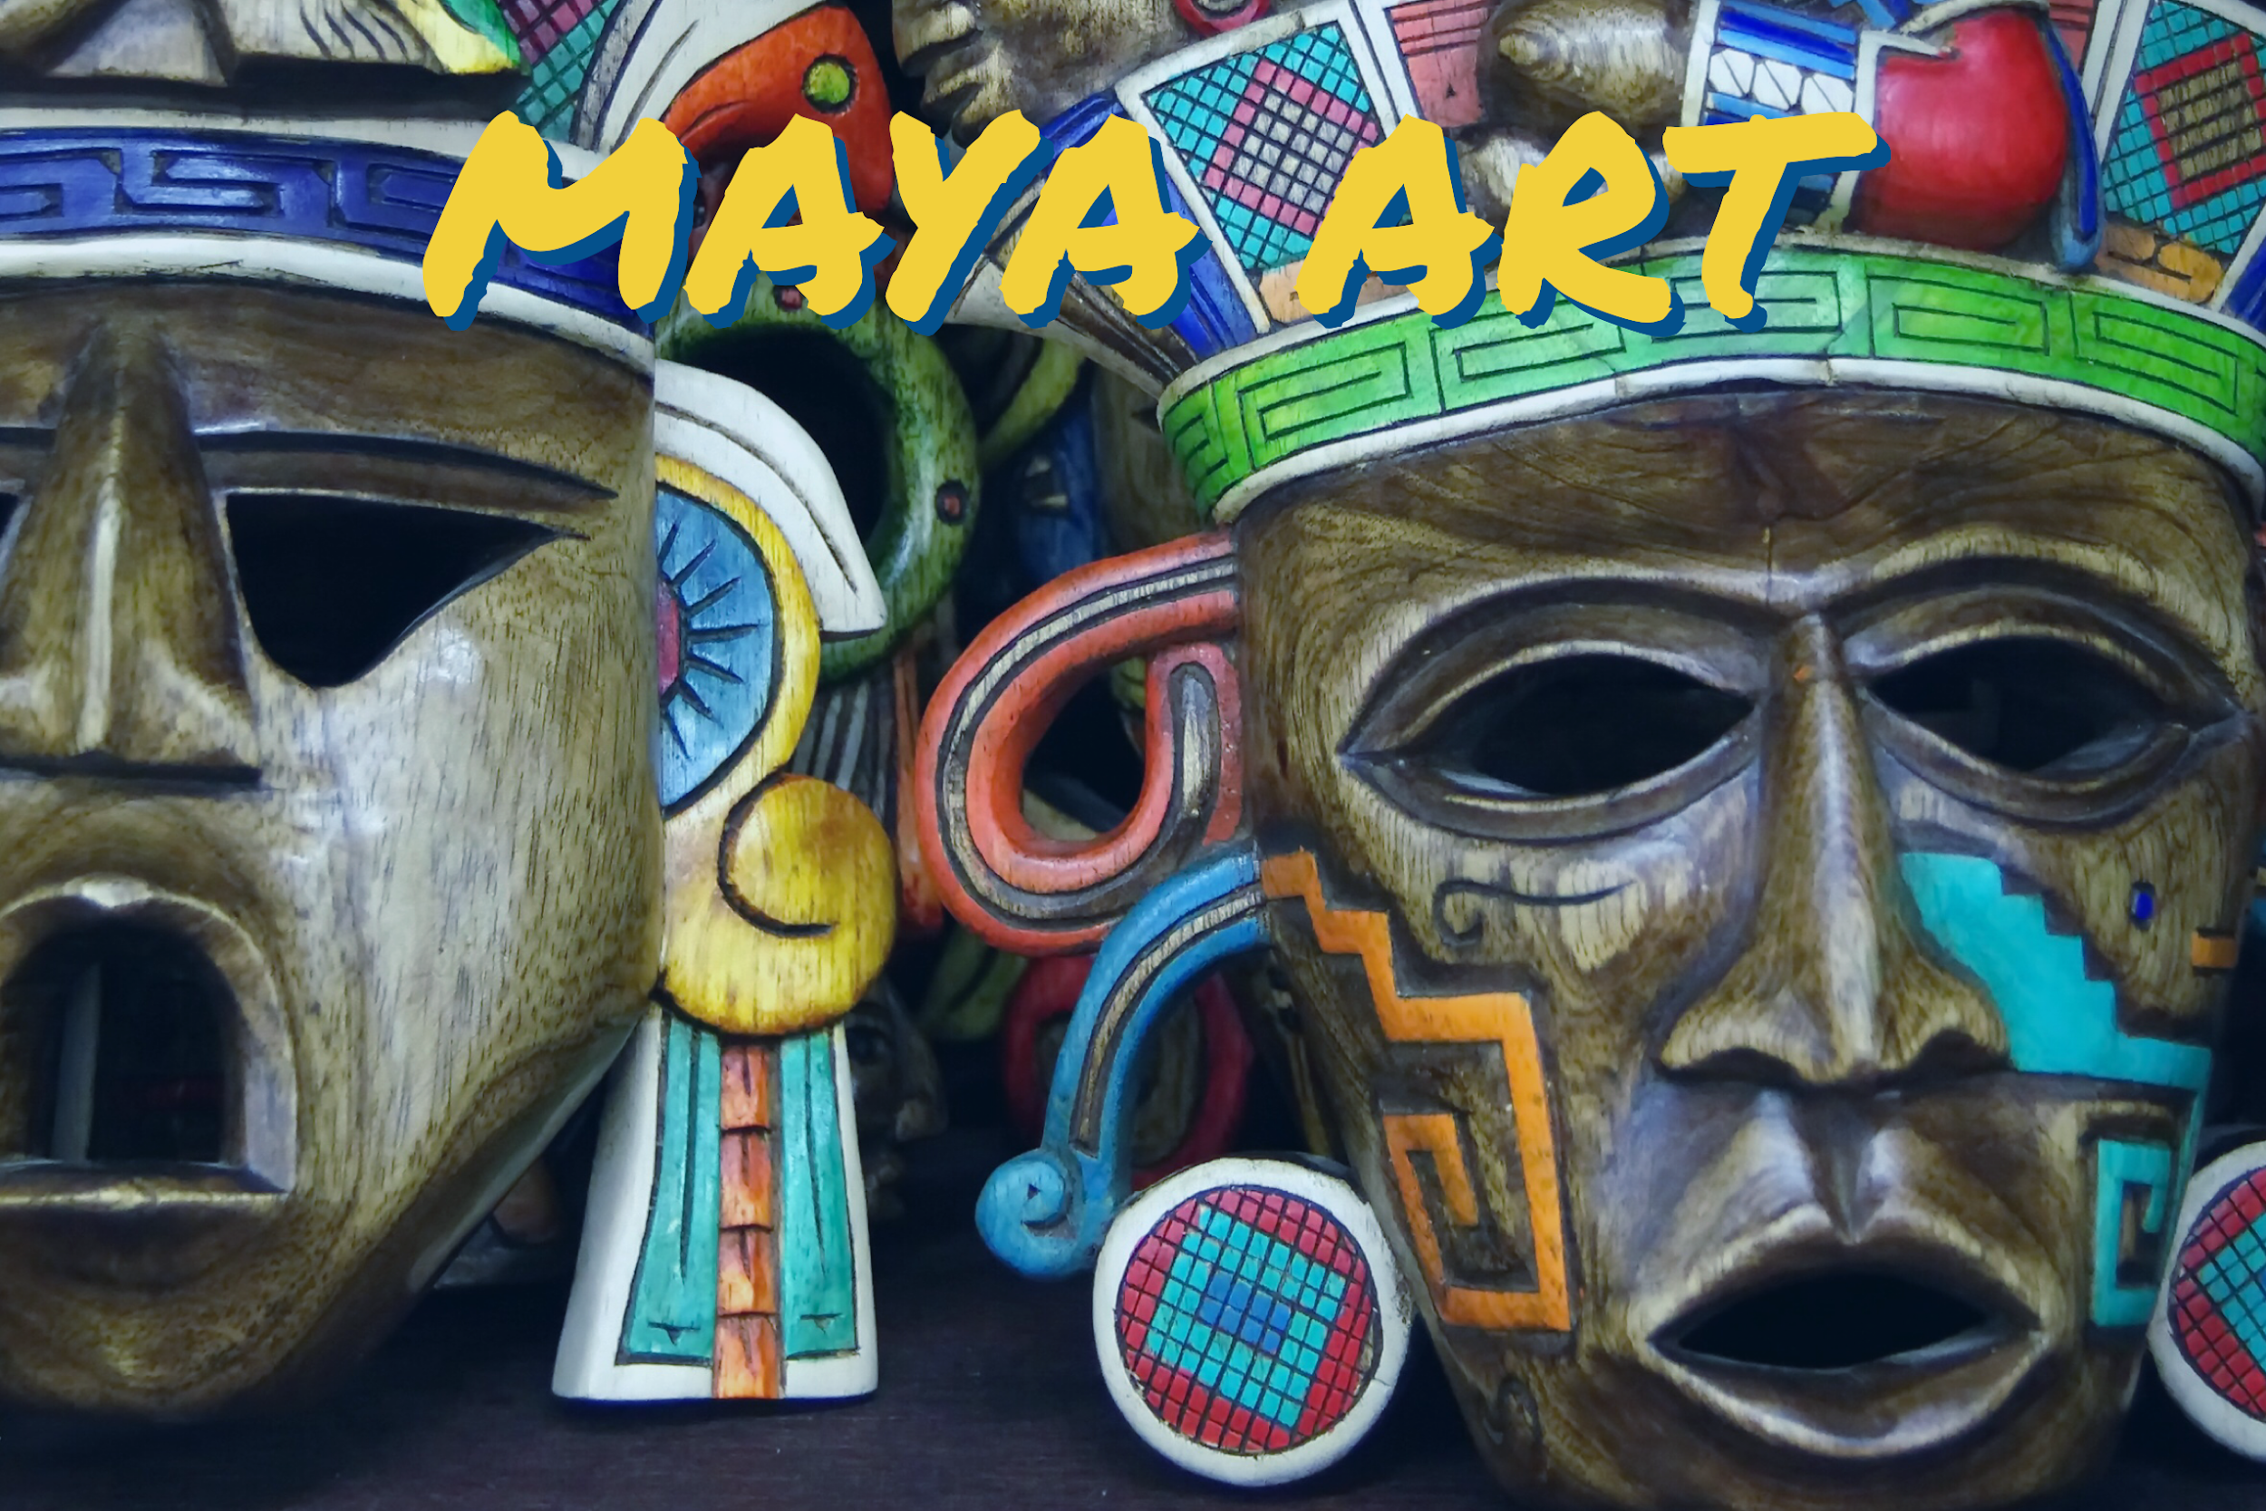

Slide 2
Your task today is mainly about being able to proportion your sketch correctly (making sure that all parts are drawn at the appropriate size, angle and shape).
The accompanying sheet for this session has a step-by-step guide to how to draw a Maya-style mask.
You can follow this guide or use it as inspiration to carefully draw your own.

Slide 3
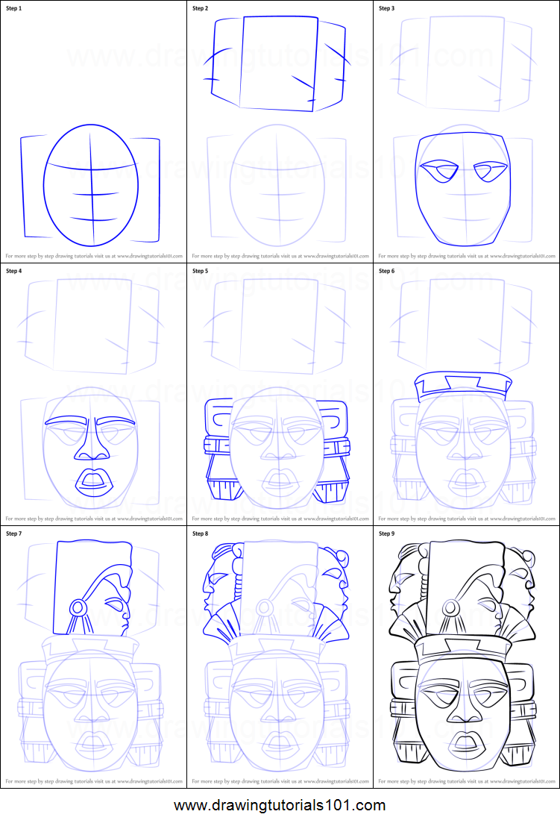
This is on a separate sheet, saved within the class web page.

Slide 4
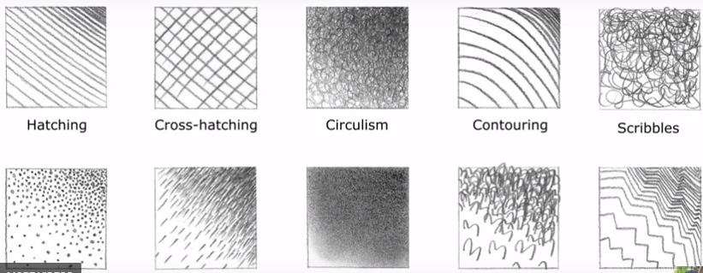
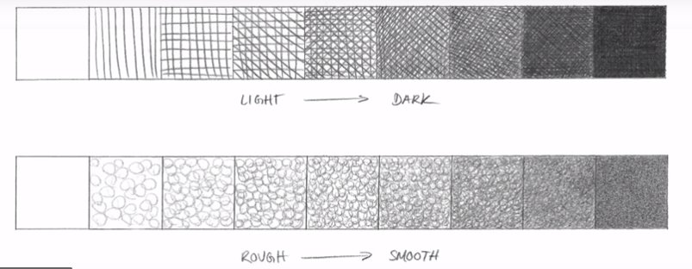
Once your sketch outline is complete, these are some shading techniques that you could use to create depth and texture
stippling
Short dashes
Blending
3s
Zig-zags

