Slide 1
Friday 22nd January 2021 LO: to write high-calibre descriptions
In today’s session, we will be looking to improve our descriptive writing by carefully considering our word choices and focus of our sentences.

Slide 2
The frequent error that people can make when writing in a descriptive way is that they tell you what is happening/ has happened.
This works to inform the reader but doesn’t enable them to picture and image themselves in the scene that you are explaining.
E.g. Tim went to a wood. It was warm and sunny. He enjoyed it.
Too simple and boring with little description.

Slide 3
The mind-set/ tactic that is better when writing descriptions is to think of it as ‘showing’ your reader.
This enables the reader to really picture what the scene is like and captivates them better.
E.g. With a beaming smile and a joyful skip, Sam entered the luscious, enchanting wood. Between these docile giants’ stretching arms, the warm, sunlight danced between the leaves.
Word choices to show how Sam feels.
Expanded noun phrase.
Personification to state how the light was seen and felt.
Personification to describe the look of the trees.

Slide 4
Today’s task
You are going to get some images which are accompanied by very basic sentences for each.
For each picture, you need to write a new, far better, descriptive sentence that ‘shows’ the reader not ‘tells’ them about the description.

Slide 5
Each sentence that you write should aim to have most of these features:
Success criteria
High calibre verbs
High calibre adverbs
High calibre adjectives
Fronted adverbials
Subordinate clauses
Relative clauses
Parenthesis ( ) - - , ,
Semi-colon/ colon
Correctly punctuated direct speech

Slide 6
e.g.
Grace was tired. She yawned.
Slumped on her books, cradling them like a pillow, Grace’s eyes were shut tight, preventing the invading light from entering. Wearily, Grace let out a yawn as she slowly drifted off to sleep.
Tips for this style of approach to description:
- Think what is being done.
- Think of how/ the manner in which it’s done.

Slide 7
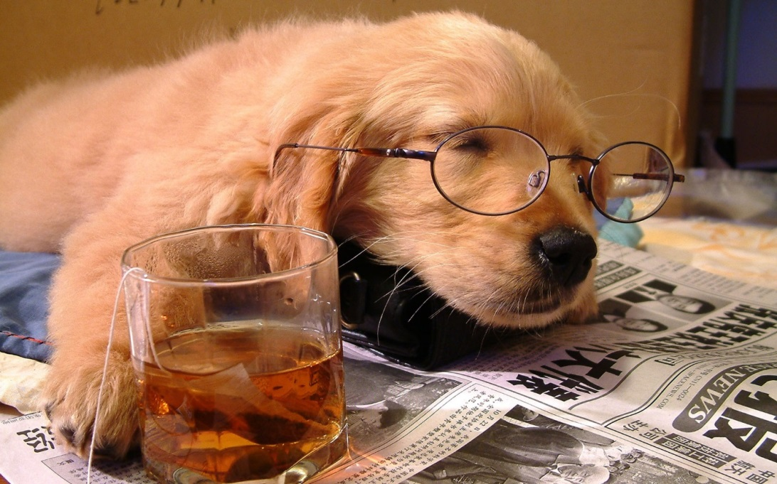
Mylo was tired.

Slide 8
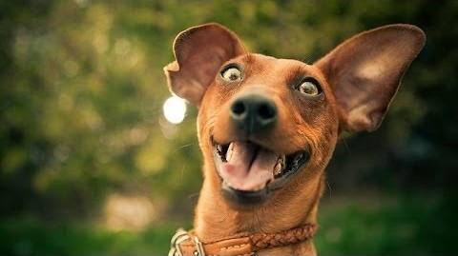
Jess was excited. She was having chicken for tea.

Slide 9
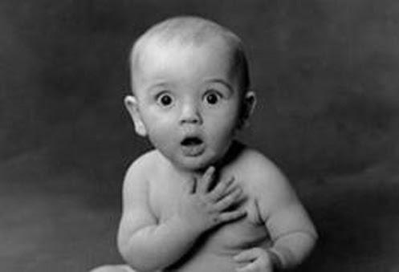
Brian was shocked. He had been elected as Prime Minister.

Slide 10
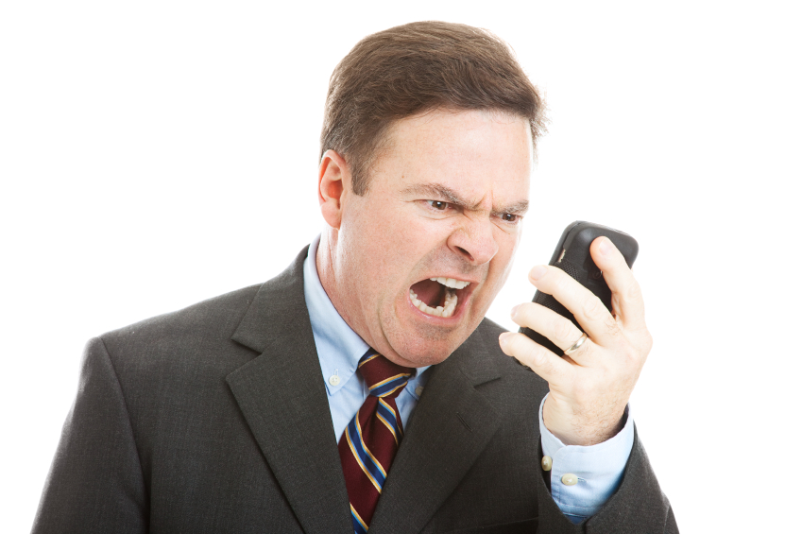
Jeff was angry.

Slide 11
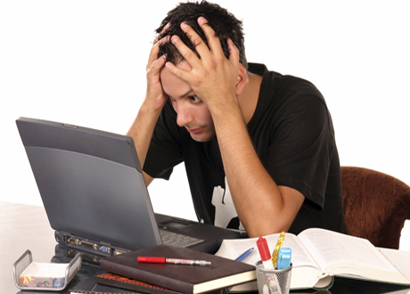
Rob was stressed.

