Slide 1



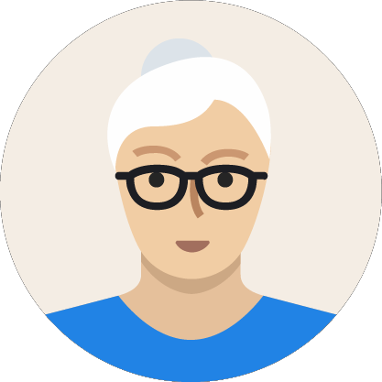

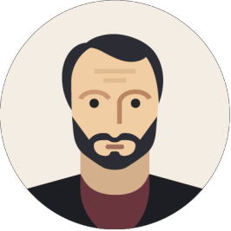



Parents Evening Presentation
BULLYING
In associationwith

Slide 2
Agenda
1
4
Our schools approach & how you can help
What is bullying?
2
How common is bullying?
5
Final thoughts
3
Spotting the signs

Slide 3


What is bullying?
Repetitive
Intentional
Power imbalance

Slide 4




Bullying is…
The repetitive, intentional hurting of one person or group by another person or group, where the relationship involves an imbalance of power. Bullying can be physical, verbal or psychological
Sexist or sexual bullying
Race, religion or culture
Young carers, children in care or home circumstance
Different types of bullying
Special education needs or disability
Sexual
orientation
It can happen face-to-face or online
Appearance or health conditions

Slide 5





Bullying can be ...
Physical
Pushing, poking, kicking, hitting, biting, pinching etc.
Verbal
Name calling, sarcasm, spreading rumours, threats, teasing, belittling
Emotional
Isolating others, tormenting, hiding books, threatening gestures, ridicule, humiliation, intimidating, excluding, manipulation and coercion

Slide 6


Bullying can be ...
Sexual
Unwanted physical contact, inappropriate touching, abusive comments, homophobic abuse, exposure to inappropriate films etc.
Online /cyber Posting on social media, sharing photos, sending
nasty text messages, social
exclusion
Indirect
Can include the exploitation of individuals

Slide 7



30%
30% of 6-15 year olds have been bullied in the past year

Slide 8
TRUE
Based on many different reports bullying levels within the previous academic year tend to fall between 25 – 30%

Slide 9
Children are five times more likely to be bullied online than at school

Slide 10
FALSE
Children are five times more likely to be bullied at school than at online

Slide 11






16,000 11-15 year olds are absent from school at any one time due to bullying

Slide 12
TRUE
Research from Red Balloon Learning Centre and National Centre for Social Research showed this to be the case

Slide 13

A whole school approach is important
Immediate Media survey of 6-15 year olds showed that…
87%
56%
48%
of bullied children faced bullying in school
were unsure of
how to get help if they or someone they know experiences bullying
admitted feeling nervous telling someone about bullying

Slide 14




Spotting the signs
1 in 10
parents are aware their child has been bullied
Change in behaviour
Avoiding talking

Slide 15
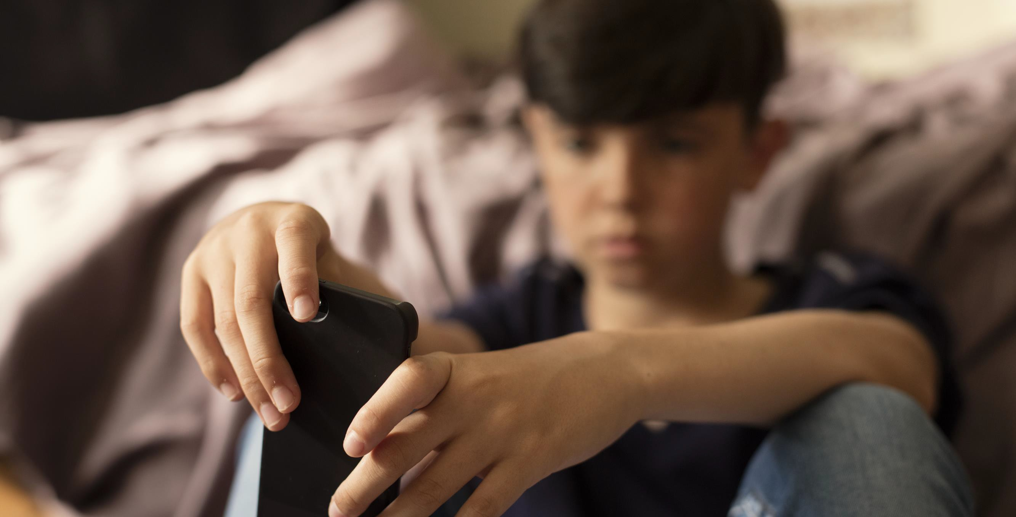





Is this bullying?
Dean’s parents have split up.
Mark tells someone on social media and it then spreads around the whole school.
Consider
Repetitive
Intentional
Hurtful
Imbalance of power
Can be physical, verbal or psychological.
Can happen face-to-face or online
Not bullying
Need more information
Bullying

Slide 16

Is this bullying?
Each time Ramon walks into a class a group of pupils giggle and whisper to each other.
Consider
Repetitive
Intentional
Hurtful
Imbalance of power
Can be physical, verbal or psychological.
Can happen face-to-face or online
Not bullying
Need more information
Bullying

Slide 17




Is this bullying?
Tania and Susan won’t let Rachel play with them.
Consider
Repetitive
Intentional
Hurtful
Not bullying
Need more information
Imbalance of power
Can be physical, verbal or psychological.
Can happen face-to-face or online
Bullying

Slide 18



Our schools approach to bullying
https://whittingham.eschools.co.uk/website/policies/221929
Our Anti Bullying Policy is updated annually and can be found on the school website - Important Information - Policies section. Paper copies are available upon request.
Please do contact your child’s class teacher if you have any concerns or queries.

Slide 19








How can you help?
Talking is the best way to help
Remember this is an emotionally-charged problem
Encourage them not to treat bullying as a secret - they can use you as release for their emotions; importantly keep the dialogue open
Praise them for being brave enough to share with you
Think very carefully about approaching other parents
Stay calm, patient, and ask
how you can help
Believe them, refrain from judging or belittling and acknowledge their feelings

Slide 20









Always report bullying to the school
Face to face
Call us
Email/Letter

Slide 21
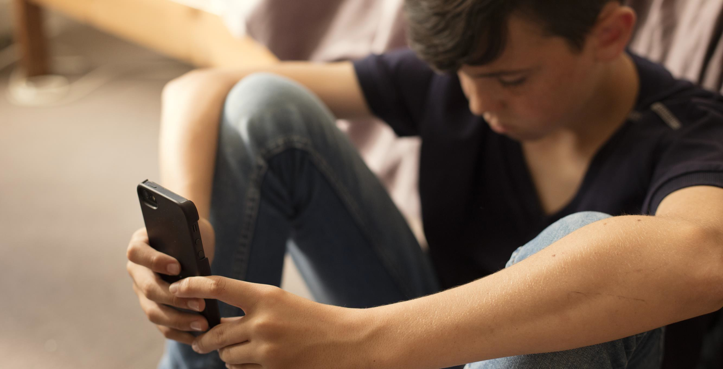
FINAL THOUGHTS

Slide 22


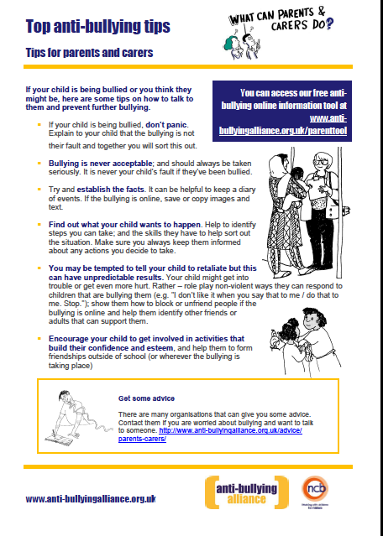


Slide 23









More resources to explore

Slide 24

Any questions?
In associationwith

Slide 25
Thank you

