Slide 1
Bhangra Music

Slide 2
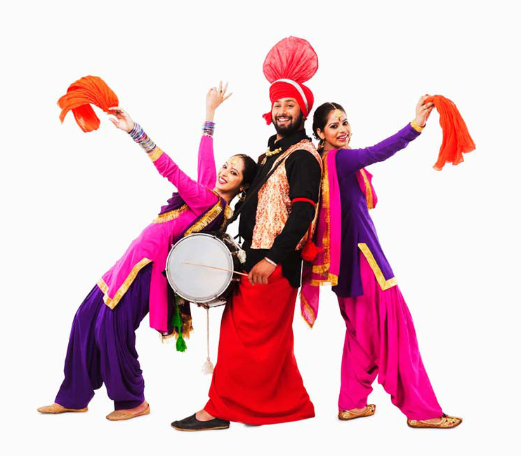
Previous Learning
Can you answer these questions?
What is music?
What is music for?
Where do you hear music?

Slide 3
LO: to identify musical styles and their features.
Context: Bhangra
In this session, we will study bhangra music.
We will look at:
the history of bhangra music,
the features of bhangra music,
listen to and appraise examples of bhangra music.

Slide 4
Vocabulary
Bhangra
Dynamics
Fast Tempo
Rhythm
Pulse/ beat
Melisma
Horn section
(trumpet, trombone and saxophone)
Punjabi
Dance

Slide 5
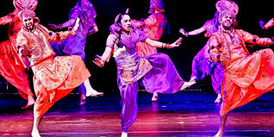
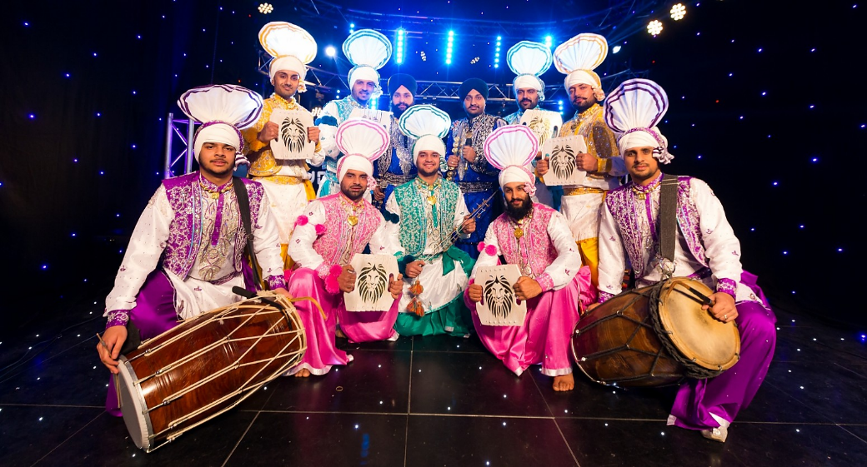
Bhangra – where did it all begin?
Bhangra music originated in Great Britain in the 1960s.
It was created from traditional Punjabi folk music and was to dance to.
It helped give young Punjabi men and women their own identity and their own music to follow.
In the 1980s, it often sold more than mainstream artists!

Slide 6
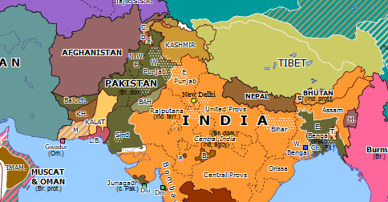
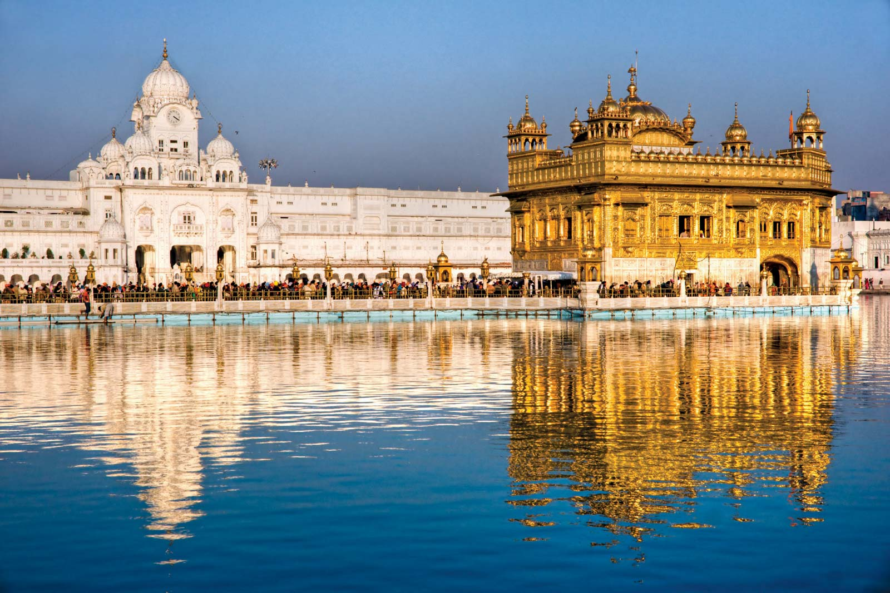
Where is Bhangra music from or found?
Punjab
An area of northern India and also northern Pakistan. It doesn’t really have any borders and varies in size depending upon the history of the area. People from the Punjab are called Punjabi, and their language is also Punjabi.

Slide 7
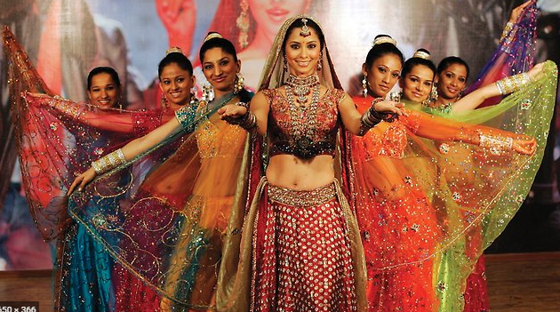
Bollywood:
Bollywood is the nickname given to the Indian film industry - it is a pun, based on “Hollywood”. Bollywood got its name from the capital city where much of it is filmed - Bombay (now called Mumbai). Bhangra music is used extensively in Bollywood films, yet was traditionally written and recorded in the UK and sold back to India.

Slide 8
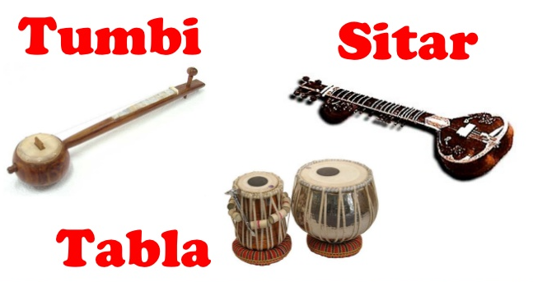
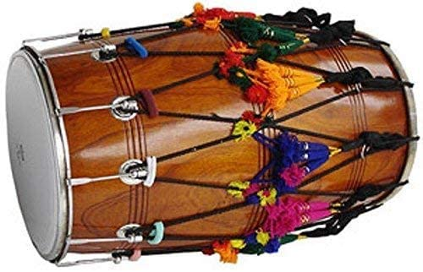
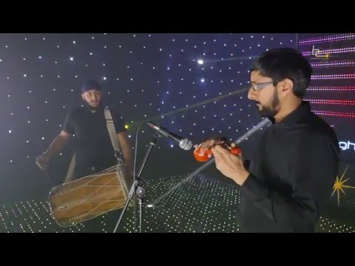
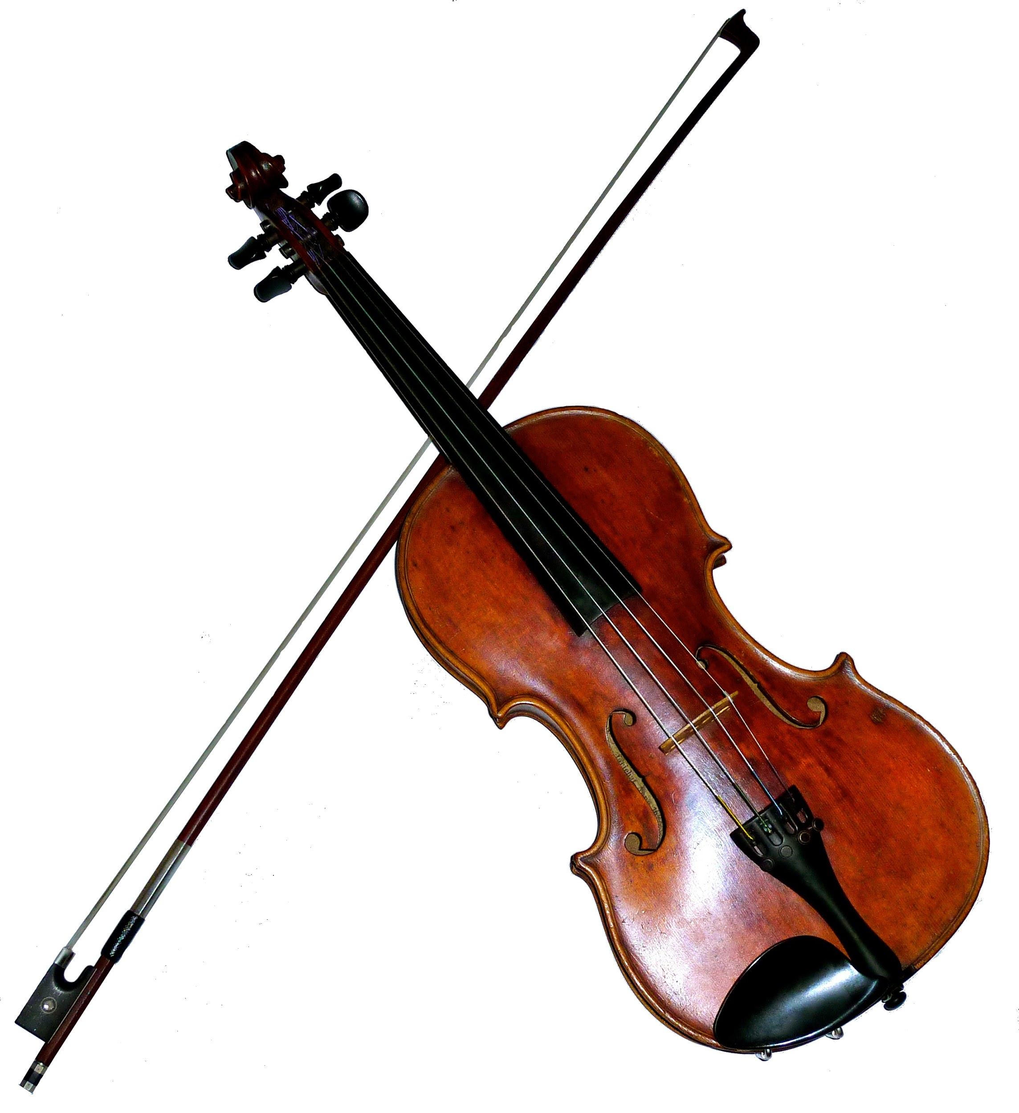
Instruments
Dhol drum - keeps the na dha rhythm.
Electric guitar - tends to be used in more modern bhangra music.
Tumbi and Sitar are stringed, like guitars. The tumbi has only one string; a sitar has between 18 and 21 strings!
Tabla are drums.
Violins are often used on bhangra music.
Watch this video of the Tumbi and Dhol - the two main instruments.

Slide 9
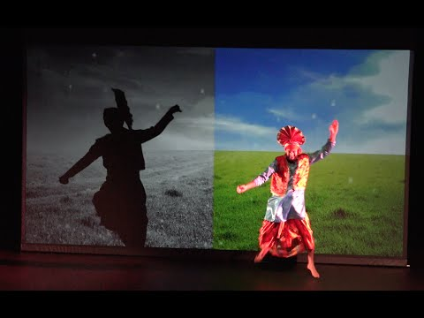
How has bhangra music has evolved over time?
Watch this video and notice the similarities and differences between traditional bhangra music and modern bhangra music (even the dancing too).
You may want to write a comparisons list – like the one below - in your book/ on your paper.
Traditional
Modern

Slide 10
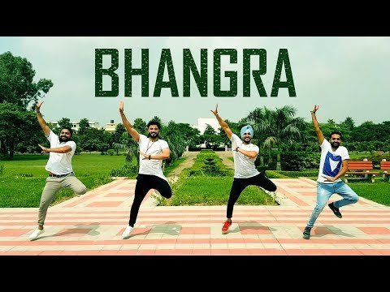
Bhangra beats and instruments can also be used for “remixes” of modern songs…
Do you like this? Why/ why not?
Explain how you feel about it.

Slide 11
Bangrha beats and instruments can also be used for “remixes” of modern songs…
Do you like this?
Explain how you feel about it.

Slide 12
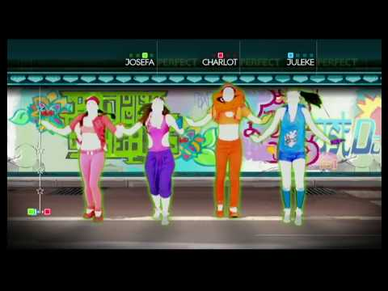
Your tasks
1) Looking back over the previous pages if needed (as well as any of your own research), summarise Bhangra music by creating an information text.
Then…
2) Try this Just Dance video – uploaded photos or videos of you in action would be amazing! (But most of all, have fun – expressing yourself is what music is all about!

