Slide 1
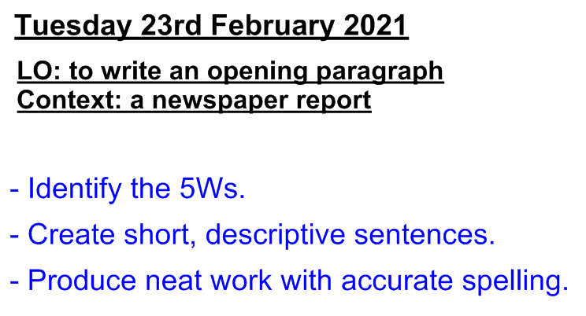

Slide 3
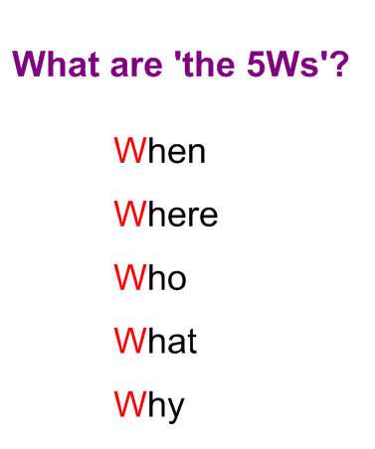

Slide 5
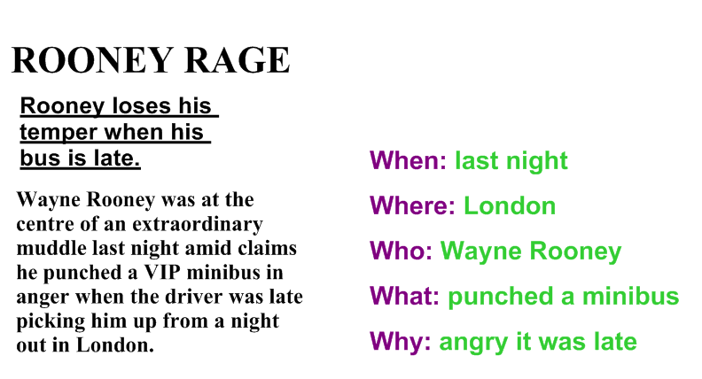

Slide 6
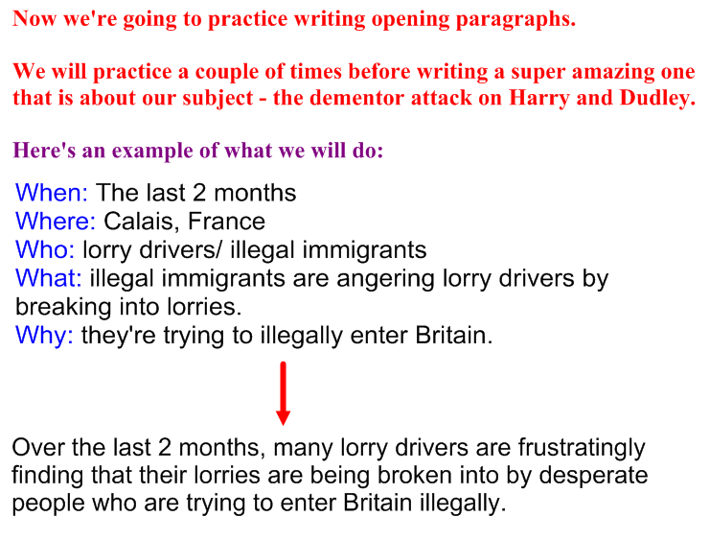

Slide 7
After seeing the example, now practice in your book/ on your paper by writing an opening paragraph of your own, using the 5Ws bullet-pointed below.
When: Friday 19th February 2021
Where: Whittingham C of E Primary School
Who: kitchen staff/ children
What: a supply of fish had been scattered across the car park.
Why: the culprit and motive are still unclear.

Slide 8
We’ve established what to include in an opening paragraph and had a practice at writing one. Now it’s time to write our amazing one for our Harry Potter newspaper report.
The first task is to establish the 5Ws for this event.
In your book/ on your paper, complete the following bullet-points (with some detail) about the 5Ws for the dementor attack.
When:
Where:
Who:
What:
Why:

Slide 9
Now write a suitable headline as well as an opening paragraph, looking to use the features listed below (you can use this same list to check and edit your own work too).

