Slide 2
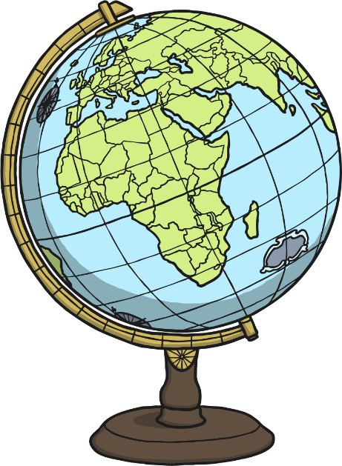
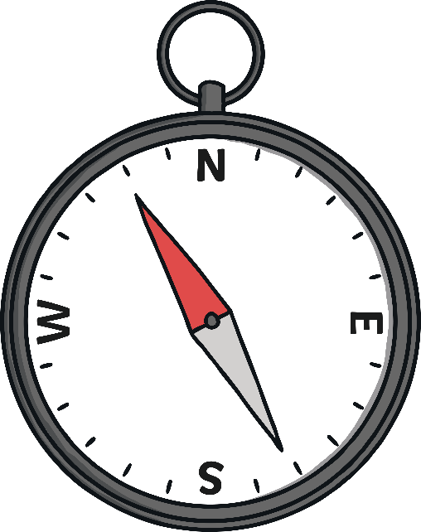
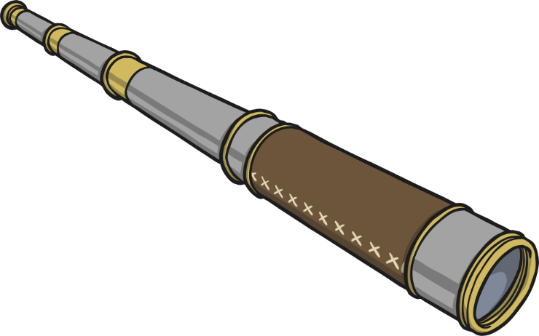
Christopher Columbus
Christopher Columbus was born in Italy.
He began sailing when he was a teenager.
He was a navigator and an explorer.

Slide 3
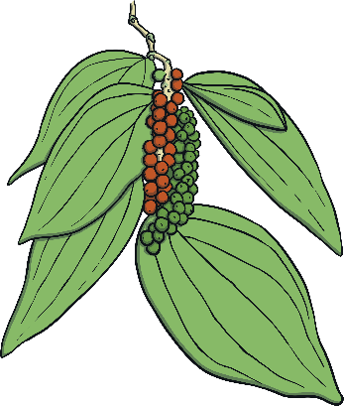
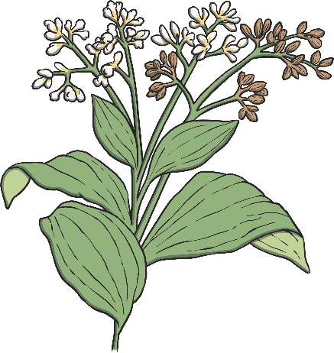
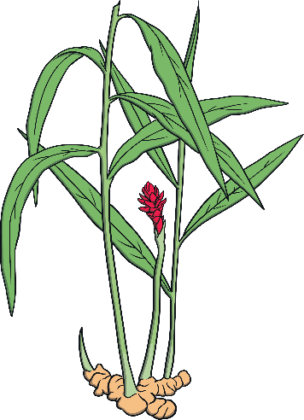
Looking for spices
Christopher Columbus wanted to find a quicker way to get to places
in Asia.
Many explorers wanted to trade for spices such as cinnamon, ginger, and black pepper.
He needed money to help him pay for his trip.
Cinnamon tree branch
Why did explorers
want spices?
They wanted to find spices to help preserve, or keep food fresh, and to help it taste better.
Ginger plant
Black pepper plant

Slide 4
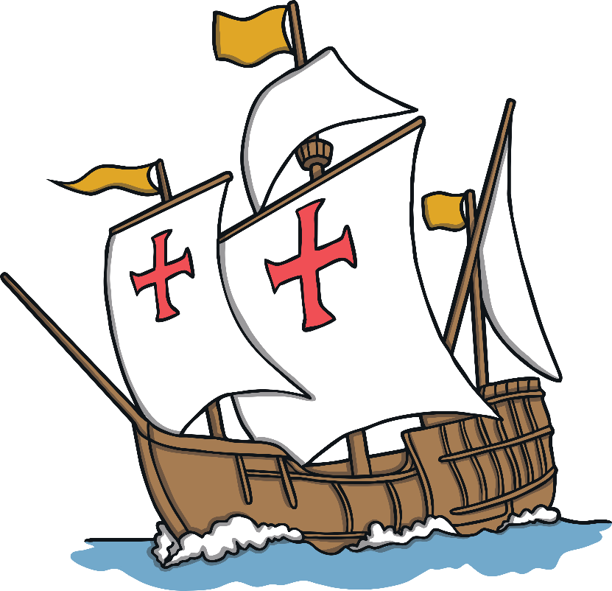
Exploration
The King and Queen of Spain agreed to give him money to buy three
ships for his voyage.
In 1492, Columbus and 90 men sailed on ships that were called the Niña, the Pinta, and the Santa Maria.
They sailed for two months.

Slide 5
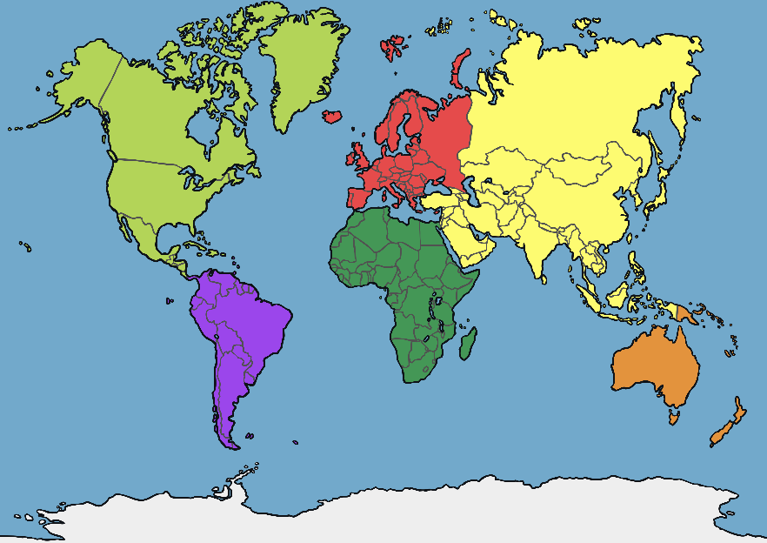
Columbus Made a Mistake
Columbus thought that he was sailing to Asia.
Instead of arriving in Asia, Columbus landed in the area that today we call the Caribbean Islands.
He named the island he landed on San Salvador.

Slide 6
Who Lived There?
People were already living on the island that Columbus and his crew first arrived at in the Caribbean.
Columbus called the people “Indians” because he thought he had found
an area of Asia called the Indies.
People who are from a certain area or place are called Native or Indigenous.

Slide 7
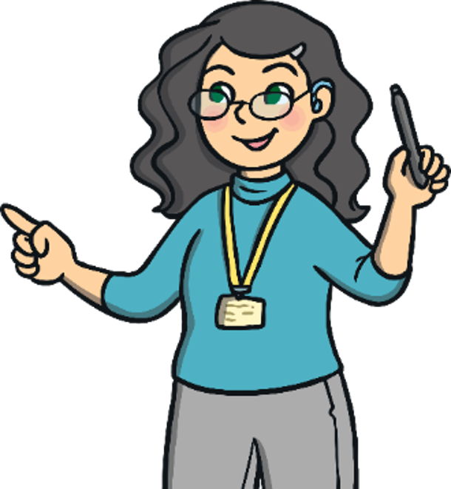
Let’s talk about it…
Some people incorrectly say that Christopher Columbus was the first
person to find, or discover, America, even though he landed in the
Caribbean islands.
Why is it important for us to understand that he did NOT
discover America?

Slide 8
The Indigenous Peoples
The Indigenous peoples were friendly and were willing to trade items
such as parrots, cotton, and spears with the explorer.
They did not like that Columbus wanted to claim their land for Spain.
Columbus took some of them as prisoners.
Christopher Columbus took these prisoners back to Spain with him to
become slaves.
What is a slave? A slave is someone who is forced to be under "ownership" of someone else.

Slide 9
Let’s talk about it…
Why was it wrong of Christopher Columbus to take the
Indigenous peoples as slaves?
Why is slavery wrong?

Slide 10
What Happened After 1492?
Columbus made three more voyages to what was then called the
“New World.”
He continued to look for gold, riches, and spices.
He continued to search for a shorter route, or path, to Asia.
He never found one.

Slide 11
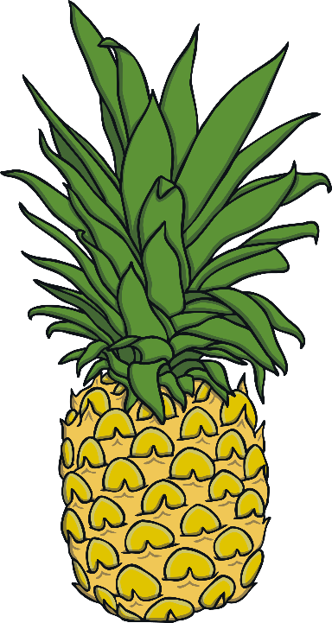
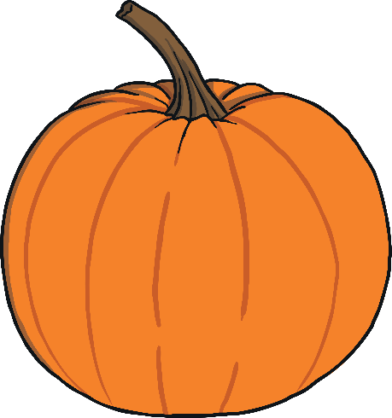
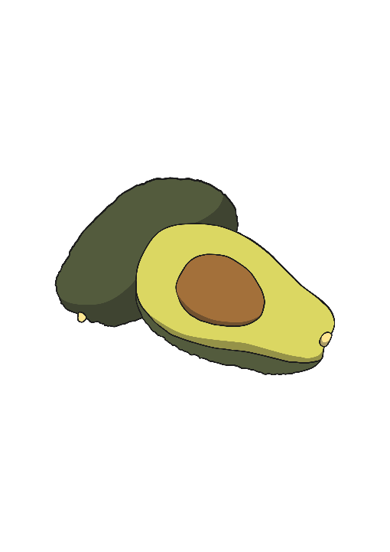
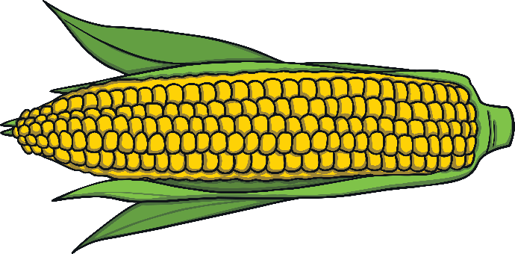
Christopher Columbus
Columbus is considered a famous explorer because his voyage
helped begin a time of great exploration around the world.
He returned to Spain with new foods from the islands like avocados,
pineapples, pumpkins, and corn. Corn kernels were planted in Europe
and became a very important crop there.

Slide 12
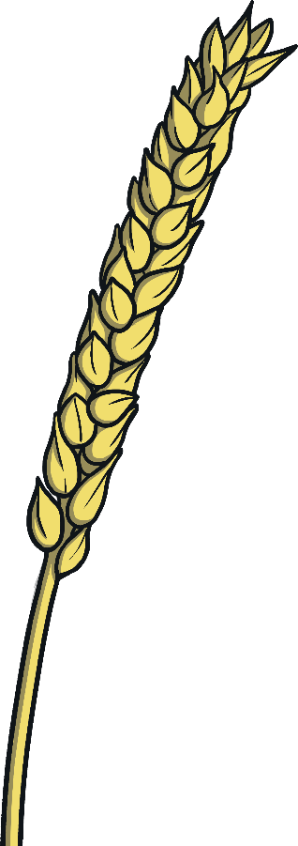
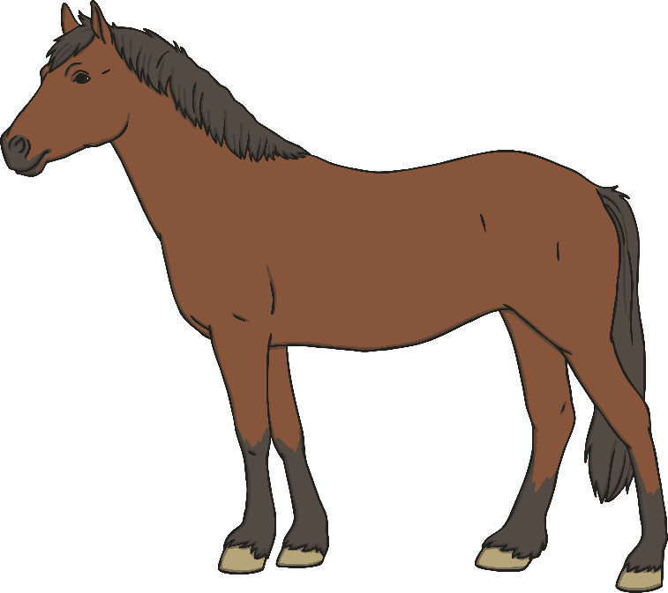
More About Columbus...
Columbus introduced horses, sugar, and wheat to the Indigenous
peoples he met on his travels.
Unfortunately, he also brought new types of disease, or sickness, to the
places he explored. Illnesses like smallpox, measles, and influenza did
not exist in this area before Columbus arrived.

Slide 13
Let’s talk about it…
Can you think of the helpful things that happened because of the
voyages of Christopher Columbus?
Can you think of the harmful things that happened because of
the voyages?

