Slide 1
Wednesday 20th January 2021
LO: to plan & write a story
In today’s session, you will be finishing off planning out an adventure story. This story will need to be descriptive and captivating to hold your reader’s attention.

Slide 2
What do I put in my plan?
Eventually we are going to write 3 paragraphs:
Paragraph 1: approaching the Maya pyramid.
Paragraph 2: entering and moving through the pyramid/ temple (to the point of finding the treasure and the pyramid starting to collapse).
Paragraph 3: trying to and eventually escaping from the pyramid/ temple.

Slide 3
Here’s a WAGOLL (what a good one looks like)
As he approached the ancient Maya pyramid, Guy Dangerous felt a sudden injection of adrenaline surge through his body. The majestic, grey architecture towered above like a powerful yet motionless giant. Before he departed on his expedition, some people said the pyramids were haunted; others believed they were cursed. Trying to forget this distraction, Guy cautiously approached the mammoth structure. It was said that no-one had touched these pyramids in centuries, let alone been inside them. It was gargantuan: the peak of these temples touched the sky itself. The only sounds were of the warm, gentle breeze through the trees and of the birds that were darting and swooping through the branches. Carefully, he caressed the coarse, rough stone. A shiver of apprehension spilled down his spine. Would he find the lost treasure of the Maya? With a final look over his shoulder, Guy tiptoed over the threshold and ventured inside the temple.
Darkness enveloped him as he strode beyond the entrance. Grabbing a torch and lighting it, Guy peered into the pitch-black void. He had heard tales of the treacherous traps in these pyramids: scissor-sharp spears, bone-crushing boulders, cruel curses – which would he encounter first? In the distance, he could see a small, stone doorway, ornately decorated with Kings and Gods. Could this be the entrance to the vault? Ducking and stooping, Guy squeezed himself into the ancient chamber. Then he saw it. Atop a small plinth, which was covered in sacred hieroglyphs, nestled the mystical relic. Taking it in both hands, he smirked with relief. Urgently, he spun around and was greeted with… silence.
Then suddenly, a roar – earth shaking, ominous and violent - erupted like a dormant volcano awakening from its slumber: the temple was collapsing. The race to escape was on!
Bolting like a race horse, Guy sprinted to get out of the crumbling pyramid. Colossal slabs of stone were falling all around him as if the walls were intent on trapping inside their limestone prison. Desperate and anxious, frightened yet focussed, Guy scanned the now dust-filled room for an escape route. This treasure - golden, shimmering and bejewelled - belonged in the temple, however Guy had been promised a great reward for its safe delivery. In an instant, scorching plumes of fire erupted from the ground like a dragon's breath. With the terrifying possibility of death, Guy vaulted over the burning cracks beneath him. Would Guy become the latest sacrifice to the Gods? Suddenly, out of nowhere, he spotted a gap in the rocks; a crack in which he could slip through. Where did it go? Guy had to go for it: he had no other option. As fast as his weary legs would carry him, he rocketed towards the gap.
"Here goes," he sighed, and leapt into the abyss…

Slide 4
Things to consider
In all your paragraphs, they need to be descriptive. As such, you should look to include the following aspects:
- High-calibre adjectives, adverbs and verbs
- Expanded noun phrases
- Fronted adverbials
- Subordinate clauses
- Emotive language (words that convey emotions)
- Reference to the 5 senses (sight, sound, smell, touch & taste)
- Similes
- Metaphors
- Personification

Slide 5
How do I start to plan?
Step 1: words & phrases (the 5 senses)
For each paragraph, create a spider-diagram of words and phrases that you might use for each paragraph.
This time, I want you to think about each of the 5 senses so that it forces you to consider and describe what is around your character (this enables your reader to picture the scene and actions that you describe much better).

Slide 6
Sentence structures
Now that we have a bank of words and phrases for each paragraph, we can then start practicing different sentence structures.
For this, I want you to use the acronym ISPACE.
This is a good way of remembering of varying your sentence openers (something that many of us still need to work on/ expand further.)

Slide 7
ISPACE (varying your sentence openers)
Under your spider-diagrams, practice writing sentences about any point in the plot, using ISPACE. (You could write 2 or 3 sentences for each part of ISPACE.)
I = -ing word to open a sentence (Dashing, sliding, breathing…)
S = simile/ metaphor/ personification.
P = preposition (e.g. Across the chamber, ____)
A = adverb (e.g. Anxiously, __________)
C = conjunction (if, because, although, despite…)
E = -ed word to open a sentence (Exhausted, exhilerated…)
e.g. Venturing deeper into the temple’s vaults, the light faded away into an inky-black fog.

Slide 8
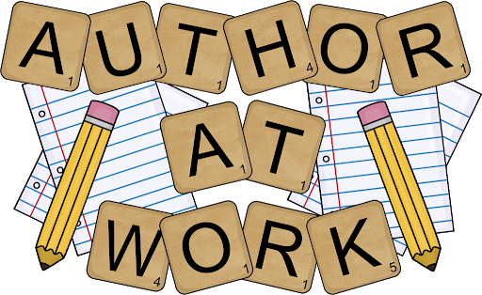
Use everything from the previous pages and your work to now create your adventure short story.

