Slide 2
Firstly, let's read the chapter which is of the dementor attack on Harry Potter and his muggle (non-magical) cousin, Dudley from the book Harry Potter and the Order of the Phoenix - this is what our newspaper article is based on.
(See the accompanying sheet within our class web page.)

Slide 4
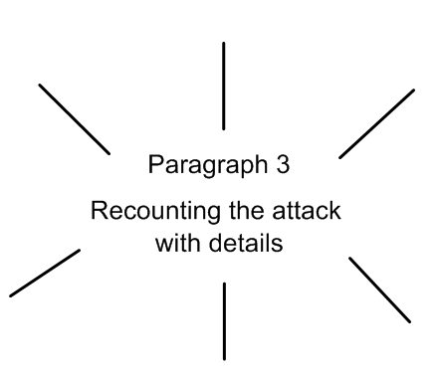

Slide 6
