Slide 1


History
Significant Explorers
Year One
History | Significant Explorers | Matthew Henson | Lesson 3

Slide 3


Meet Quizby!
I will appear like this, click me to reveal a key question.
Can you spot me in the
Lesson Presentation?
Hi, I’m Quizby!
The questions that appear will help
you to think about the key learning throughout the lesson.

Slide 4
Aim
To explore the achievements of Matthew Henson.
Success Criteria
I can explain why Matthew Henson was a significant explorer.
I can describe the key events in Matthew Henson’s life.
I can discuss how Matthew Henson’s achievements have been recognised in different ways as time has passed.

Slide 5







Who Was Matthew Henson?
Matthew Henson was an explorer.
He is famous for exploring the Arctic.
Many people around the world have heard of Matthew Henson but he is not as well known as some other famous explorers.
There is some disagreement among historians as to who reached the North Pole first but many believe that it was Matthew Henson along with Robert Peary and four Inuits: Ooqueah, Ootah, Egingwah and Seegloo.

Slide 6
Who Was Matthew Henson?
This is when Matthew Henson lived.
1300
1400
1500
1600
1700
1800
1900
2000
2100
Queen Victoria
Ibn Battuta 1304-1368/9 or 1377
The Gunpowder Plot
First World War
The Great Fire of London
Matthew Henson 1866-1955
SpaceX becomes the first private company to send humans into space

Slide 7
Who Was Matthew Henson?
Matthew Henson was born in 1866 in Maryland, United States of America.
Both of Matthew’s parents died when he was a young boy.
When he was about 12 years old, Matthew got himself a job aboard a ship as a servant for the captain and the other members of the crew.
Captain Childs taught the young Matthew many skills. He taught him to plan voyages as well as how to read and write.
When Captain Childs died, Matthew Henson left the ship and found a job in a shop that sold clothing and hats, including fur clothing.

Slide 8
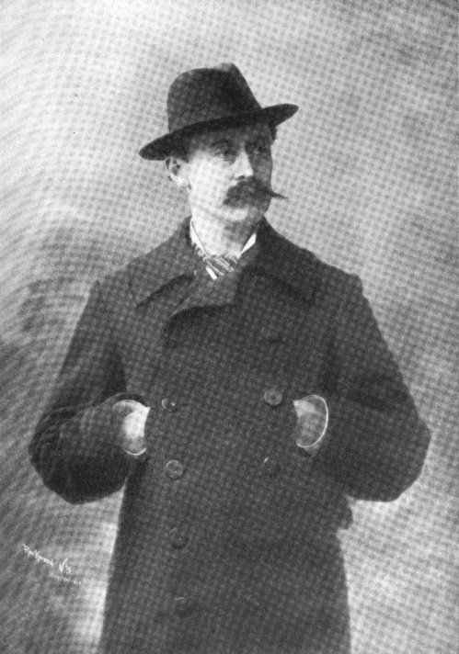
Who Was Matthew Henson?
One day, a man came into the clothing shop.
This man was Robert Peary and he was an explorer.
He told Matthew all about his adventures and Matthew told him about his own travels.
Robert was so impressed with all the things that Matthew Henson knew about exploring and the world that he gave him a job straight away.
“Photo of Robert Peary” by [Julian Felsenburgh] is licensed under CC BY 3.0
This is Robert Peary. Before he met Matthew Henson, he had already been exploring in Greenland (which is in the Arctic).

Slide 9
Who Was Matthew Henson?
Treating people differently because of the colour of their skin or because they or their family members come from a different country or area is called racism.
Racism is now against the law but it wasn’t when Matthew Henson was alive. Unfortunately, racism is still something that affects the lives of people today.
Matthew Henson lived in a time in America when Black people did not have the same rights and opportunities as some White people.
Matthew’s great achievements are even more impressive because of what he had to overcome to find jobs and to become a respected explorer.

Slide 10
The North Pole
Matthew joined Robert Peary on his next exploration. They were to go on many expeditions together.
Robert was determined to be the first person to lead an expedition to the North Pole.
The North Pole is the northernmost point of the Earth and is part of the Arctic polar region.
The South Pole is the southernmost point of the Earth and is part of the Antarctic polar region.

Slide 11
The North Pole
Other explorers living around this time were also preparing and trying to be the first to travel to the South Pole.
Robert Peary wanted to be the first to arrive at the North Pole for the sense of achievement, to become famous and to make money.

Slide 12
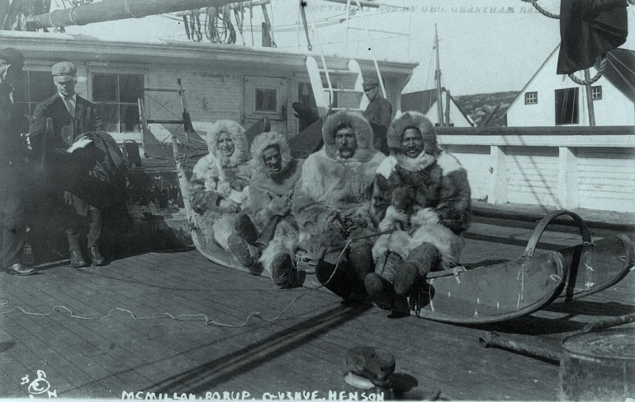
The North Pole
It was very difficult travelling across Greenland to the North Pole.
Robert Peary, Matthew Henson and the rest of the team travelled on sledges pulled by dogs.
Temperatures were lower than the temperature inside a freezer.
On one of their attempts to get to the North Pole, eight of Robert Peary’s toes snapped off due to the extreme cold.
Matthew Henson (far right) is shown here with some team members on one of their many attempts to reach the North Pole.
“Men and sled that went on Peary's North Pole Expedition, 1905-1906 (LC-DIG-GGBAIN-68223) (21635170314)” by [Hiàn] is licensed under CC BY 3.0

Slide 13
The North Pole
Matthew Henson had many skills that meant he was great to have around on the journeys to the North Pole.
What sort of skills do you think would be useful when exploring in the Arctic?
Tell your partner some of your ideas.

Slide 14
The North Pole
Matthew was a good carpenter.
He built and fixed the sledges that were pulled by dogs through the ice and snow.
He was a good hunter, good at fishing and was also good at handling the dogs.
Matthew learnt skills from the Inuit of Greenland and he spoke their language fluently.
The Inuit, who lived near to the North Pole, liked Matthew and they trusted him.
In the Inuit languages, Inuit means ‘the people’ so this is why we just say the word Inuit when talking about this group of people. If we said ‘Inuit people’, we would be saying ‘people people’ and that is saying the same thing twice!

Slide 15
The North Pole
It took several attempts but it is thought that in April 1909, Matthew Henson, Robert Peary, Ooqueah, Ootah, Egingwah and Seegloo arrived at what they believed to be the North Pole.
Matthew was at the front of the group and unknowingly went about two miles past the spot they believed to be the North Pole. When they walked back to the point of the North Pole, he later wrote that he noticed, “my footprints were the first at the spot.”

Slide 16
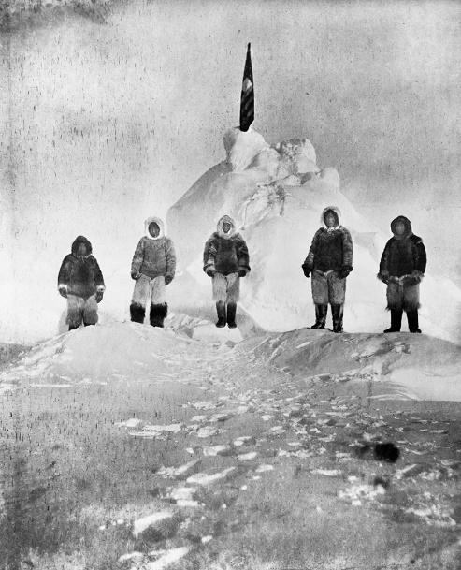
The North Pole
Matthew Henson is photographed at the North Pole with Ooqeah, Ootah, Eginigwah and Seegloo. Matthew Henson is in the middle.
Can you give at least one
reason why Matthew Henson
was a significant explorer?
X
It is believed that Robert Peary took this photograph.
“Matthew Henson and four Inuit guides.jpg” by [DragonflySixtyseven] is licensed under CC BY 3.0

Slide 17
Who Was First?
When Matthew Henson wrote about his journey to the North Pole, he wrote that his friend and boss of many years, Robert, hardly spoke to him on the return journey.
Why do you think that was?
Talk to your partner about this.
Example answer: We can’t be sure but here are some ideas:
Robert was annoyed with Matthew because he was the first person to set foot on the North Pole.
Robert wanted all the glory for himself so didn’t want to talk to Matthew.

Slide 18
Who Was First?
Another explorer called Frederick Cook returned from the Arctic at a similar time and claimed to have reached the North Pole before Robert Peary, Matthew Henson and their team.
However, for many years, it was Robert Peary who was celebrated for being the first person to reach the North Pole.
Some people have questioned whether Matthew and the team actually reached the North Pole at all. These people have said that they may have been a few miles short.

Slide 19
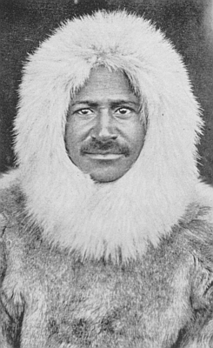
Who Was First?
Matthew Henson was talked about just as Robert’s assistant.
Although Robert was officially the leader of the expedition and had sorted out the money for the trip, Matthew being forgotten like this was not fair.
Matthew’s achievements were overlooked and ignored because most White people at that time did not believe that Black people were as capable of doing such amazing things.
“Matthew Henson return.jpg” by [Robbot] is licensed under CC BY 3.0

Slide 20
Who Was First?
Just as with Matthew’s achievements, the important role the Inuit members played in the expedition was also ignored and forgotten about.

Slide 21
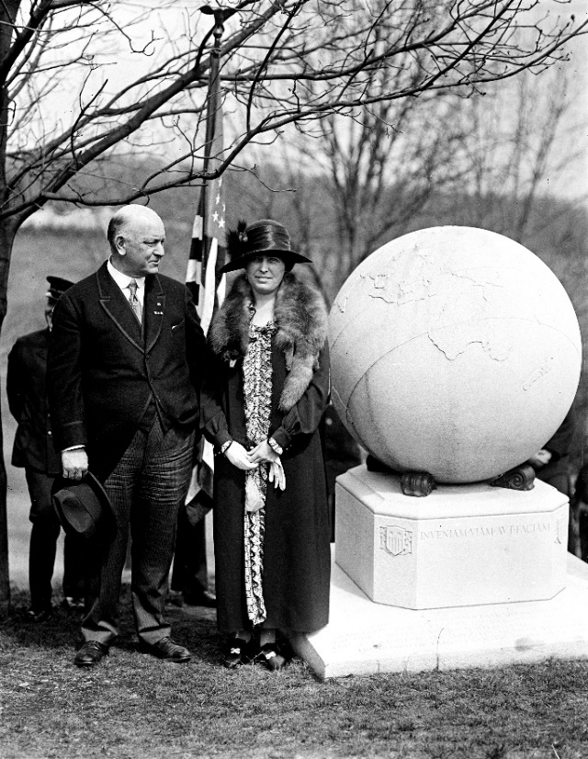
Who Was First?
Robert Peary had the fame he had always longed for.
He received many medals from various societies.
He was promoted in the Navy.
Twice, he was made president of the Explorers Club.
His house became an important place for tourists to visit after his death.
This is the large monument to Robert Peary near where he is buried.
“Peary daughter at grave (cropped).jpg” by [Themadchopper] is licensed under CC BY 3.0
Can you talk about how and why Matthew Henson’s
achievements were overlooked?
X

Slide 22
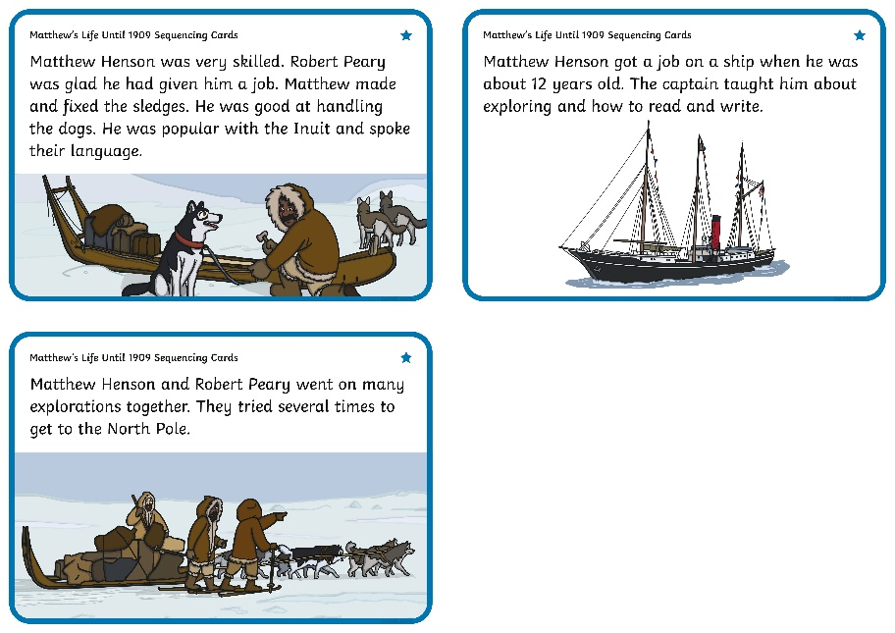
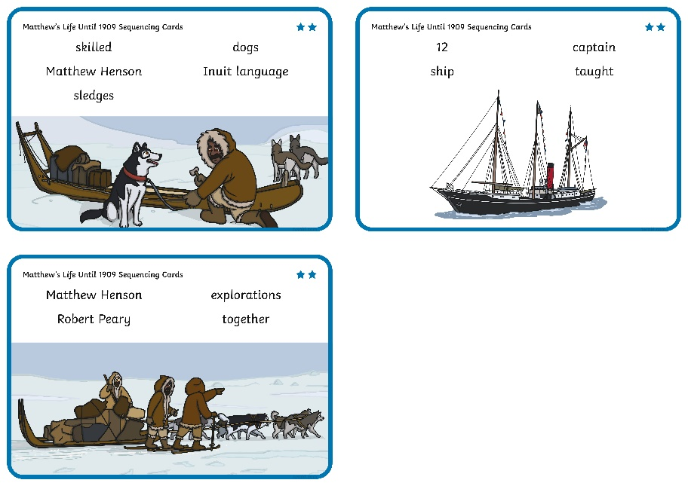
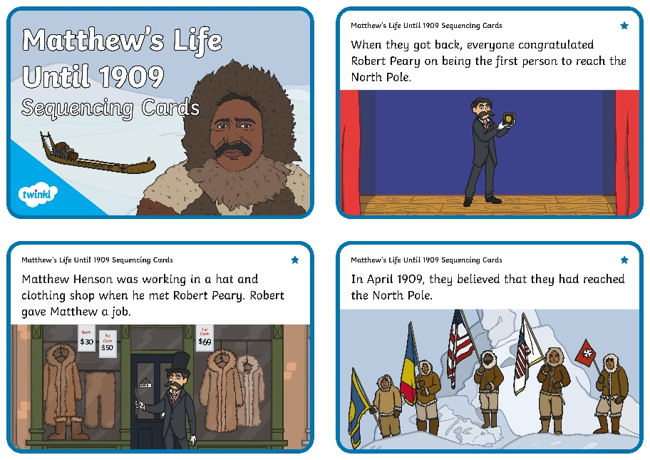
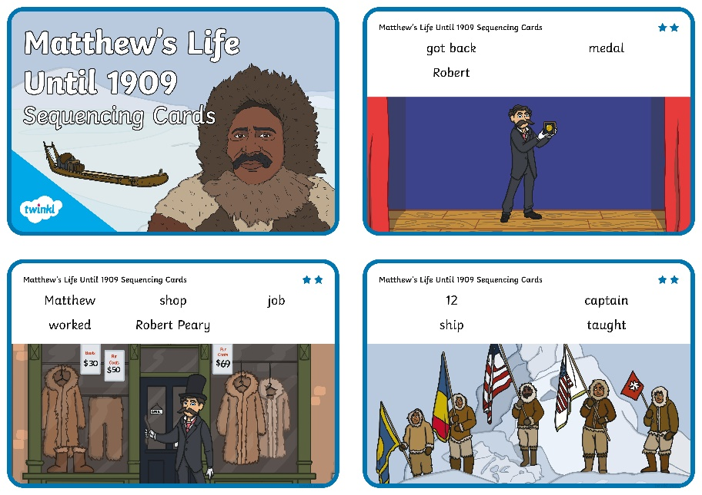
Matthew’s Life Until 1909
Work with a partner to cut out the pictures on the Matthew’s Life Until 1909 Sequencing Cards.
Talk about each picture and place the events in the order that they happened.

Slide 23
Matthew’s Life Until 1909
Can you talk about the key events in Matthew Henson’s life?
X

Slide 24
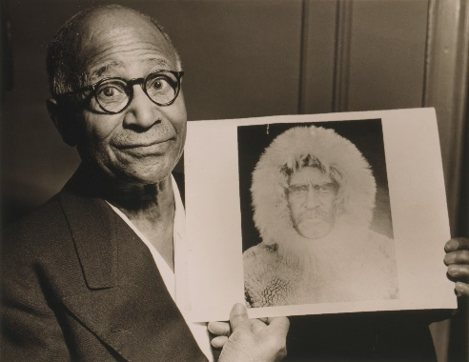
Life After the North Pole
Matthew received little attention after they returned from the North Pole.
He got a job in a government office where he worked for thirty years. Matthew did receive some honours when he was older.
Nearly 30 years after his expedition to the North Pole, he was made a member of the Explorers Club.
Over 35 years after his expedition to the North Pole, he received a US Navy medal like the one Robert Peary had received.
He was invited to the president’s house a year before he died.
Matthew Henson is shown here as an older man. He is holding a photograph of Robert Peary.
“Matthew Henson NYWTS.jpg” by [Davepape] is licensed under CC BY 3.0
Can you give at least one reason why Matthew Henson
was a significant explorer?
X

Slide 25
Life After the North Pole
45 years after Matthew died, he received a Hubbard medal. This was given to his niece on his behalf. Robert Peary received this medal during his own lifetime.
In 1988, Matthew and his wife were moved to the same cemetery as Robert Peary. There was a ceremony and a memorial was put in place for Matthew Henson. In 1986, Matthew Henson and Robert Peary appeared together on a US stamp.
Why do you think Matthew Henson received recognition
years after his expedition?
X
Matthew didn’t receive the recognition he deserved because of the colour of his skin. Now, views have changed and people are trying to celebrate him properly.

Slide 26
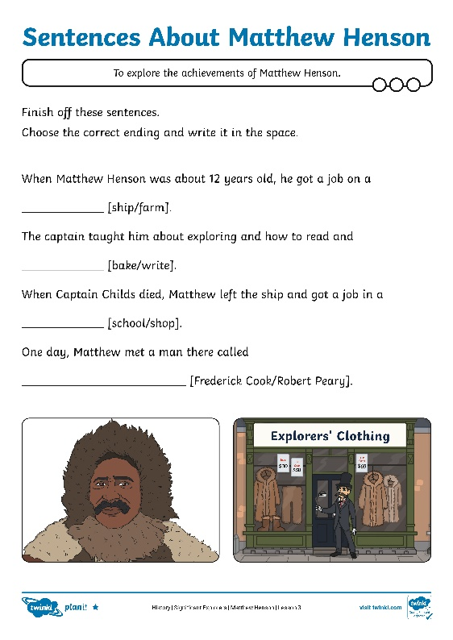
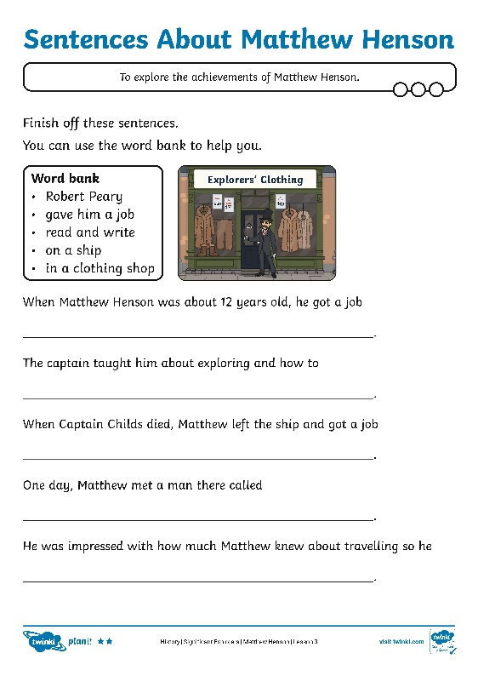
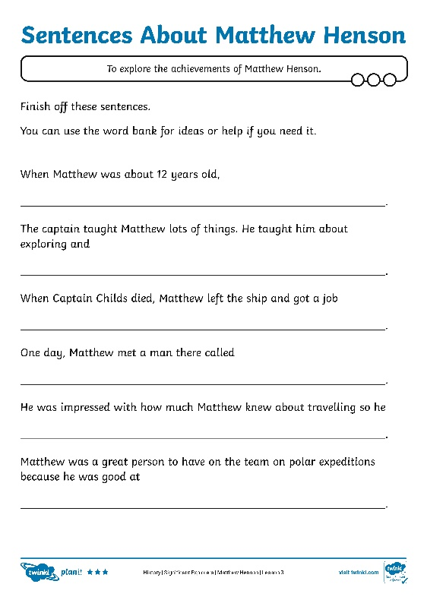
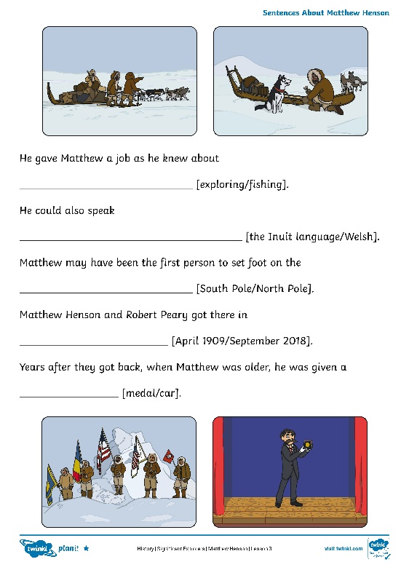
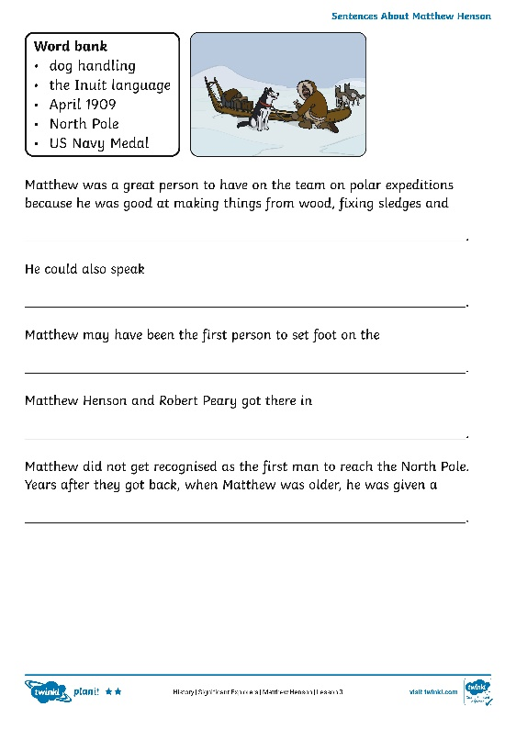
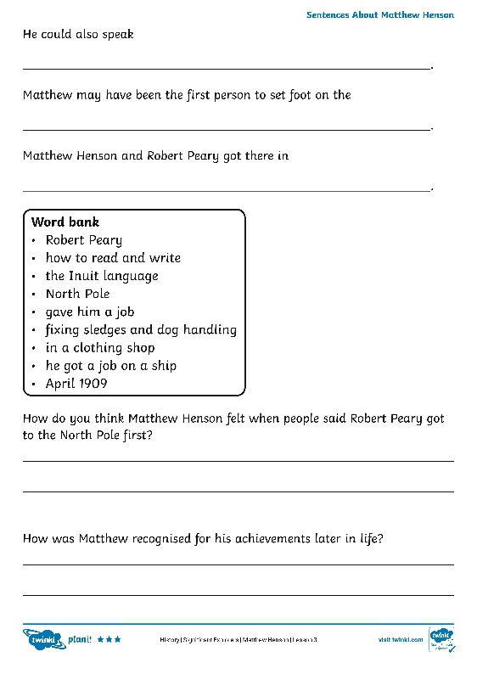
Sentences About Matthew Henson
Show what you know about Matthew Henson by completing the Sentences About Matthew Henson Activity Sheets.

Slide 27
Was Matthew Henson a
Significant Explorer?
The following words could be used to describe Matthew Henson.
If you had to choose only three of these words to describe him, which would you choose?
Take some time to think about this and write the three words on your whiteboard.
skilled
forgotten
adventurous
friendly
strong
fit
determined
generous
extraordinary

Slide 28
Was Matthew Henson a
Significant Explorer?
Investigations into whether Matthew and the rest of the team were the first to reach the North Pole have been done in recent years but it is not clear if they were the first to get there.
Is Matthew still significant even if they didn’t reach the North Pole?
Tell your partner what you think about this.
“Matthew Henson return.jpg” by [Robbot] is licensed under CC BY 3.0

Slide 29
Was Matthew Henson a
Significant Explorer?
Maybe you said something like this:
He should be remembered for the amazing skills and experience he had as a polar explorer.
He should be remembered because for years he did not receive the recognition he deserved for his exploring.
“Matthew Henson NYWTS.jpg” by [Davepape] is licensed under CC BY 3.0

Slide 30
Aim
To explore the achievements of Matthew Henson.
Success Criteria
I can explain why Matthew Henson was a significant explorer.
I can describe the key events in Matthew Henson’s life.
I can discuss how Matthew Henson’s achievements have been recognised in different ways as time has passed.

