Slide 1
Wednesday 9th February 2021 LO: to understand the events and effect of the Spanish invasion upon the Maya
In this session, we will look at:
When the Spanish arrived in South America
Why the Spanish invaded
How the Spanish treat the Maya
Did the Maya survive?

Slide 2
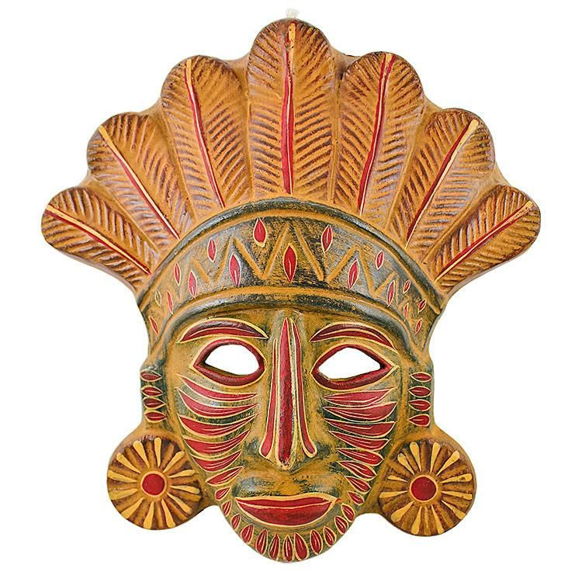
Prior knowledge
When people talk about the fall of the Maya civilisation, they often say it was because of the Spanish invasion. From our last session, we know this isn’t actually true.
What 3 main factors are believed to have caused the fall of the great Maya civilisation?
-
-
-

Slide 3
Prior knowledge
When people talk about the fall of the Maya civilisation, they often say it was because of the Spanish invasion. From our last session, we know this isn’t actually true.
What 3 main factors are believed to have caused the fall of the great Maya civilisation?
- Deforestation
- Drought
- War

Slide 4
Your task is to create an information text that provides facts and a detailed explanation to these points.
When did the Spanish arrived in South America and who led them?
Explain the various reasons for why the Spanish invaded.
Explain how the Spanish treat the Maya.
Did the Maya survive?
To create your information text, use these sources of information.
Source 1
Information sheet
(can be found on our school web page).
Source 2
Watch this video.
The Maya & The Spanish Conquest - YouTube

