Slide 1
Tuesday 12th January 2021 LO: to understand Maya beliefs and ways of worship

Slide 2
Introduction
The Maya civilisation believed that all actions and deeds had a consequence (good or bad).
As such, their daily lives were full of links to worship and paying respect to the gods.
They frequently made offerings to the gods (sometimes this was animal or even human sacrifices).

Slide 3
Your task
Go to the BBC Bitesize web page about Mayan worship through using this link/ URL https://www.bbc.co.uk/bitesize/topics/zq6svcw/articles/z2gkk2p
Using this site - and any other research you do - you must create an information text about Maya gods and worship.

Slide 4
What to include
You must include the following in your information text:
The names and responsibilities/ characteristics of the main gods.
Explain the different ‘levels’ of the world according to Maya beliefs.
What the Mayans did to worship the gods.

Slide 5
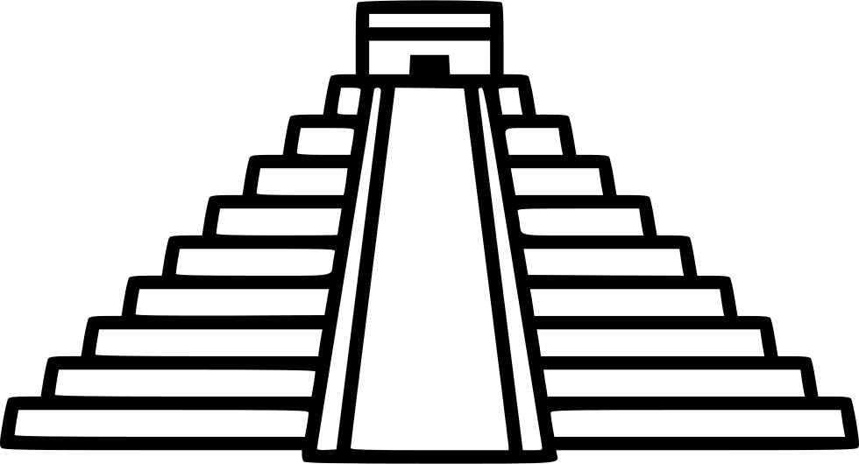
What to include (continued)
The Maya had 2 types of pyramids. In your information text, draw the 2 different types of pyramids (below)and match the correct description to each correct pyramid by writing the matching description underneath your drawing.
This pyramid was for offerings and sacrifices. The priests, the King and any sacrifices were the only ones allowed to climb the steps.
This pyramid was in honour of the gods and usually no one was allowed to climb the steps apart from the King. It was often highly decorated and was always tall to reach up towards the gods.
?

