Slide 1
Science
Friction

Slide 2
What is friction?
Things move when a force is applied (e.g. moving a football requires the player to kick the ball – energy from the player’s leg gives enough force to move it).
But the ball will eventually stop. Why is that?
It stops because of friction.
Watch this video from BBC Bitesize which explains a little more about friction. https://www.bbc.co.uk/bitesize/clips/z79rkqt

Slide 3
Your task
We are going to create a scientific report on an experiment to investigate friction.
To do this well, you will need to understand and use the following vocabulary:
Friction - force - smooth - rough
Opposing force - energy - gravity
- Stationary - movement

Slide 4
Your task (continued)
A true scientific investigation is split into several parts. Over the next few pages, we’ll look at each section where I’ll explain what it is and then you need to write your own.
In each section, you need to write the subtitle that is in red and then follow the guidance for each part.

Slide 5
Title/ question to investigate:
Does the material of a surface affect the distance that an object can travel? (Copy this into your book/ onto your paper.)
Prediction (state what you think will happen and give an explanation as to why you think that).
e.g. I predict that the material of the surface area will not have an affect on the distance an object can move because _____________________________.
(Write your own, using this as a guide.)

Slide 6
Equipment (list as bullet points what you will need to conduct the experiment). (Copy the following into your book/ onto your paper.)
e.g.
Equipment:
- a coin or counter of some sort,
- a piece of material (a tea-towel, toilet roll, a piece of clothing)
- a piece of paper,
- a desk or hard floor.

Slide 7
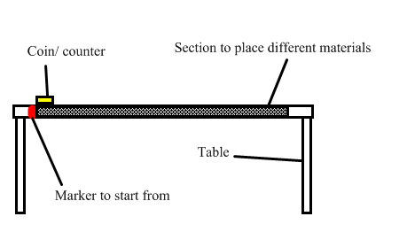
Diagram (draw a simple diagram to show how to set up the equipment). (Copy the following into your book/ onto your paper.)

Slide 8
Method (Copy this into your book/ onto your paper.)
Set up the equipment as shown in the diagram.
Place the coin/ counter on the desk/ table/ hard surface with the back edge at the start line/ mark.
Push the coin/ counter with 1 finger with a medium level of force.
Measure the distance that the coin/counter has travelled.
Repeat the experiment but with the various materials under the coin/counter.
Record all results in your result table.

Slide 9
Results (Copy this table with the materials that you have experimented with listed into your book/ onto your paper and complete as you now do the experiment and record your findings.)
If you don’t have a ruler, your could use a different way of measuring, e.g. how many thumb widths or finger lengths, etc.)
Material under the coin/ counter | Distance travelled (cm) – each square shaded is worth 1 cm travelled
Table top
Paper
Fabric (cotton t-shirt)
Fabric (carpet)
…

Slide 10
Conclusion (Write about what your results show you and try to scientifically explain why this is the case.)
E.g. My results from this experiment show me that the difference in the material of a surface does affect the distance an object can travel: the coin moved furthest when on a ________ surface. It moved the least distance when on a ________ surface. I believe this is the case because __________________________.

