Slide 1
Thursday 11th February 2021/ Friday 12th February 2021 LO: to identify and explain everyday forces
Due to our Youtube Live session with Michael Morpurgo yesterday, not everyone managed to get going/ finish their egg drop challenge.
As such, I’m using this afternoon to provide time to finish them off and test them.
If you have finished your egg drop capsule/ vehicle, there are some further slides that follow the ones from yesterday that look at evaluating and explaining your findings.

Slide 2
Recap.
What forces are acting in this scenario?

Slide 3
Recap.
What forces are acting in this scenario?
Gravity pulls all objects towards the ground.
Grip/ traction from the dogs paws and their muscle power causes thrust forward.
Friction and air resistance act to slow the dogs and sled.
Upthrust/ uplift from the pressure of the sled on the snow pushes upwards against the sled and the dogs paws.

Slide 4
In all scenarios, for every force there is an opposing force. When one force is greater than its opposing force the object moves or changes shape.
e.g. When the dogs pull harder, the force of thrust is increased to overcome the friction and drag (air resistance and so the dogs and sled move forwards.
Gravity pulls all objects towards the ground.
Grip/ traction from the dogs paws and their muscle power causes thrust forward.
Friction and air resistance act to slow the dogs and sled.
Upthrust/ uplift from the pressure of the sled on the snow pushes upwards against the sled and the dogs paws.

Slide 5
Your task: the egg drop challenge
You will need:
An egg,
Tape and/ or string,
Various spare materials (e.g. paper, cardboard, toilet roll, plastic bottles… anything that’s spare really!),
A plastic bag or plastic sheeting (at least 1),
An adult (the taller, the better).

Slide 6
Your task: the egg drop challenge
You will need:
In this task, you will drop an egg from a height (an adult holds it high above their head and let it drop to the floor – do this outside!).
HOWEVER - as you may have already guessed - if we did that, the egg would crack and splatter on the floor.
What you must do is:
Identify what forces are occurring.
Think of what forces you will need to aim to increase and which to decrease to be able to land your egg gently down to the ground without a crack.
Design and build your parachuting egg vessel/ holder and test it.

Slide 7
So what forces are occurring when we drop an egg and how do we stop the egg from breaking?
Increase the air resistance
(This counter-acts the force of gravity.)
Gravity
The combination of these 2 forces (if great enough) causes the egg to crack.
Both of these aspects would reduce the likelihood of your egg breaking.
Upthrust
(This is the recoiling force that is created when an object pushes against another.)
Reduce upthrust

Slide 8
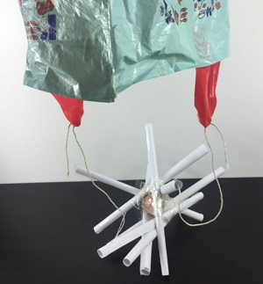
Now look at this image of an egg that is going to be dropped. What’s changed and how will this hopefully stop the egg from breaking? Label and explain.

Slide 9
Now it’s your turn…
Now that you’ve identified the forces that are acting on a falling egg, you must consider what forces you need to increase and which to decrease in order to land your egg safely.
Draw a design of your egg holder/ vessel and annotate it with scientific descriptions as to what forces are acting an how your design manipulates these forces to enable you to land your egg without cracking.

Slide 10
Now it’s your turn…
Once you’ve drawn and explained your design, make it.
Once it’s made you can place your egg into your vessel and test it.
SAFETY
Be careful with scissors if you use them.
Plastic bags are not a toy and can be a hazard to breathing if used incorrectly.
Do not climb up a height or stand near a big drop! Instead get an adult to hold it high above their head and drop (this will be around 3m in height, which is plenty, and means no one is in danger from falling.)

Slide 11
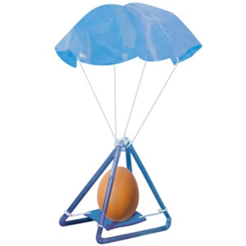
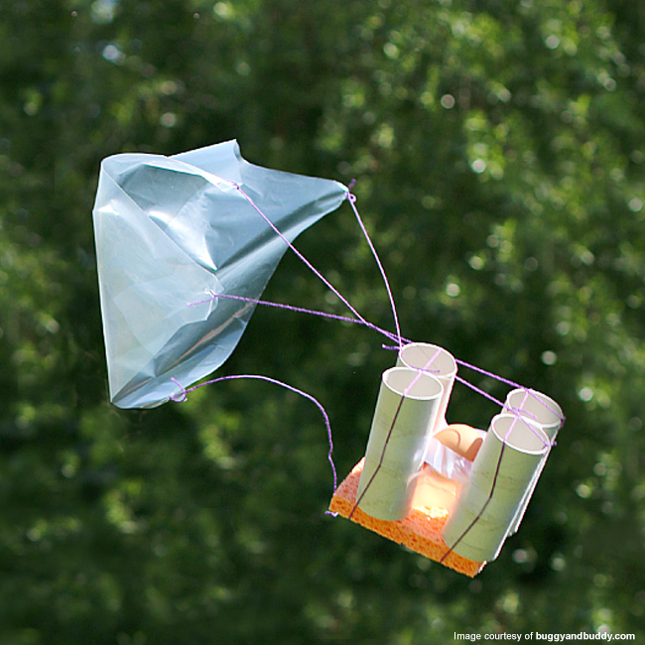
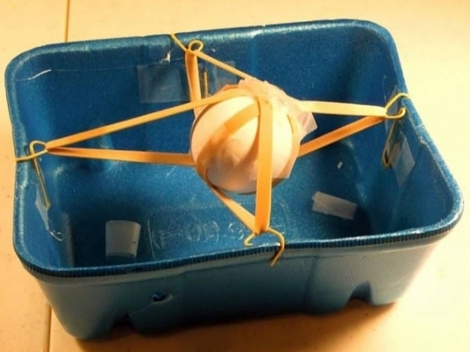
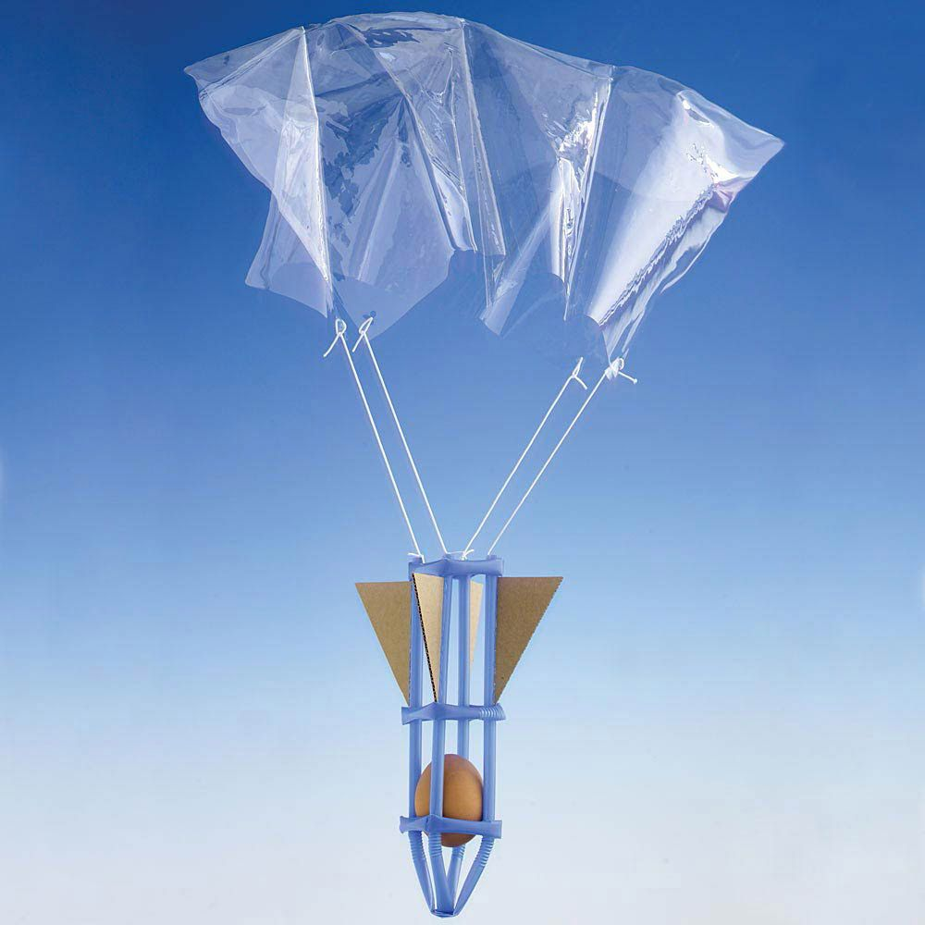
Here are some design ideas.

Slide 12
Evaluation
For each of the following points, consider what your egg drop creation was like and write detailed answers.
Did your egg break? If so, to what extent?
If not, or very little, what protected it? Explain how this happened using scientific language and referring to the level of each force that is in action.
If it did crack, which forces were making it crack?
Cracked or not, could your design be made better? If so what improvements would you make and why? How would these improvements change the forces acting on the egg?

