Slide 1
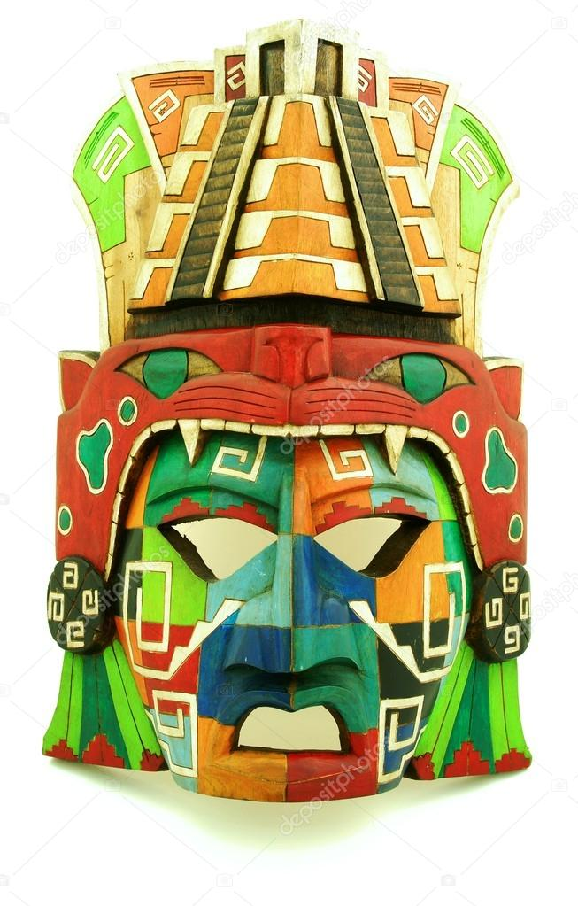
The Maya decline
What happened to the ancient Maya?

Slide 2
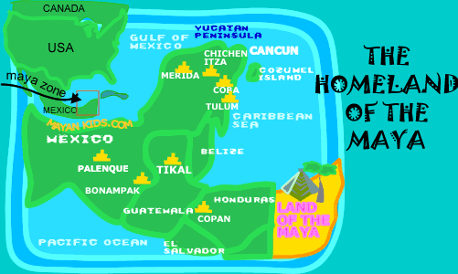
Nobody knows where they came from, but about 4000 years ago, a new tribe appeared in Central America. They settled in the rainforests of the Yucatan Peninsula and were very clever people.

Slide 3
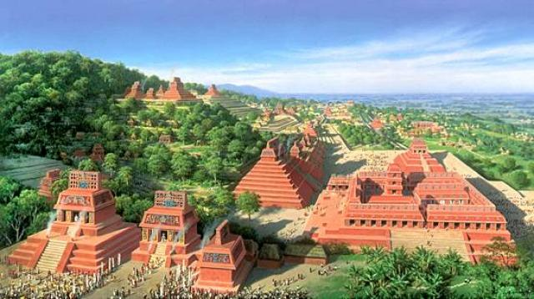
Before very long, the Maya had built hundreds of cities as they were skilled builders. They built palaces, temples, pyramids, walls, and homes. The cities were connected not only by roads but also by farming, trade, written and spoken languages and other advances such as astronomy and a calendar were amongst their achievements.

Slide 4
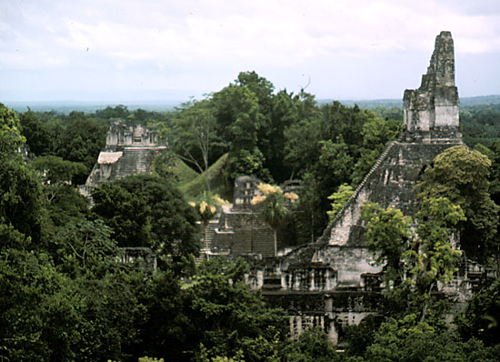
However, by around 900 CE, the Maya cities were mostly deserted; the great Maya cities fell into ruin.
Many people believe that the Spanish, who came to conquer central and southern America, were to blame for the fall of the Maya civilisation. But the Spanish didn’t arrive in the area until 1521 CE.
(We’ll be looking at the Maya-Spanish events in a later lesson.)
So why did the Maya civilisation diminish?
Today, we’re going to look at several theories.

Slide 5
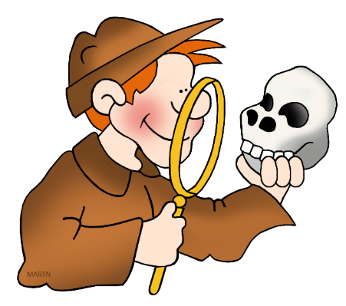
Archaeologists don’t really know what happened to the Maya population during 900AD for sure but they have lots of different theories.
Your task:
1) Make a page of information that summarises each theory.
2) Decide which theory, or combination of theories, is the most likely cause of the demise of the Maya, using the information you’ve learnt to explain why.

Slide 6
Monday 8th February 2021
LO: to understand the various theories of the demise of the Maya Civilisation
Your page should be split into different sections.
After you’ve created a paragraph/ detailed notes for each potential factor, you should then explain what you think caused the demise of the Maya, making sure you give details and reasoning to your opinion.
Deforestation
Drought
War

Slide 7
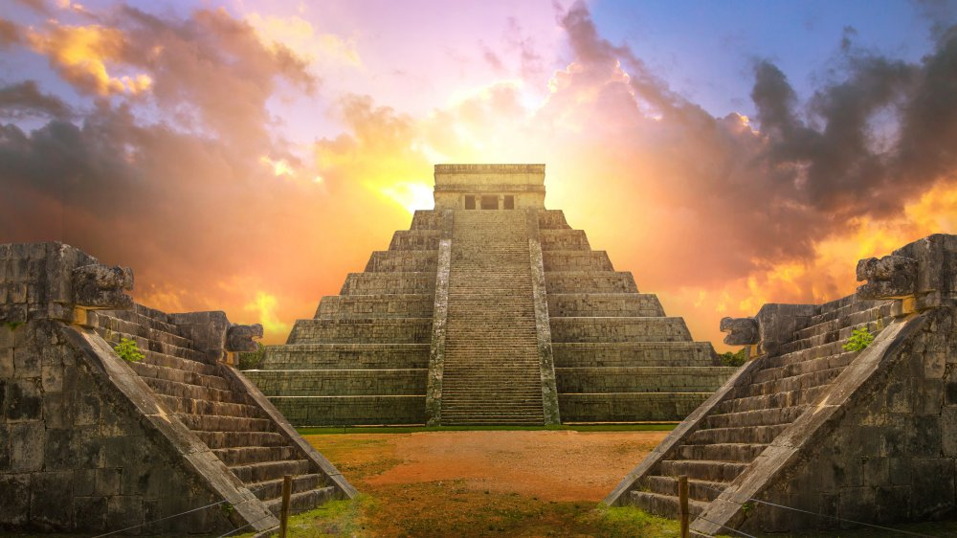
The following video and web page from BBC Bitesize gives a good start to your research, including a video.
https://www.bbc.co.uk/bitesize/topics/zq6svcw/articles/zndq7p3
The pages that follow on from this also provide lots of useful information that you can use.
You can, of course, do your own research too for your information pages and summary.

Slide 8
Deforestation
Could the chopping of trees meant that the Maya power stopped?

Slide 9
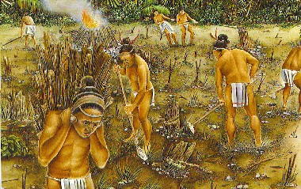
Cut and burn
The Ancient Maya were fantastic farmers and were able to produce food for their entire city (which could be up to 200,000 people).
A bigger population meant more food was needed. As a result, more land was needed to grow crops.

Slide 10
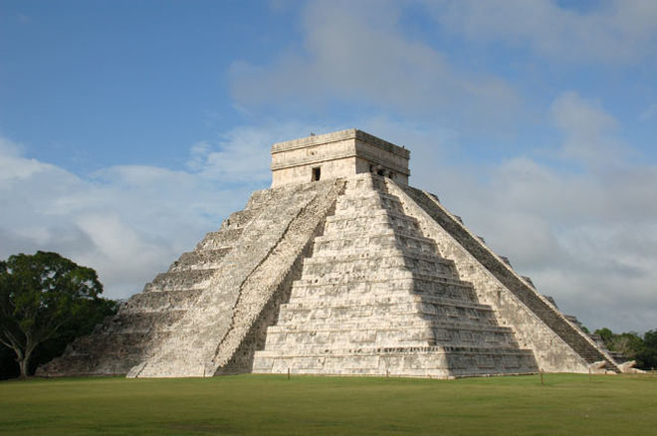
For each temple made, the Maya needed bricks to create the large buildings. Around 20 trees were needed to burn to heat just one square meter of lime plaster which was used to build the temples!

Slide 11
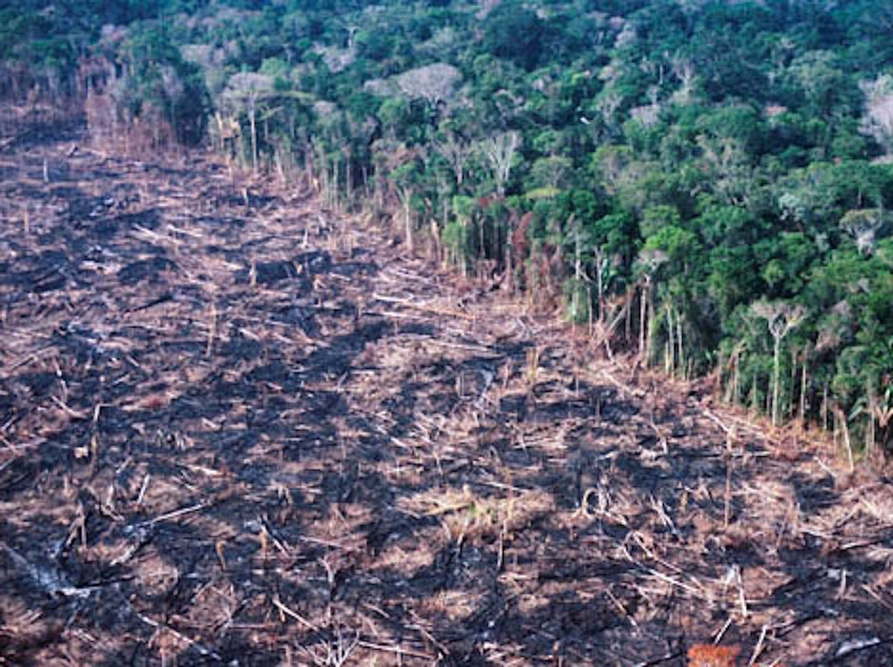
The lack of trees meant that the floor had very little nutrients in it which meant the crops didn’t grow very well.
The result of this meant mass starvation and the population had to move to live elsewhere (migration).

Slide 12
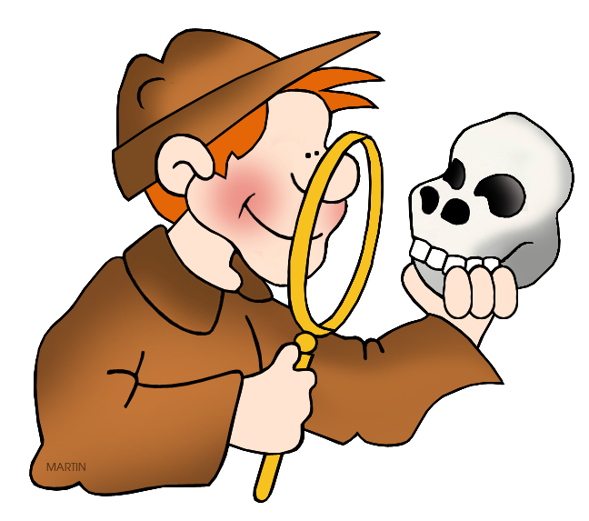
Many historians believe that the deforestation and lack of crops was the main cause for the Maya civilisation to die out.

Slide 13
Drought
Scientists have proven that around 900AD, there was a drought which meant no rainfall

Slide 14
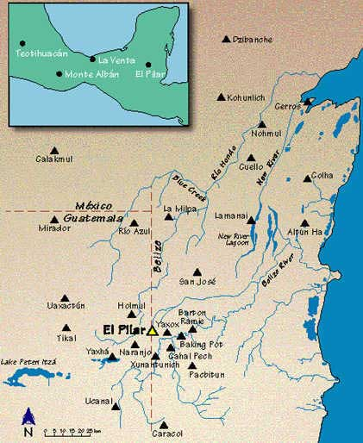
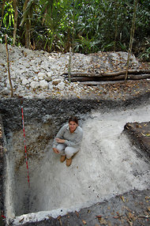
Water!
The Maya mainly settled where there was a river to make sure they had a water supply to water their crops and drink.
Where there was no water supply, the Maya made their own underground wells which were fed (filled up) with rain water.

Slide 15
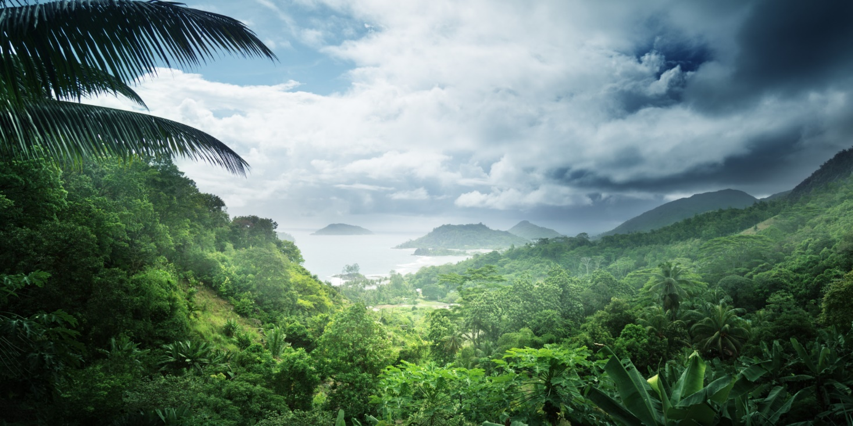
The constant deforestation of trees also had an impact on the water. The trees held water which evaporated to make rain clouds. No trees meant no clouds which meant less rain.

Slide 16
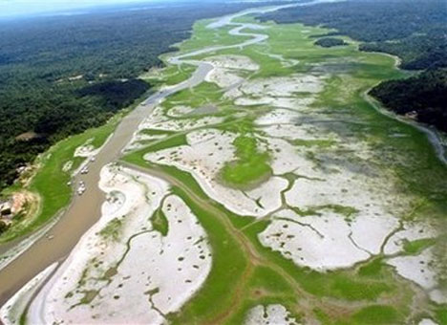
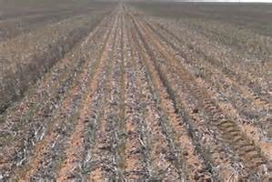
The lack of rain meant rivers and reservoirs quickly dried up. As a result, there was nothing to drink or to use to water the crops. The crops quickly failed and people began to die due to dehydration.

Slide 17
The area where the Maya lived (Central America) has had terrible droughts in the past. Evidence suggests that this occurred around 900AD which resulted in hundreds of thousands of people dying.

Slide 18
War
The Maya cities were constantly at war with each other. Could this be responsible for the downfall of the civilisation?

Slide 19
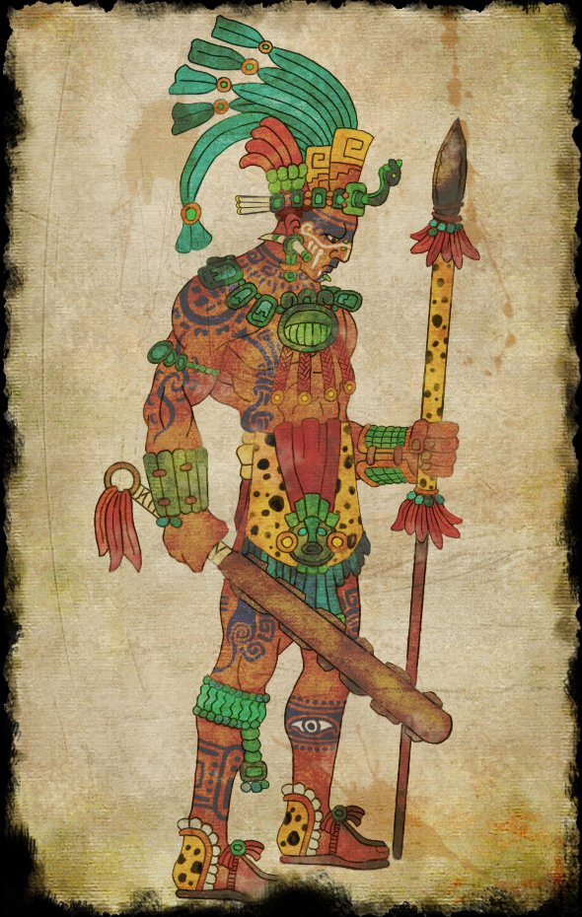
War
War had always been a large part of Maya life. As the population grew, so did the need to capture land to grow crops from each cities’ enemy.

Slide 20
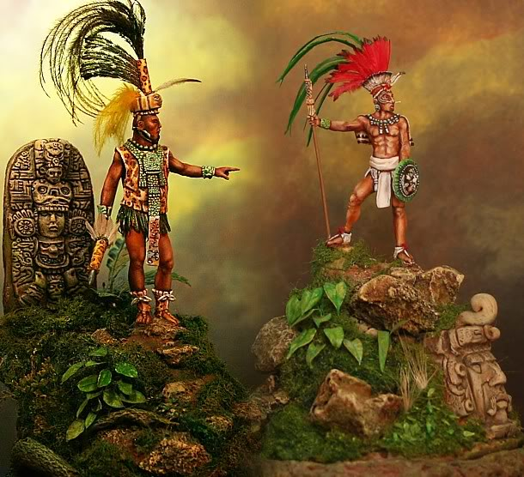
It quickly became a priority to attack more and more cities to make sure all citizens would not starve.
Many Kings, Nobles and Priests were taken prisoner leaving cities being ruled by a different royal family.

Slide 21
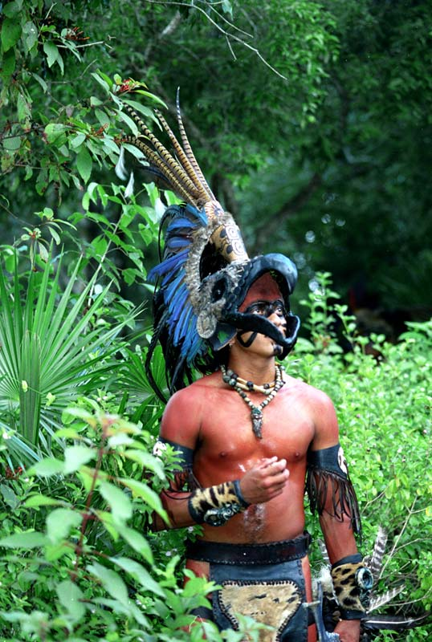
As the crops started to die, the Maya needed more and more people to capture and sacrifice to the Gods to make them happier. The Maya believed this would make the crops grow.
War was costly to each city and many weapons also had to be made to protect the warriors.

Slide 22
War created unrest amongst many civilisations. Many people died and it cost a lot of money. Did this cause the Maya decline? What do you think?

