Slide 2
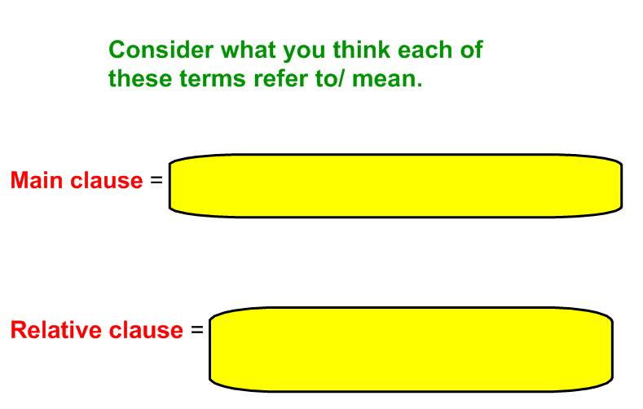

Slide 4
e.g.
Main clause Relative clause

Slide 6
ANSWERS (there are alternatives to how you could put these sentences with parenthesis so use this as a guide).
Bob – who is in Year 6 – is secretly an evil genius.
Newcastle United (who are often called ‘The Magpies’) are Mr Charlton’s favourite team.
Marley, who was on her way to the zoo, was excited.

