Slide 1


Slide 3
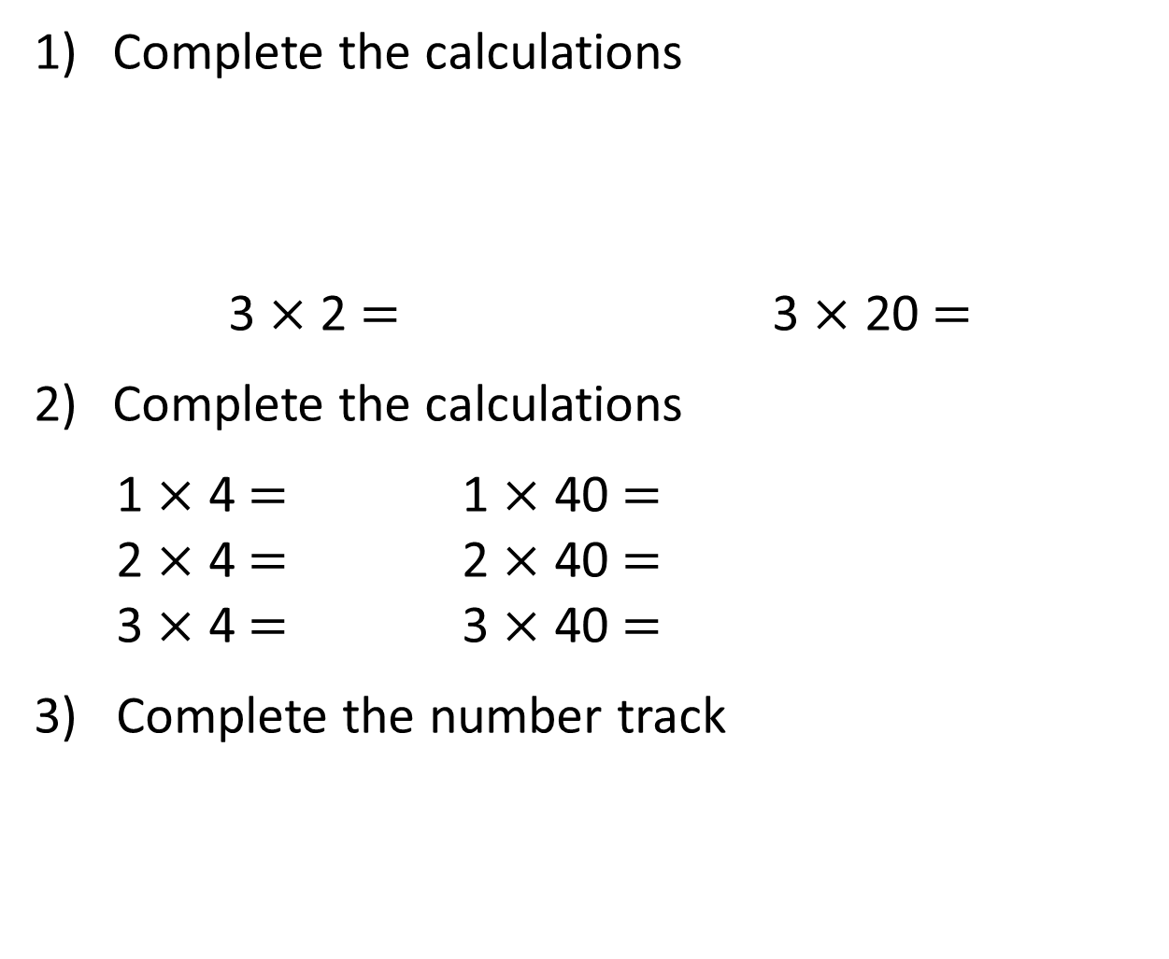
Complete the calculations
3 $×$ 2 $=$ 3 $×$ 20 $=$
Complete the calculations
1 $×$ 4 $=$ 1 $×$ 40 $=$
2 $×$ 4 $=$ 2 $×$ 40 $=$
3 $×$ 4 $=$ 3 $×$ 40 $=$
3) Complete the number track
30 | 60 | 90 |  | 150 |  | 210 | 240

Slide 4
Complete the calculations
3 $×$ 2 $=$ 3 $×$ 20 $=$
Complete the calculations
1 $×$ 4 $=$ 1 $×$ 40 $=$
2 $×$ 4 $=$ 2 $×$ 40 $=$
3 $×$ 4 $=$ 3 $×$ 40 $=$
3) Complete the number track
6
60
4
40
8
80
12
120
30 | 60 | 90 |  | 150 |  | 210 | 240
120
180
270
300

Slide 6


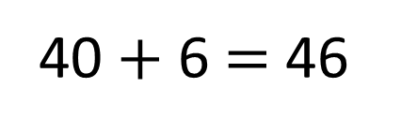
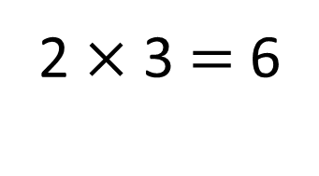
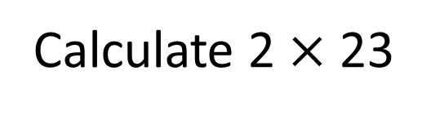
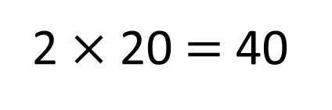
Calculate 2 $×$ 23
46
23
40 $+$ 6 $=$ 46
20
3
2 $×$ 20 $=$ 40
2 $×$ 3 $=$ 6

Slide 7

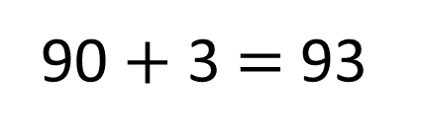
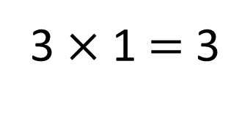
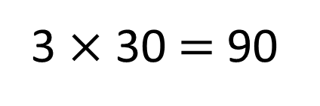
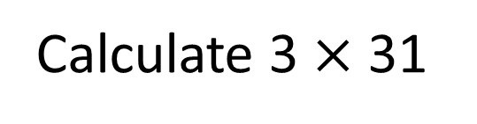
Calculate 3 $×$ 31
Have a think
93
31
90 $+$ 3 $=$ 93
30
1
3 $×$ 30 $=$ 90
3 $×$ 1 $=$ 3

Slide 8
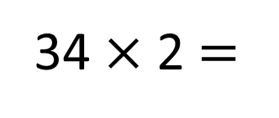
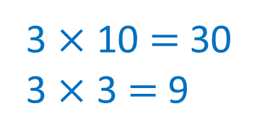
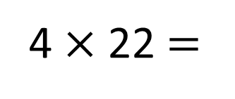
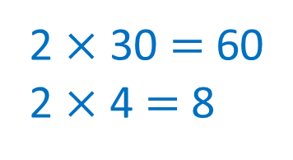
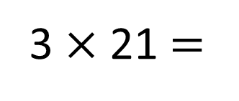
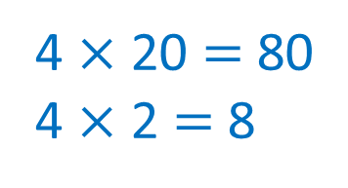
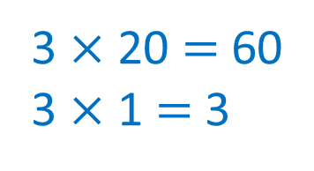
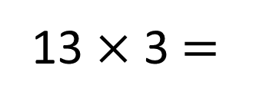
Calculate
Have a think
3 $×$ 21 $=$
63
4 $×$ 22 $=$
88
3 $×$ 20 $=$ 60
3 $×$ 1 $=$ 3
4 $×$ 20 $=$ 80
4 $×$ 2 $=$ 8
34 $×$ 2 $=$
68
13 $×$ 3 $=$
39
2 $×$ 30 $=$ 60
2 $×$ 4 $=$ 8
3 $×$ 10 $=$ 30
3 $×$ 3 $=$ 9

Slide 9


Arrange 3 of the digit cards into the calculation below.
3
3
2
2
$$×$$
Have a think
What is the largest total you can make?
What is the smallest?
How many different totals can you make?

Slide 10
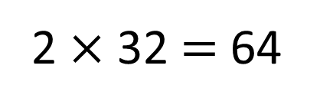
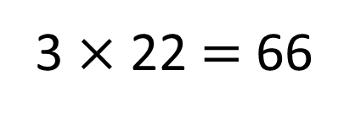
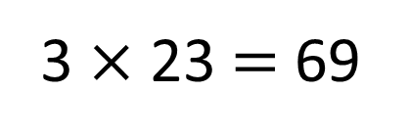
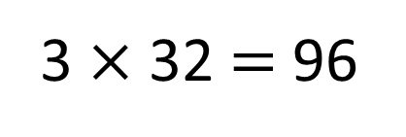
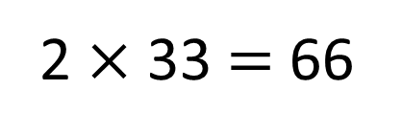
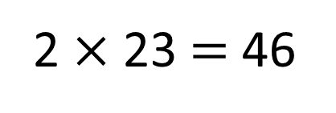
Arrange 3 of the digit cards into the calculation below.
3
3
2
2
3 $×$ 32 $=$ 96
2 $×$ 32 $=$ 64
3 $×$ 23 $=$ 69
2 $×$ 23 $=$ 46
3 $×$ 22 $=$ 66
2 $×$ 33 $=$ 66
96
What is the largest total you can make?
What is the smallest?
How many different totals can you make?
46
5

Slide 11

Use 3 digit cards to complete the calculation below.
$× =$84
Have a think
Which 3 cards could you use?
Can you find more than one solution?

Slide 12
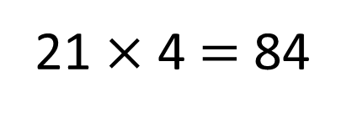
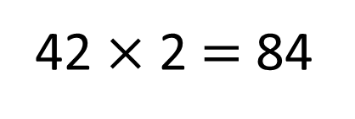
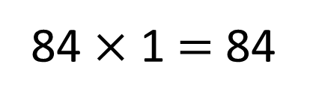
Use 3 digit cards to complete the calculation below.
$× =$84
84 $×$ 1 $=$ 84
42 $×$ 2 $=$ 84
21 $×$ 4 $=$ 84
Which 3 cards could you use?
Can you find more than one solution?

