Slide 2
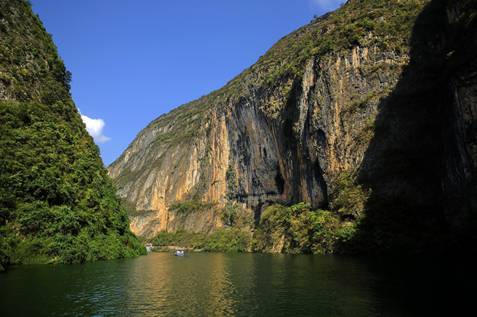
The Yangtze (Cháng Jiāng) Fact Sheet
The Yangtze is the longest river in Asia and the third longest in the world
It flows for 6,418km from glaciers on the Tibetan Plateau to the East China Sea at Shanghai
The Yangtze is heavily polluted by local industry
The River Dolphin that used to live in the river is now extinct and the river is home to three endangered species: the Chinese Alligator, Chinese Paddlefish and the River Pig (porpoise)
Did you know?
The river is home to the Three Gorges Dam, the world’s largest power station.

Slide 3
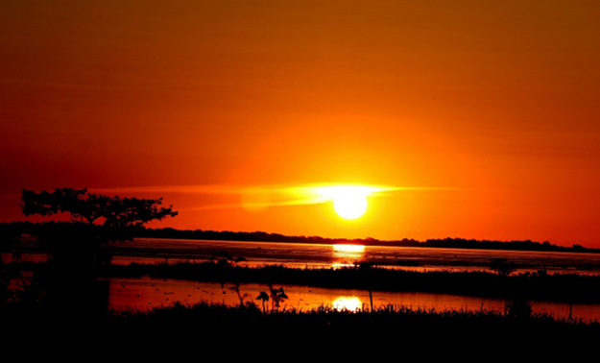
The Amazon Fact Sheet
The Amazon River is the second longest river in the world and has the largest capacity
The river is 6 miles wide at its widest point
The river’s source is formed by melting glaciers found high in the mountains of Peru. It then flows through Brazil, Ecuador, Bolivia, Colombia, Peru and Venezuela before flowing into the Atlantic Ocean
The Amazon flows through the largest Rainforest in the world
Did you know?
The Amazon was named by a Spanish explorer who told stories of a tribe of female warriors who lived by the river.

Slide 4
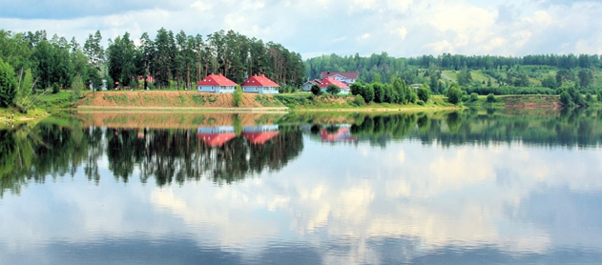
The Volga Fact Sheet
The Volga is the longest river in Europe, measuring 3,692km
The source of the river is in the Valdai Hills in Russia and its mouth is at the Caspian Sea
The river valley is very fertile and rich in minerals, making it an ideal environment for growing wheat
The pollution, caused by the many industrial areas the river runs through, is of great environmental concern
The river is mostly used for transport and shipping goods. It is also used for supplying electricity to the surrounding towns and cities
Did you know?
The Volga was widened in places for navigation purposes.
The Volga is a source of Caviar, a delicacy made from the eggs of Sturgeon fish.

Slide 5
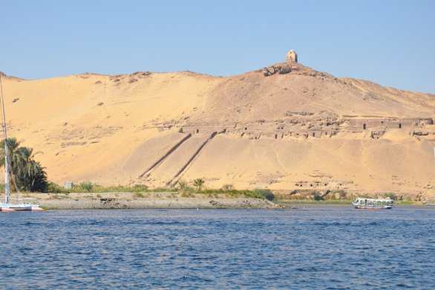
The River Nile Fact Sheet
The River Nile is 6,650km long, making it the longest river in the world
The Nile is in north-eastern Africa and runs through Sudan, Burundi, Rwanda, DR Congo, Tanzania, Kenya, Ethiopia, Uganda and Egypt
The river’s source is in the rainforests of Rwanda and its mouth is in the Mediterranean Sea
The Egyptians have depended on the river since ancient times. The banks of the Nile are full of valuable minerals, enabling farmers to grow crops in the fertile soil
Did you know?
Nearly all the cultural and historical sites of Ancient Egypt are found along the riverbanks of the Nile.

Slide 6
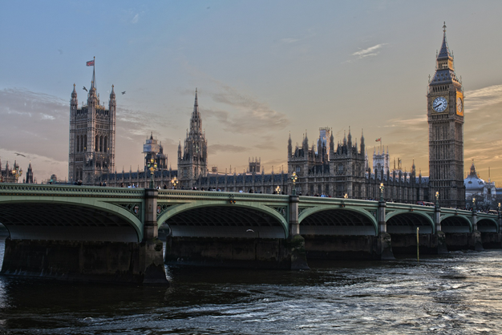
The River Thames Fact Sheet
The River Thames is 346km long, making it the longest river in England and the second longest in the United Kingdom
The source of the Thames is at Thames Head in Gloucestershire, and it flows into the North Sea at the Thames Estuary
Although the river is now mainly used for tourism, its main use was once for transporting goods in and out of the country
Did you know?
The river is policed by five police forces and there is also a London Fire Brigade fire boat on the river

Slide 7
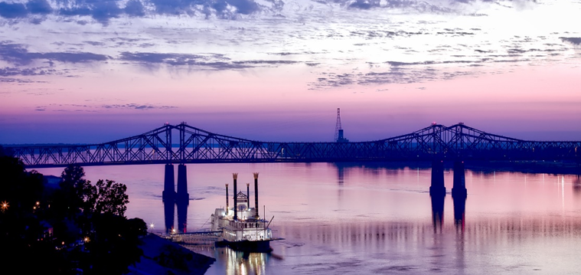
The Mississippi Fact Sheet
The Mississippi is 3,779km long, making it the longest river in America
In 1922, water skiing was invented on the Mississippi river
The river source is at Lake Itasca in Northern Minnesota in the USA and it flows through 10 states before emptying into the Gulf of Mexico
The Lake Pontchartain Causeway is the second longest road bridge in the world and crosses the river in New Orleans. It is 24 miles long!
Did you know?
The name Mississippi comes from the Anishinabe people who called the river ‘Messipi’, which means Big River or Father of the Waters.
Minneapolis lies on both banks of the Mississippi.

Slide 8
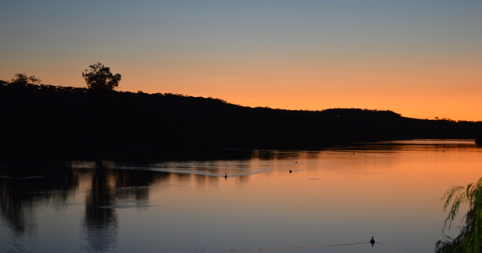
The Murray River Fact Sheet
Dams were built to assist with irrigating the land to help crops grow, but this has drawn water away from ecosystems that need it
The source of the river is high in the Australian Alps. The river flows into the Indian Ocean
There are many animals in the Murray River that can only be found in Australian waters, including Golden Perch, Murray Cod and the Platypus
Did you know?
The Aborigines believed the river was created by the great ancestor Ngurunderi as he chased Pondi (The Murray Cod) through the landscape.
The Murray is 2,575km long.

Slide 9
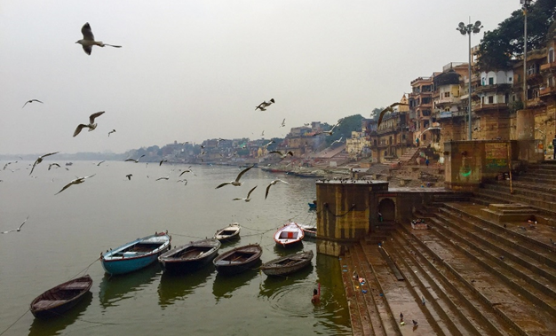
The Ganges Fact Sheet
The Ganges is 2,525km long and starts its journey in the Himalayas
The river flows through Nepal, India and Bangladesh, where it empties into the Bay of Bengal
The Ganges deposits minerals and nutrients into the surrounding land, making it ideal for farming
The Ganges is heavily polluted due to the many cities that deposit waste products into it. Pollution threatens both humans and more than 140 fish species
Did you know?
Hindus believe the waters of the Ganges are purifying and if they bathe in the river their sins will be forgiven and they will be cured of illness.
‘Wishing candles’ are places in the river to represent a wish for a friend or family member.

