Slide 1
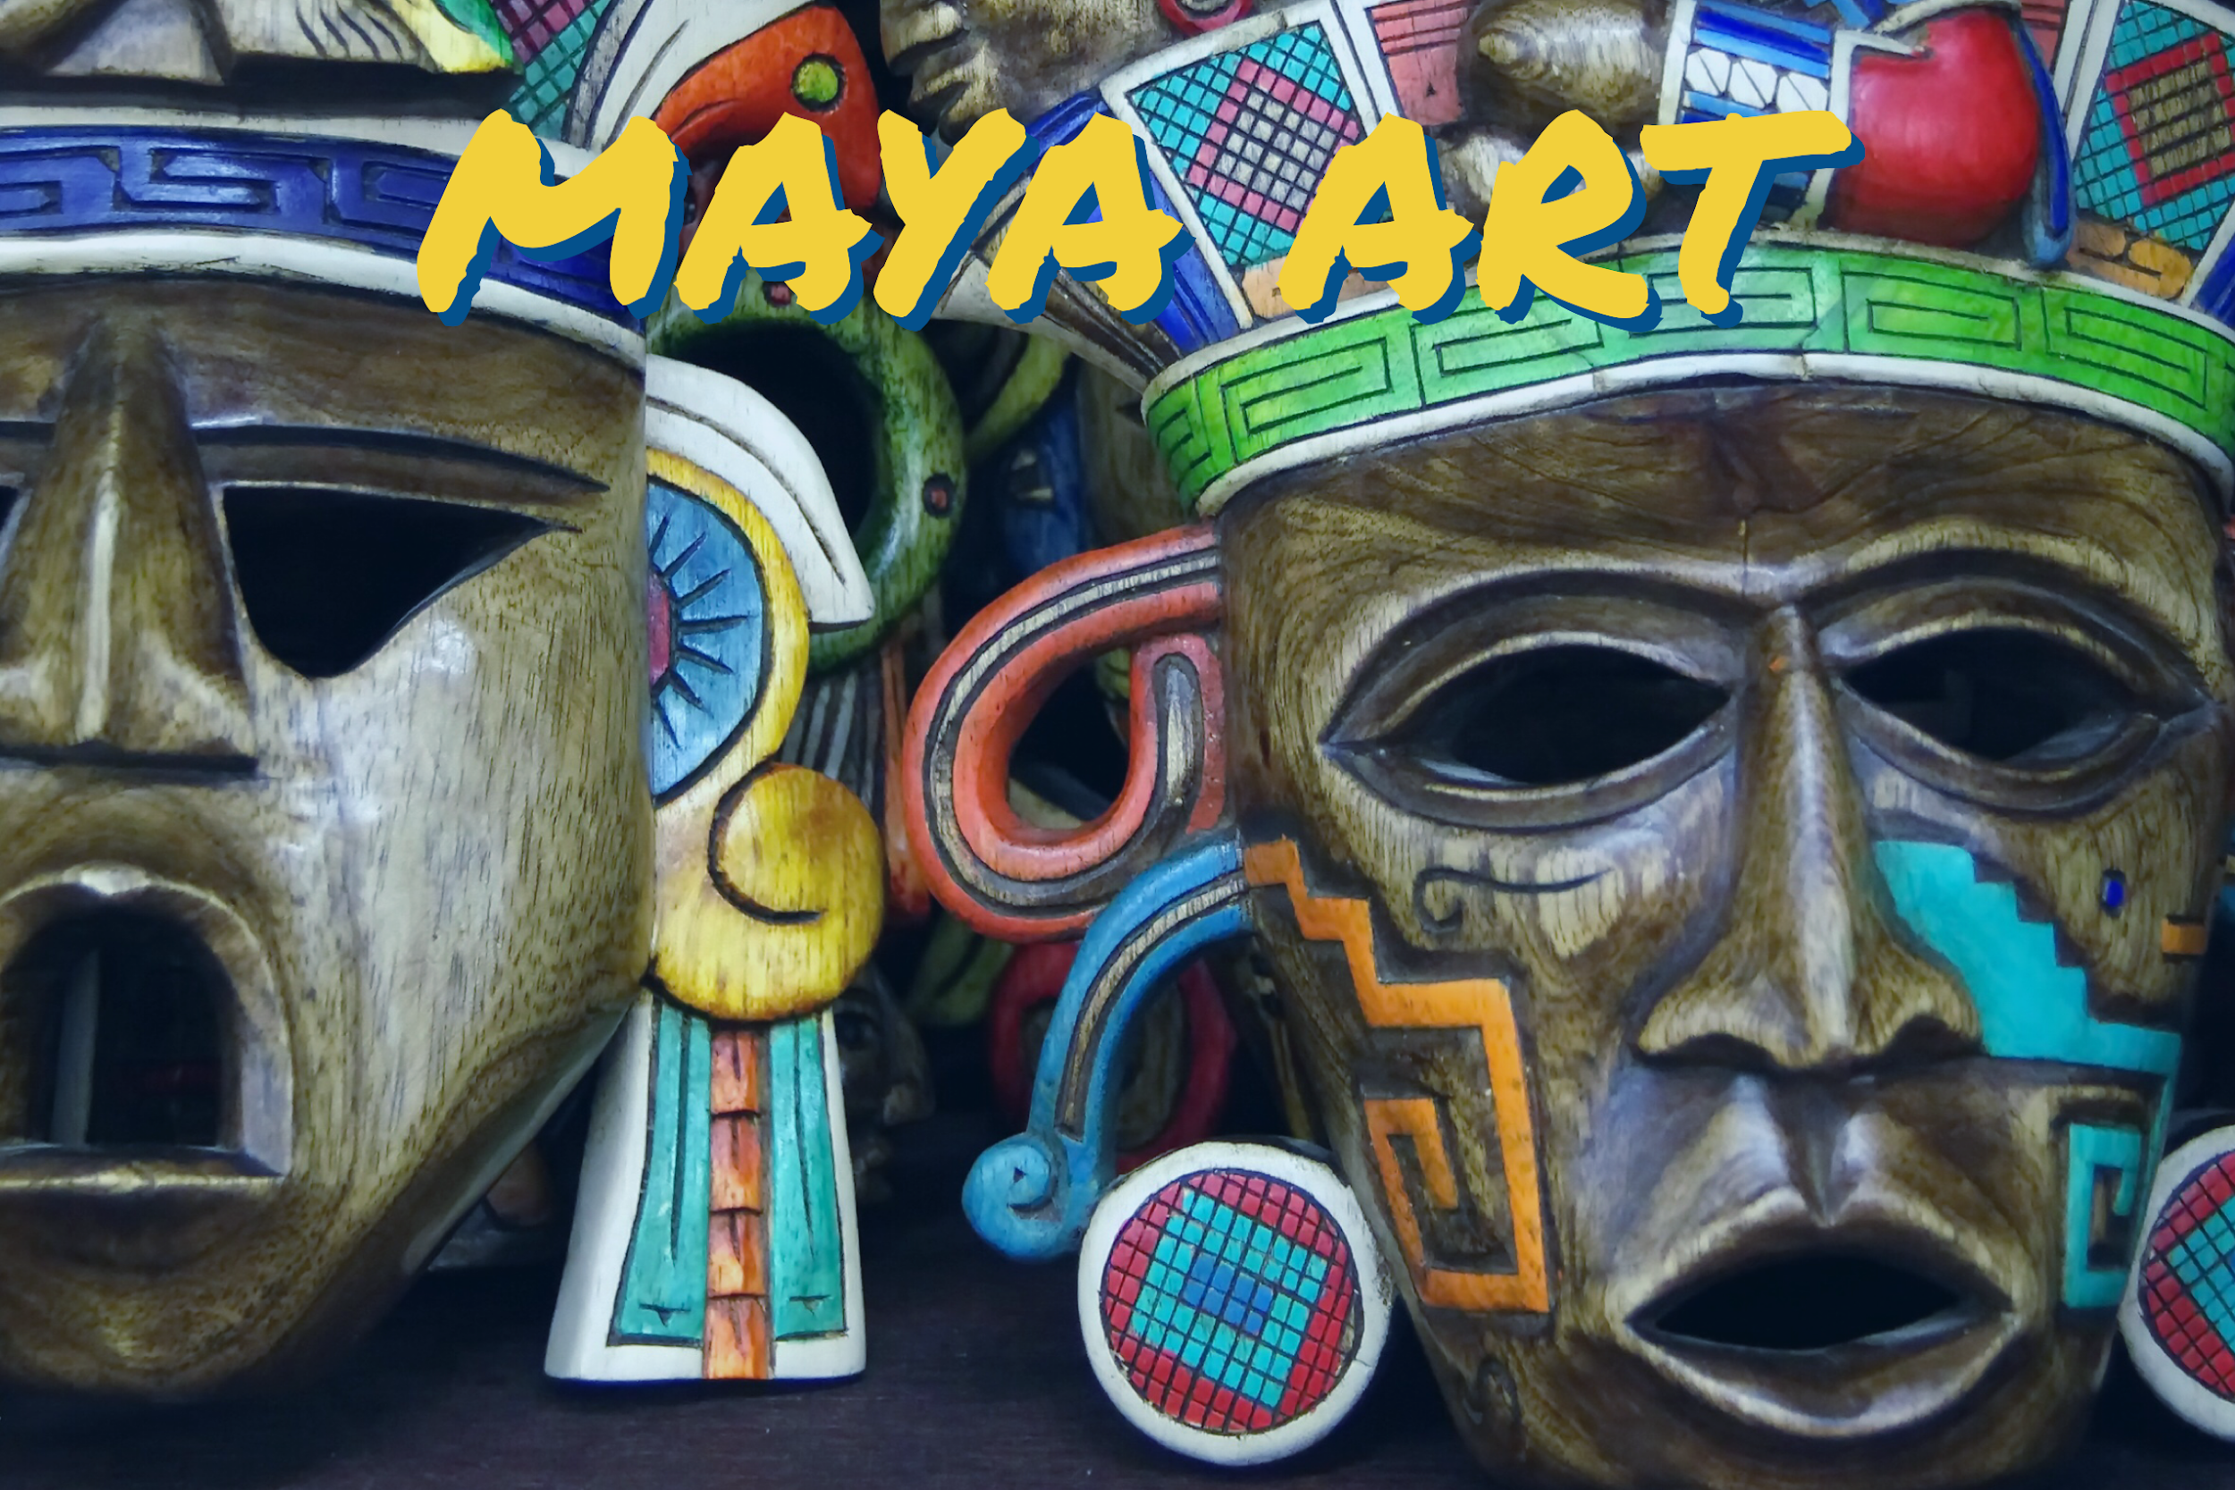

Slide 2
Your task today is to consider light source and shading.
For every object, there is a varying amount of light that covers each part.
The amount of light on a certain part of an object varies depending on the position of the light source.

Slide 3
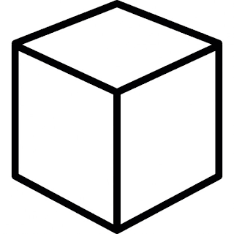
Here’s an example of a box. It has no light source and so has no shading. It doesn’t look particularly 3D.

Slide 4
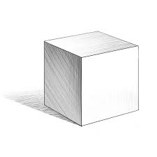
Here’s an example of a box but with a light source and shading. It looks far more 3D as the shading gives the impression of where a light source is and accents the shape of the object.
The shading is darker the further away/ more obstructed a surface is.
Shading to show the shadow at the opposite side from a light source.
Light source
(the direction of light)

Slide 5
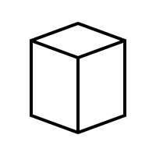
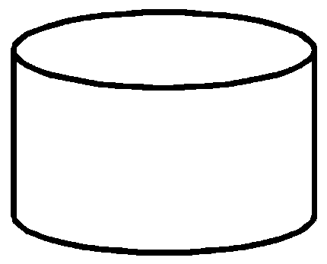
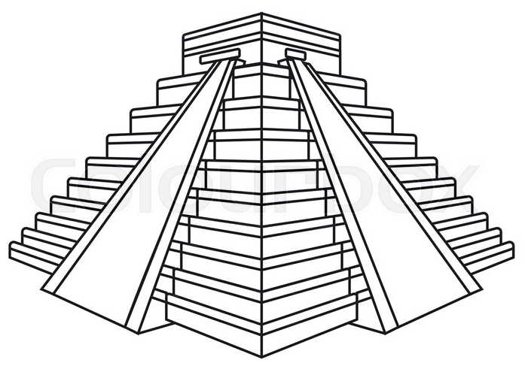
Print out or draw the objects and then shade them to show the amount of light across all surfaces and points (you can use whichever shading technique that you’d like – see the next page for a reminder).
Light source
(the direction of light)
Light source
(the direction of light)
Light source
(the direction of light)

Slide 6
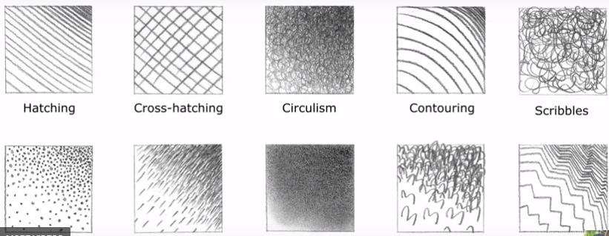
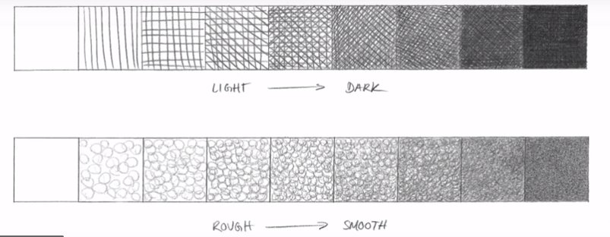
These shading techniques that we’ve looked at to try to incorporate these into your sketching to create depth and texture.
stippling
Short dashes
Blending
3s
Zig-zags

Slide 7
Now that we’ve practiced creating depth and texture in sketching, we are going to create a Maya-style mask sketch of our own.
This work will go across two sessions:
- The 1st: to practice drawing our own mask and shading skills & annotating our 1st sketch to evaluate our own work.
- The 2nd: to create our final, best piece of artwork.

Slide 8
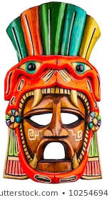
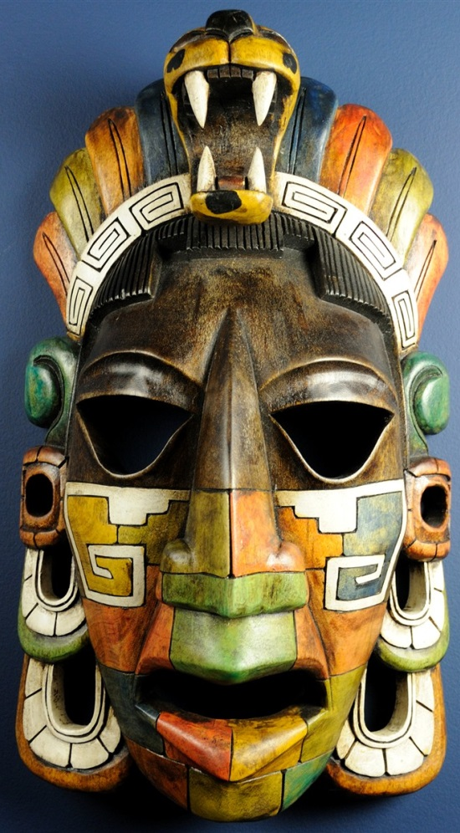
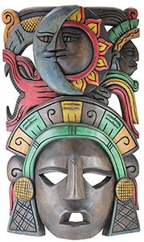
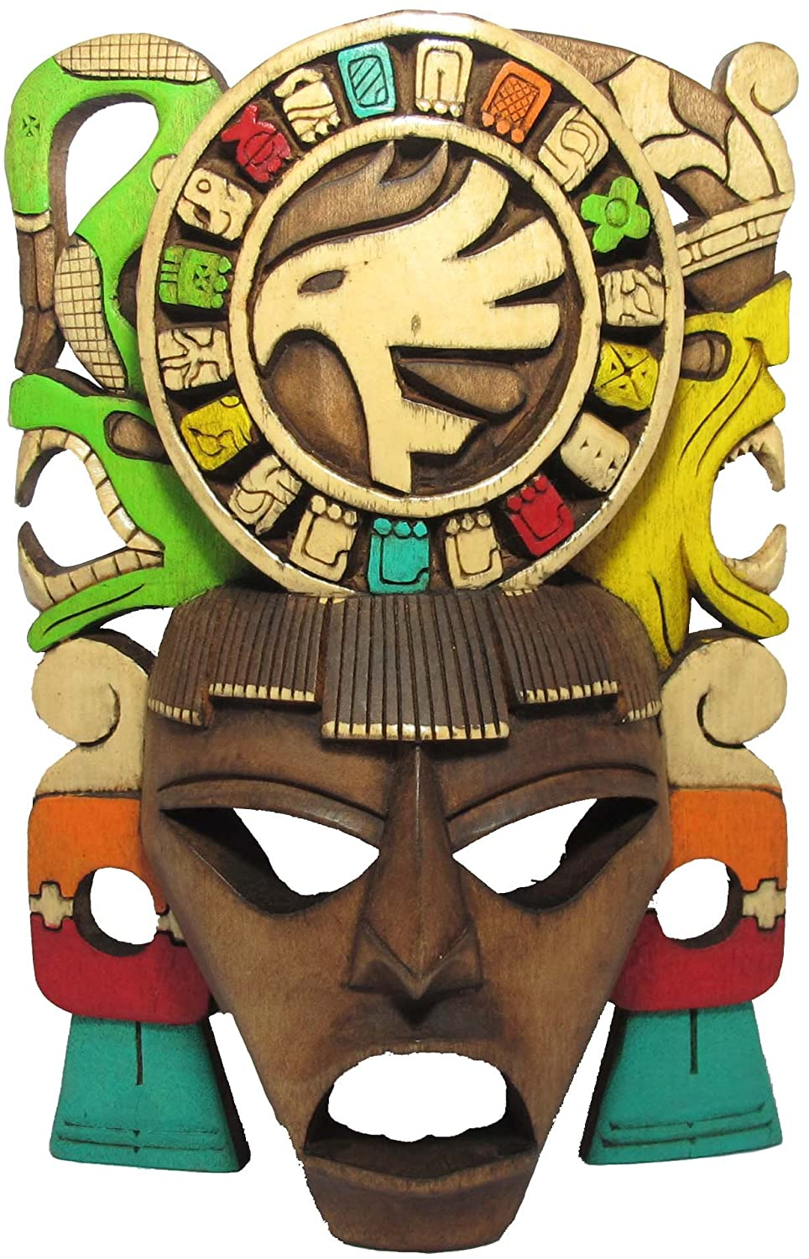
Use the following images to either as a source to copy one of the ideas or as inspiration to create your own design.

Slide 9
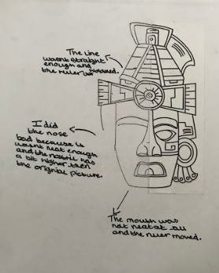
Once you have finished, evaluate your work:
- Pick out and write about aspects of your artwork that you like.
Pick out aspects of your artwork that you think could be better and how.
e.g.

