Slide 2
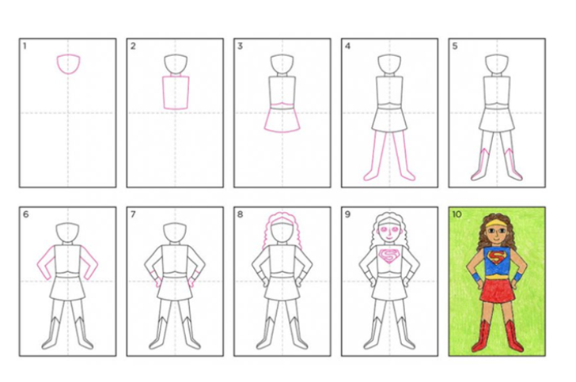
Use one of the following guides to draw your superhero character outline.

Slide 3
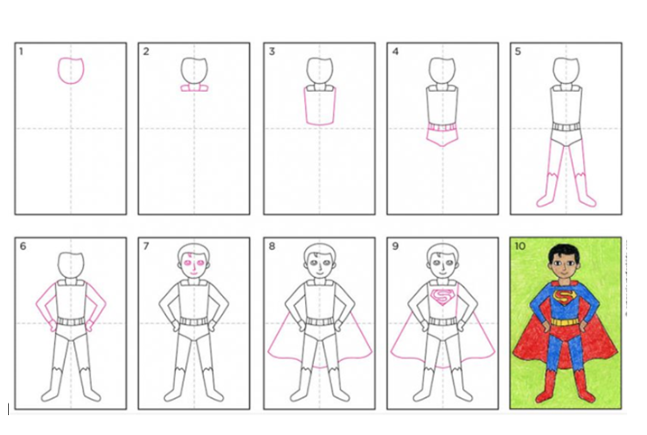

Slide 6
