Slide 1
Thursday 14th January 2021 LO: to plan a story
In today’s session, you will be planning out a thriller story. This story will need to be descriptive and captivating to hold your reader’s attention.

Slide 2
What do I put in my plan?
Eventually we are going to write 3 paragraphs:
Paragraph 1: being outside a forest and hearing a scream/ odd sound.
Paragraph 2: entering and moving through the forest.
Paragraph 3: being deeper in the forest and being confronted.

Slide 3
Here’s a WAGOLL (what a good one looks like)

Slide 4
Things to consider
In all your paragraphs, they need to be descriptive. As such, you should look to include the following aspects:
- High-calibre adjectives, adverbs and verbs
- Expanded noun phrases
- Fronted adverbials
- Subordinate clauses
- Emotive language (words that convey emotions)
- Reference to the 5 senses (sight, sound, smell, touch & taste)
- Similes
- Metaphors
- Personification

Slide 5
How do I start to plan?
Step 1: words & phrases
For each paragraph, create a spider-diagram of words and phrases that you might use for each paragraph.
Step 2: sentence practice
Using the words and phrases that you’ve thought of, practice writing sentences with different structures (a range of different sentence structures ensures that you’re writing doesn’t become flat and boring).

Slide 6
In each spider diagram, think about:
The 5 senses (sight, sound, smell, touch and taste) to describe every object/ noun in the scene.
What was happening.
How your character felt.

Slide 7
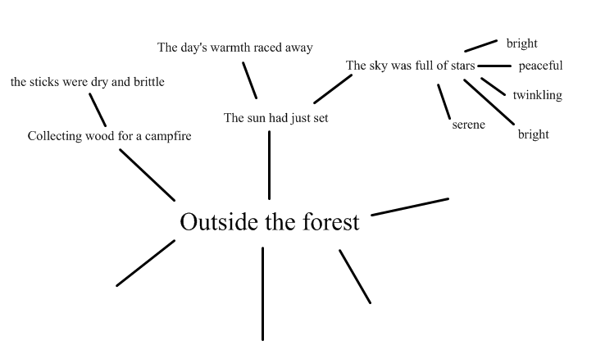
This is an incomplete example. You can draw your own in your book/ on your paper.

Slide 8
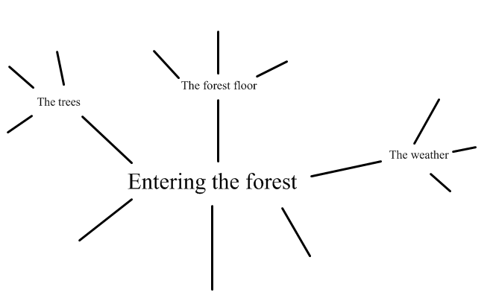

Slide 9
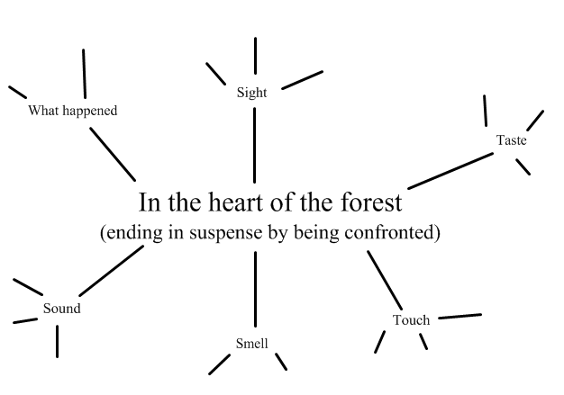

Slide 10
Sentence structures
Now that we have a bank of words and phrases for each paragraph, we can then start practicing different sentence structures.
Read the example of the first sentence structure on the sheet (this is loaded of the class web page) before then writing one of your own using the same structure.
Once you’ve written at least one sentence for that sentence type, move on to the next one to practice another sentence structure.
(The focus of each sentence can be for any of the 3 paragraphs/ points of your story.)

