Slide 1

Monday 23rd April 2018
Accelerated Reader Workshop

Slide 2

Aims of the session:
What is Accelerated Reader?
How does it work?
Feedback for the children
Reward system
How can I help my child?

Slide 3
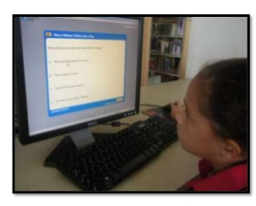

What is Accelerated Reader (AR)?
A personalized reading practice program that accelerates growth in reading ability.
The children take a STAR test, which is designed to respond to their answers and give an accurate reading level.
This means that pupils are reading books they CAN access at a level which is appropriate – it avoids situations when pupils are discouraged by books that are ‘too hard’.

Slide 4
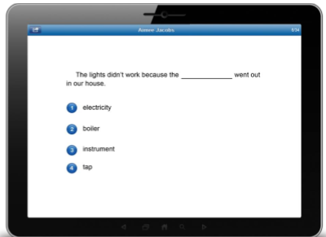
What is a Star Reading test?
Star Reading test is an online test used to measure your child’s reading level.
The test uses multiple-choice questions
It takes around 20 minutes
This test identifies your child’s Zone of Proximal Development (ZDP)

Slide 5
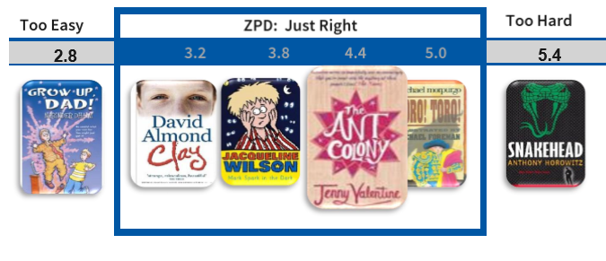
Zone of Proximal Development (ZDP)
A range of book levels recommended for each pupil based on their reading ability (Star test)
The pupil has free rein to choose books from within their entire ZDP range (based on quiz results and teacher feedback).

Slide 6

How do the children select books?
AR includes over 30,000 books. These can be found in the school library, classroom book corners, our Oxford Reading books as well as public libraries, book shops, homes etc.
Each book is assigned three scores to help your child make a suitable choice:
1. Book Level (BL)
2. Interest Level
3. Points

Slide 7
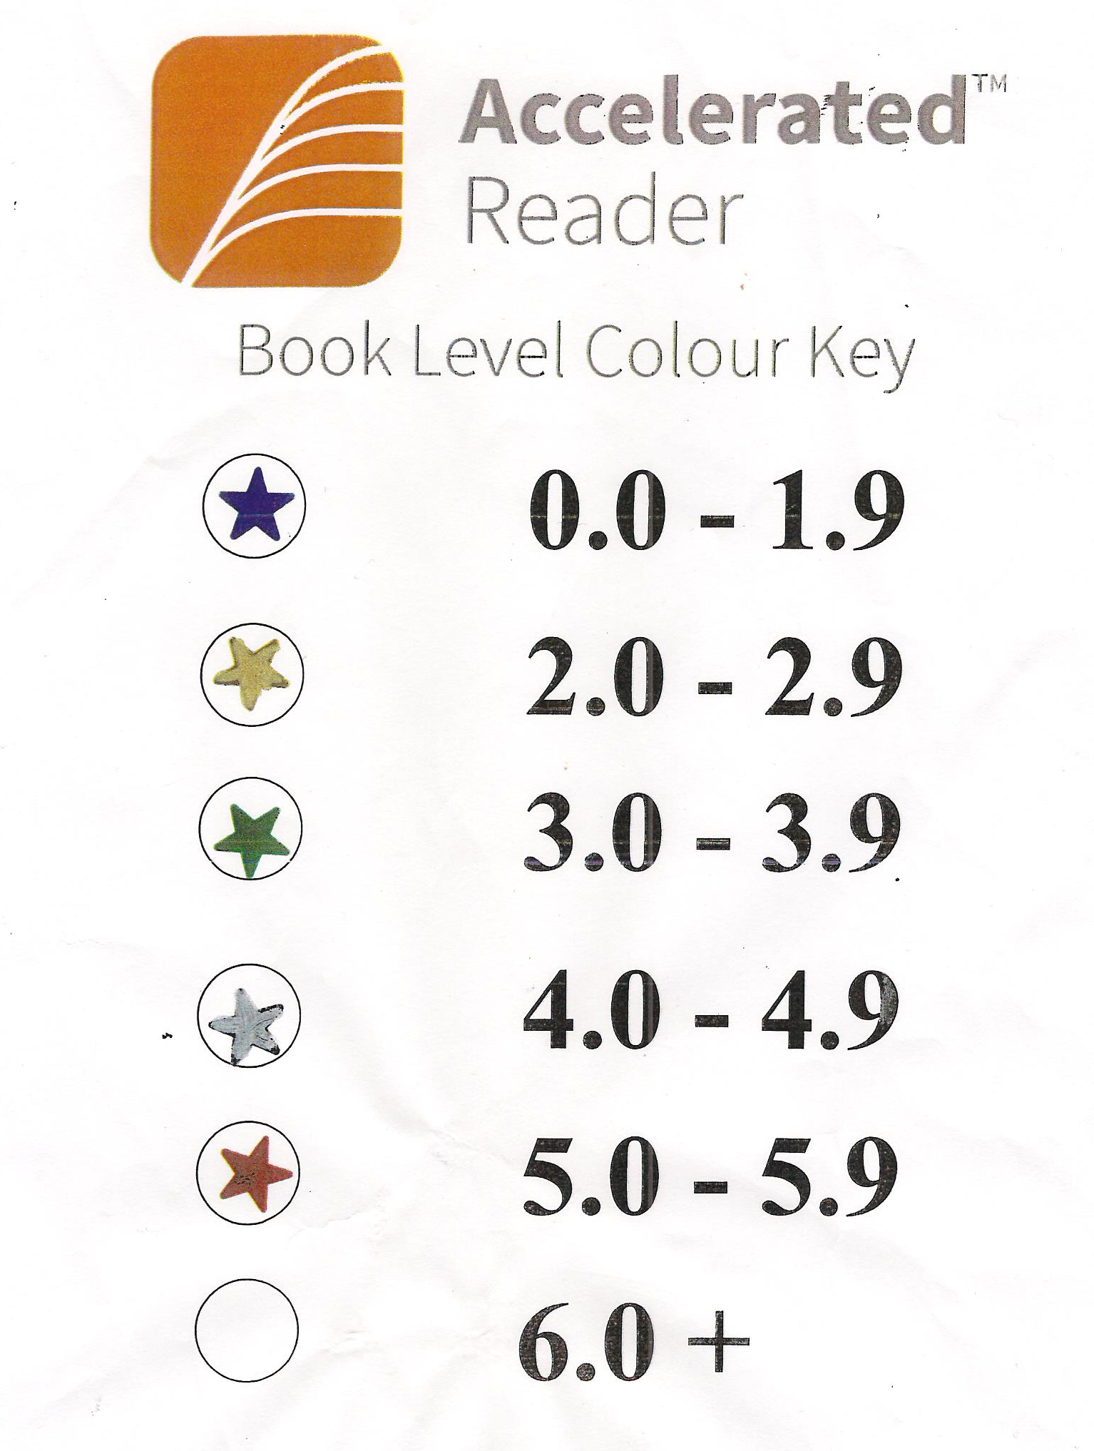
Book levels (BL)
All quizzed books have a Book Level (BL).
Represents the difficulty of the text.
Based on two main factors:
1. average sentence length
2. difficulty of words
The Star Reading test tells your child what range of Book Levels to read within - Zone of Proximal Development.

Slide 8
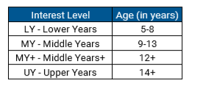
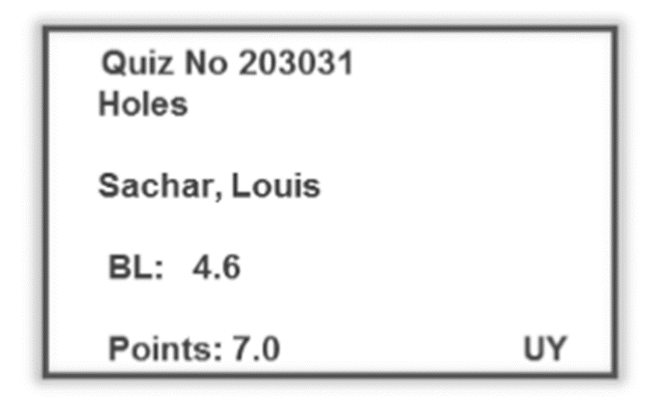
Interest Level
Indicates for which age group a book is suitable for. It does this based on the content and themes.

Slide 9
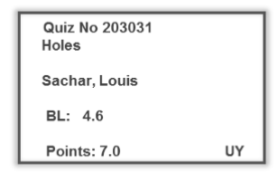
Points
Books are assigned Points based on their word count.
Points are earned by passing quizzes.

Slide 10

Activity
Look at the books on your table
Put them into order of book level – starting with the lowest book level up to the highest book level
Remember to think about:
1. the sentence level
2. difficulty of words
Also think about the Interest Level of each book

Slide 11
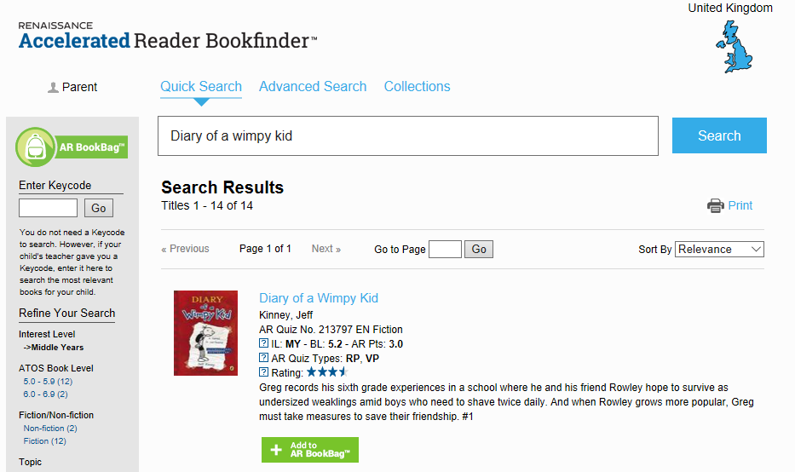
AR BookFinder
A search engine for all books with Accelerated Reader quizzes
www.arbookfind.co.uk

Slide 12
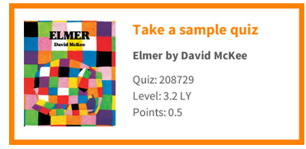
Reading Practice Quizzes
Ask questions that measure a pupil’s comprehension of a book.
There are 3, 5, 10 or 20 questions in a Reading Practice quiz depending on the length and complexity of the book.
Approximately 200 new quizzes are added to the programme every month.
http://readforpleasure.co.uk/
http://readforpleasure.co.uk/quizzes/quizzes/208729.html

Slide 13
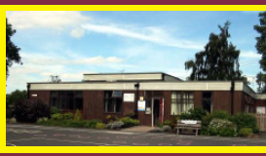
Reading quizzes are to be completed at home – not in school

Slide 14
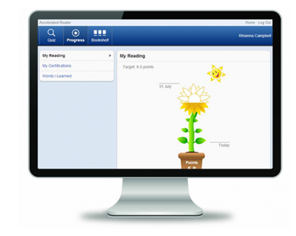
Instant Feedback
Every time a child reads a book and takes a quiz with Accelerated Reader, they get immediate feedback on their results.
The Opportunity to Praise Students Report is
automatically produced after every quiz, showing
the results of the quiz just taken.
The Accelerated Reader primary experience shows children the progress they are making with a simple and attractive sunflower design.

Slide 15
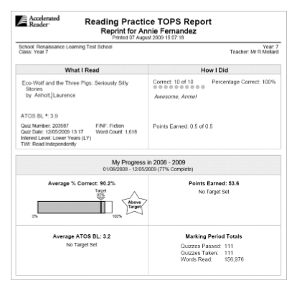
TOPS Report
Children working towards individualised goals will have their progress towards those goals displayed on their TOPS Reports.

Slide 16

Rewards
100% Readers
Aim - to achieve 100% in their reading quizzes
This will encourage the children to read carefully – reading for meaning
Raffle ticket for each quiz passed at 100% - entered into raffle each Friday – Celebration Assembly

Slide 17

Rewards
Millionaire Club
Aim – to read a million words
Special treat

Slide 18

How can I help my child become a better reader?
Make time for them to read at home. Children need to read for at least 20 minutes every day to improve their reading ability.
• Encourage your child to read; discuss books, asking questions about what they have read; and visit your local library.
• Find suitable books for your child at www.arbookfind.co.uk. Use the Search function to look for specific titles or topics, or go to Advanced Search to browse for books within your child’s ZPD and interest level.

Slide 19


