Slide 1
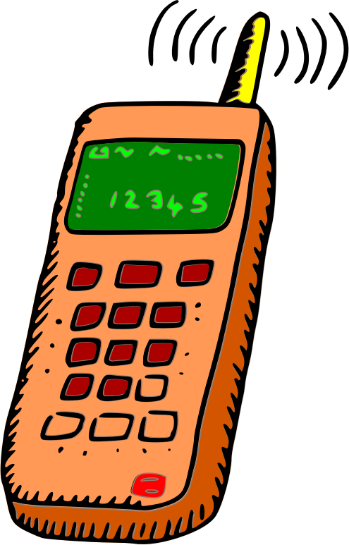
Starter
How do we communicate with each other?
With a partner, list or mind map all the different options we have for communicating with each other, in today’s modern world…

Slide 2
Learning Objectives
1. To understand how the Mayans communicated their language in writing.
2. To know what Mayan hieroglyphics (glyphs) and logograms are.

Slide 3
In the modern world there are so many different ways to communicate with each other.
From social media to sign language, and Skype to satellite phones – we really are spoilt for choice.
But…
This wasn’t the case for people living in the Mayan Civilization.
They had to communicate with each other in different ways.

Slide 4
Of course the Mayans had their own languages and spoke to each other (like we do).
But when it came to written communication the Mayans did things a bit differently
Watch this video now

Slide 5
Mayan Glyphs represent single spoken sounds (like phonics) that are combined to make words – much like our language.
Logograms are images that represent specific objects or words.

Slide 6
This website lets you write any message you want in Mayan hieroglyphics!
What would you like to write?
Click here

Slide 7
Plenary
1. Share and discuss your logogram designs with someone who hasn’t seen them yet.
2. Discuss whether logograms would be useful in the modern world. Decide how we could use them and where they would be useful.
Is there a modern day equivalent to logograms?

