Slide 1


Tuesday 17th September 2024
Accelerated Reader Workshop

Slide 2


Aims of the session:
What is Accelerated Reader?
How does it work?
Feedback for the children
Reward system
How can I help my child?

Slide 3
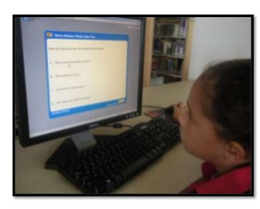

What is Accelerated Reader (AR)?
A personalised reading practice program that accelerates growth in reading ability. We use this system once your child has completed the Read Write Inc program
The children take a STAR test, which is designed to respond to their answers and give an accurate reading level.
This means that pupils are reading books they CAN access at a level which is appropriate – it avoids situations when pupils are discouraged by books that are ‘too hard’.

Slide 4
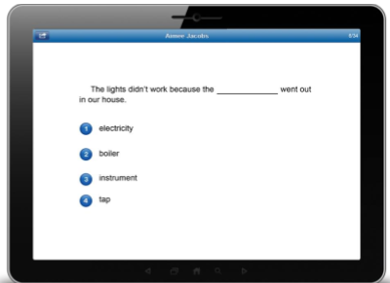
What is a Star Reading test?
Star Reading test is an online test used to measure your child’s reading level.
The test uses multiple-choice questions
It takes around 20 minutes
This test identifies your child’s Zone of Proximal Development (ZDP)

Slide 5
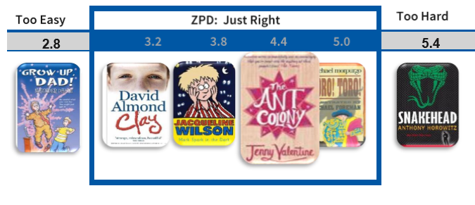
Zone of Proximal Development (ZDP)
A range of book levels recommended for each pupil based on their reading ability (Star test)
The pupil has free rein to choose books from within their entire ZDP range (based on quiz results and teacher feedback).

Slide 6

How do the children select books?
AR includes over 30,000 books. These can be found in the school library, classroom reading, our extensive range of reading books, public libraries, book shops, homes etc. Thee books that your child brings home will have the ZPD written on the spine of the book.

Slide 7
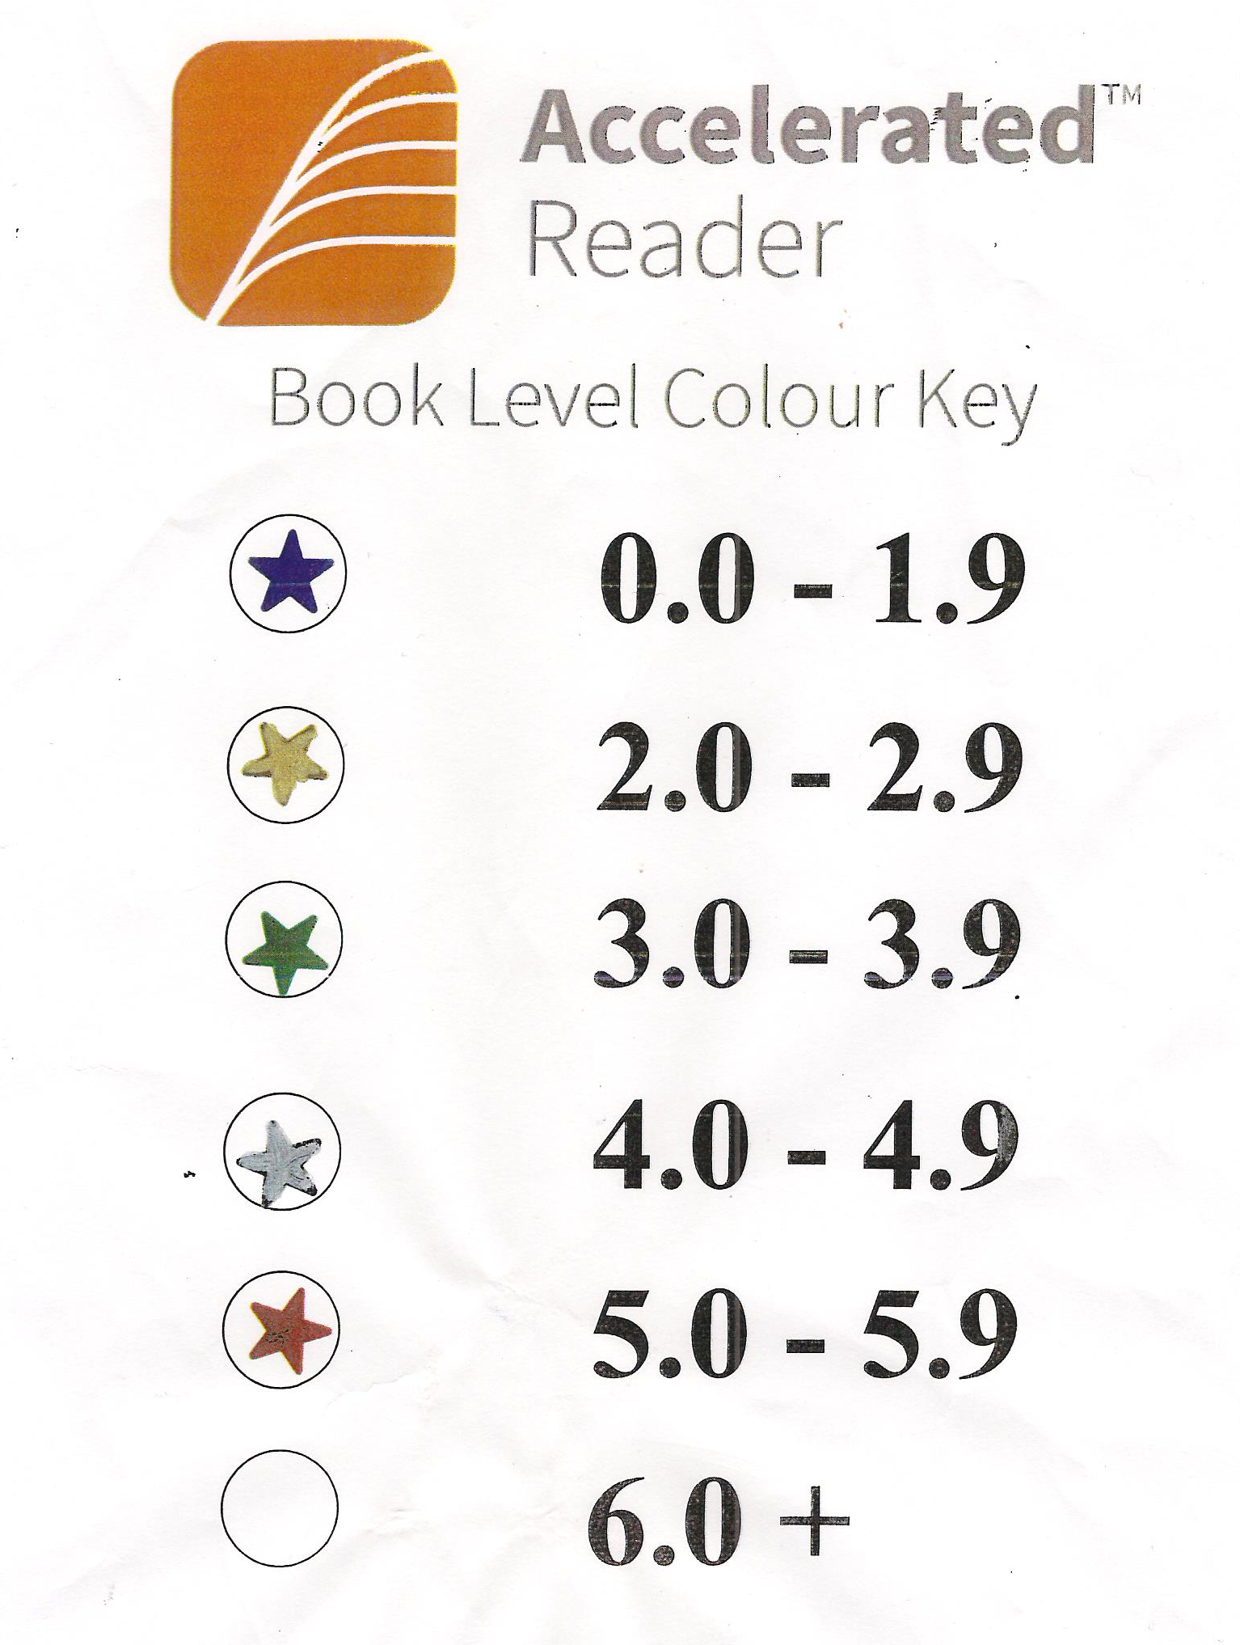
Book levels (BL)
All quizzed books have a Book Level (BL).
Represents the difficulty of the text.
Based on two main factors:
1. average sentence length
2. difficulty of words
The Star Reading test tells your child what range of Book Levels to read within - Zone of Proximal Development. This is taken each term and your child’s score will be written in their reading record or sent as a class dojo home.

Slide 8
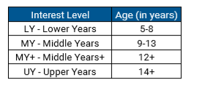
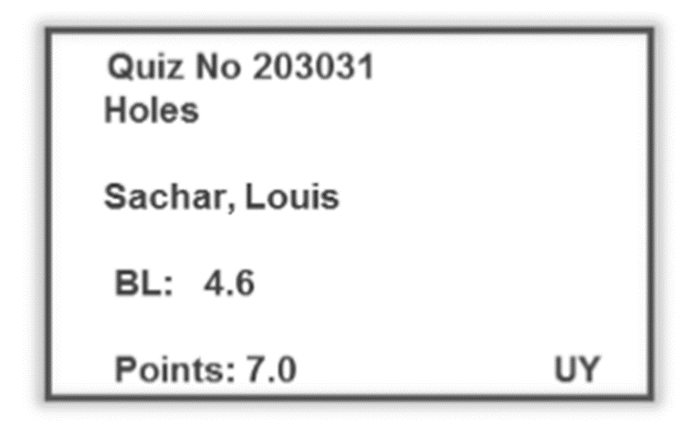
Interest Level
Indicates for which age group a book is suitable for. It does this based on the content and themes.

Slide 9
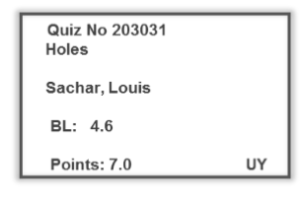
Points
Books are assigned points based on their word count.
Points are earned by passing quizzes.

Slide 10
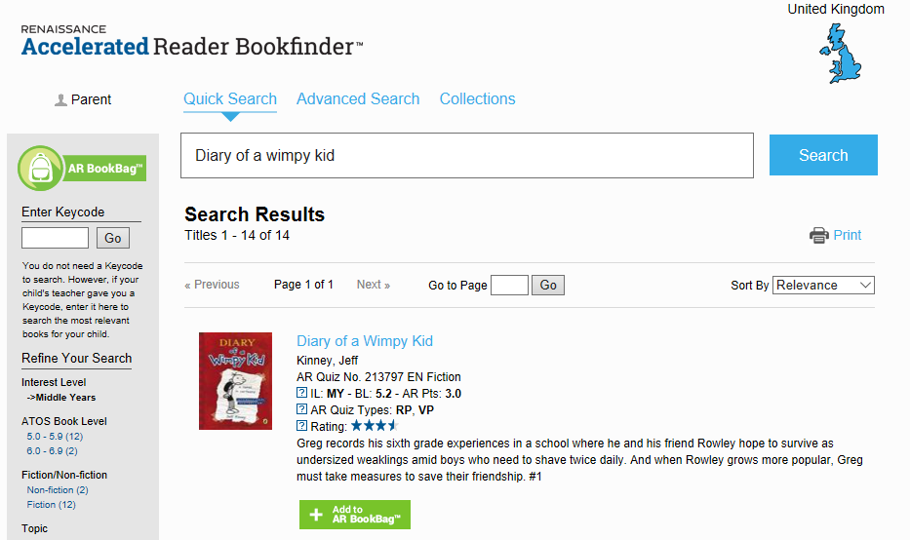

AR BookFinder
A search engine for all books with Accelerated Reader quizzes
www.arbookfind.co.uk

Slide 11
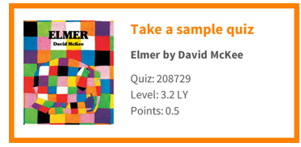
Reading Practice Quizzes
Ask questions that measure a pupil’s comprehension of a book.
There are 3, 5, 10 or 20 questions in a Reading Practice quiz depending on the length and complexity of the book.
Approximately 200 new quizzes are added to the programme every month.
http://readforpleasure.co.uk/
http://readforpleasure.co.uk/quizzes/quizzes/208729.html

Slide 12
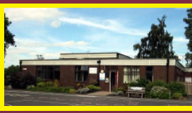
Reading quizzes are to be completed at school – not at home

Slide 13
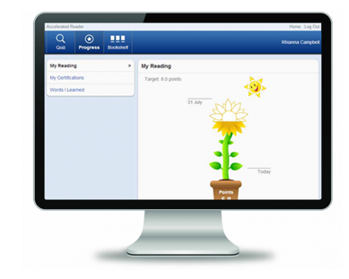
Instant Feedback
Every time a child reads a book and takes a quiz with Accelerated Reader, they get immediate feedback on their results.
The Opportunity to Praise Students Report is
automatically produced after every quiz, showing
the results of the quiz just taken.
The Accelerated Reader primary experience shows children the progress they are making with a simple and attractive sunflower design.

Slide 14

Rewards
100% Readers
Aim - to achieve 100% in their reading quizzes
This will encourage the children to read carefully – reading for meaning
Raffle ticket for each quiz passed at 100% - entered into raffle each half term in Celebration Assembly and will be entitled to our infamous Barter Books treat.
Children will also be given a raffle ticket for reading regularly at home as this is a key part of their continued development in reading.

Slide 15
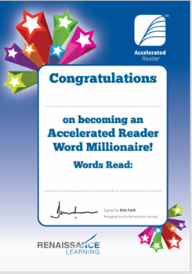
Rewards
Millionaire Club
Aim – to read a million words
Special treat of a book of their
Choice purchased for them to keep
Which will be awarded in
Celebration Assembly

Slide 16

How can I help my child become a better reader?
Make time for them to read at home. Children need to read for at least 20 minutes every day to improve their reading ability.
• Encourage your child to read; discuss books, asking questions about what they have read; and visit your local library.
• Find suitable books for your child at www.arbookfind.co.uk. Use the Search function to look for specific titles or topics, or go to Advanced Search to browse for books within your child’s ZPD and interest level.

Slide 17


