Slide 1
Tuesday 26th January 2021 LO: to identify and understand features of a play-script
In this lesson, we will be looking at the structure and features of a play-script and comparing this to a story’s structure and features.

Slide 2
Story v. play-script
What features are in a story?
Look at the next page where there is an example of a story and try to pick out all the features.
Label an example of each feature that you identify.

Slide 3
Chapter 2
Old Lord Capulet was in a jovial mood on the evening of his party. “Welcome gentlemen! Ladies that have their toes unplagued with corns will have a bout with you. Come musicians, play!” he said.
He encouraged all the young folk to enjoy the dancing, including his daughter, Juliet, who soon took to the floor with a dashing knight. She was so merry and so very pretty that even the love-struck Romeo noticed her. Indeed, not realising that she was Lord Capulet’s daughter, Romeo suddenly found that his heart no longer belonged to Rosaline, but to Juliet! “O, she doth teach the torches to burn bright! Did my heart love till now?” he breathed. Romeo did not keep his feelings to himself but, as if in a dream, stood declaring his new love to all about him.

Slide 4
Split into chapters
Characters descriptions
Chapter 2
Old Lord Capulet was in a jovial mood on the evening of his party. “Welcome gentlemen! Ladies that have their toes unplagued with corns will have a bout with you. Come musicians, play!” he said.
He encouraged all the young folk to enjoy the dancing, including his daughter, Juliet, who soon took to the floor with a dashing knight. She was so merry and so very pretty that even the love-struck Romeo noticed her. Indeed, not realising that she was Lord Capulet’s daughter, Romeo suddenly found that his heart no longer belonged to Rosaline, but to Juliet! “O, she doth teach the torches to burn bright! Did my heart love till now?” he breathed. Romeo did not keep his feelings to himself but, as if in a dream, stood declaring his new love to all about him.
Inverted commas for speech.
Setting description
Set out in paragraphs

Slide 5
Story v. play-script
What features are in a play-script?
A play-script may be something fairly new or uncommon for you to have seen.
As such, let’s take a look at some of a play-script’s features in details on the following pages.

Slide 6
Title
The name given to the play script.
Annie
Wicked
Macbeth
EastEnders
Romeo & Juliet

Slide 7
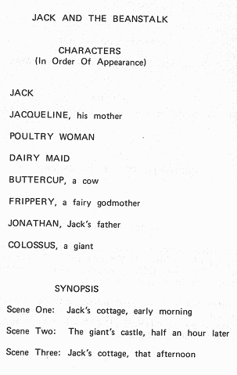
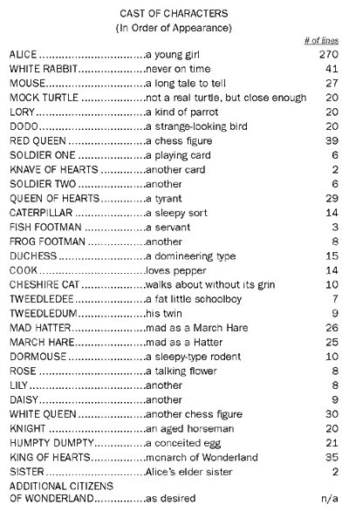
Character List
Found at the beginning of a play script.
It tells us what characters are in the play.
Sometimes it gives us a description of the character and their characteristics.

Slide 8
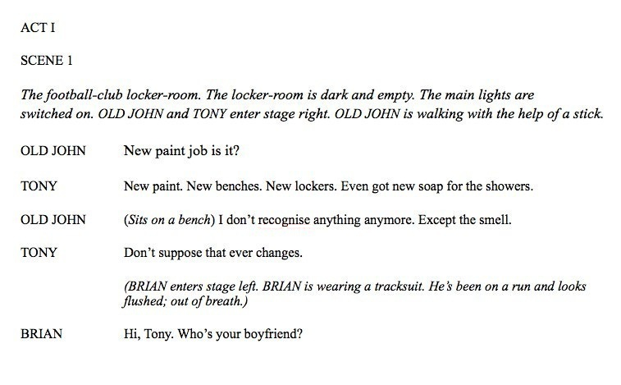
Stage directions
- Used to set the scene.
- They are an instruction. They tell an actor what they should be doing in that scene (their actions) or how they should talk.
- Normally presented in brackets or in italics.

Slide 9
Setting the scene
Gives the actors information/a description about the scene.
Where it is.
What it is like (weather).
Who is there.
It is a dark, cold night and Mel and Sid are sitting on a green park bench. The street lights are dim and the sound of the traffic can just be heard in the background.
SCENE ONE: Daddy bear comes into the house. Mummy and baby follow him. They are tired after their morning walk in the woods.

Slide 10
Dialogue
- The speech between characters.
- The character’s names are on the left hand side of the page.
- No speech marks.
- The speech is separated by a colon (:)

Slide 11
Scenes
- Like chapters in a book, it is a different part of the play.
- Used when you want to change the location or the time the dialogue is taking place.
- At the start of a new scene, it is important to say where and when it is happening.

Slide 12
Story v. play-script
Now that we’ve looked at play-script features, label the example of a section of a play-script with the features we’ve just looked at:
Title
Character list
Scene title
Scene description
Stage directions
Dialogue

Slide 13
Romeo & Juliet
Scene 2 – The Capulet party
Characters: Lord Capulet (Head of the Capulet family), Juliet (Lord Capulet’s daughter), Romeo (Lord Montague’s son), Tybalt (Lord Capulet’s nephew), Lady Capulet & Juliet’s nurse.
Inside the grand home of the Capulet family, busy with guests, all dressed in finery to impress. Musicians are playing energetic music and people are happy dancing and chatting. Romeo and his friends, Mercutio and Benvolio enter wearing party masks to disguise the fact that they are Montagues.
Lord Capulet: (Moving through the crowds in a jovial mood.) Welcome gentlemen! Ladies that have their toes unplagued with corns will have a bout with you. Come musicians, play!
(More guests, including Juliet, join in the dancing. Romeo sees Juliet and stops in his tracks.)
Romeo: (Said almost breathlessly.) O, she doth teach the torches to burn bright! Did my heart love till now?
Tybalt: (Turns around and looks at Romeo with fury.) This, by his voice, should be a Montague. To strike him dead I hold it not a sin.

Slide 14
After reviewing the features of a story and a play-script, list the features to compare the 2 genres of writing.
Story
Play-script

