Slide 1
Year 3 - Spring - Block 2
Money

Slide 2
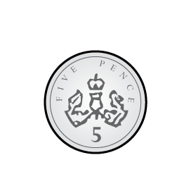
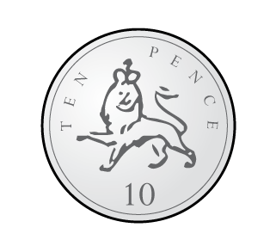
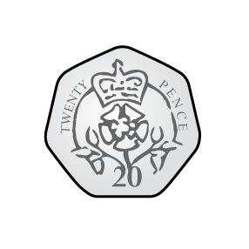
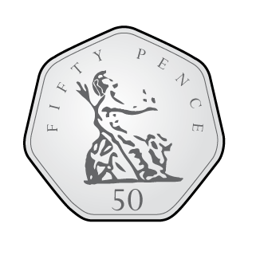
Rosie has 5 silver coins in her purse.
She can make 40 p with three coins.
She can also make 75 p with three coins.
How much money does Rosie have in her purse?

Slide 3
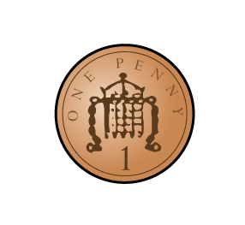
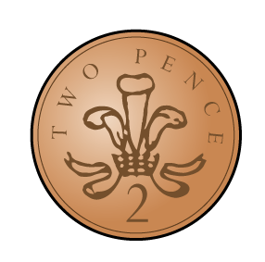
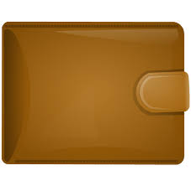
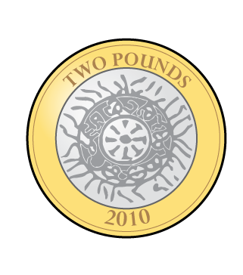
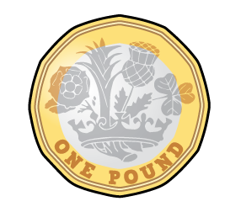
Amir has 5 different coins in his wallet.
What is the greatest amount of money he could have in his wallet?
What is the least amount of money?

Slide 4
Dexter has 202 pence.
He has one pound coin.
Show five possible combinations of other coins he may have.

Slide 5
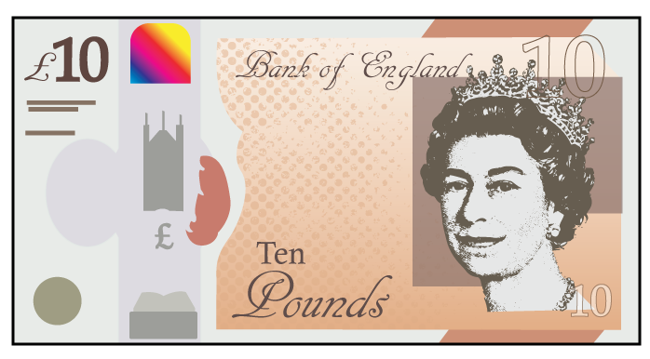
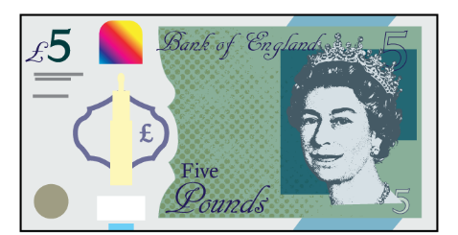
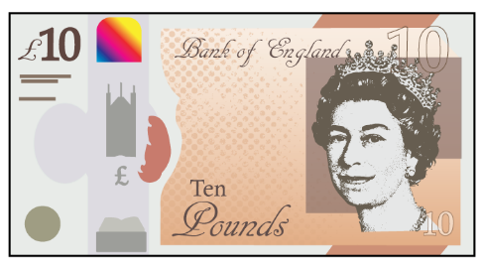
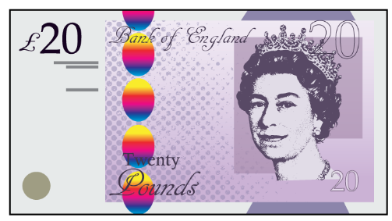
Whitney thinks that she has £10 and 3 p.
Is she correct?
Explain your answer.

Slide 6
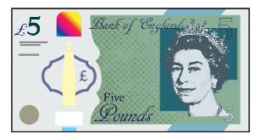
Dora thinks there is more than £5 but less than £6
Is Dora correct?
Convince me.

Slide 7
Dora bought these muffins.
Muffins cost 35 p each.
How much did Dora spend?
Tommy bought three times as many muffins as Dora.
How many muffins did Tommy buy?
How much money did Tommy spend on muffins?
How much more money did Tommy spend than Dora?

Slide 8
Rosie has £5
Has she got enough money to buy a car and two apples?
What combinations of items could Rosie buy with £5?
£3 and 35 p
£2 and 55 p
85 p
75 p

Slide 9
Jack has £2 and 90 p.
Teddy has three times as much money as Jack.
How much more money does Teddy have than Jack?
Rosie has twice as much money as Teddy.
How much more money does Rosie have than Jack?

Slide 10
Three children are calculating £4 and 20 p subtract £1 and 50 p.
£4 $−$ £1 $=$ £2 Annie
20 p $−$ 50 p $=$ 30 p
£1 $+$ 30 p $=$ £1 and 30 p
Teddy
The difference is £2 and 70 p.
£4 and 20 p $−$ £2 $=$ £2 and 20 p
£2 and 20 p $+$ 50 p $=$ £2 and 70 p Eva
Who is correct? Who is incorrect?
Which method do you prefer?

Slide 11
Dora spends £7 and 76 p on a birthday cake.
She pays with a £10 note.
How much change does she get?
The shopkeeper gives her six coins for her change.
What coins could they be?

Slide 12
Amir has £4
He buys a pencil for £1 and 20 p and a book for £1 and 45 p.
Which bar model represents the question?
Explain how you know.
Use the correct bar model to help you calculate how much change Amir receives.
£4
?
£1 and 20 p | £1 and 45 p | ?
£4 | £1 and 20 p | £1 and 45 p

