Slide 1
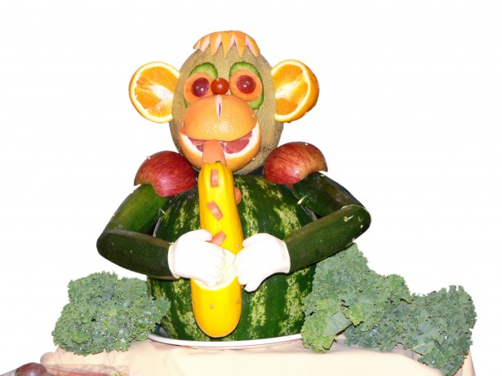
SUMMER MENU 2019
FIRST & PRIMARY SCHOOL
WEEK ONE
7th May - 11th November 2019
Homemade Dish
 | Monday | Tuesday | Wednesday | Thursday | Friday
Main Course Choices
Potatoes Pasta/Rice |  |  |  | Wholegrain Rice Naan Bread
Vegetables
Salad Bowl
Starters or Sweets
Spaghetti Bolognaise
Roast of the Day with Yorkshire Pudding
Jacket Potato with a Choice of Fillings
Curry of the Day
Fish Fingers
Garlic Bread
Creamed Potatoes
Roast Potatoes
Chips
Seasonal Vegetables
Seasonal Vegetables
Seasonal Vegetables
Seasonal Vegetables
Seasonal Vegetables
Seasonal Salad
Seasonal Salad
Seasonal Salad
Seasonal Salad
Seasonal Salad
Fruit Muffin with a Glass of Milk or Juice
Homemade Assorted Fruit Sponge with Custard
Shortbread Biscuit
with Slice of Fruit and Glass of Milk or Juice
Fruit Crumble with Ice Cream
School Pudding of the Day
Fresh Fruit and a selection of Breads are always available daily
Drinking Water is Available Daily on the Dining Room Tables
Menus are Subject to Change

Slide 2
SUMMER MENU 2019
FIRST & PRIMARY SCHOOL
WEEK TWO
7th May - 11th November 2019
Homemade Dish
 | Monday | Tuesday | Wednesday | Thursday | Friday
Main Course Choices |  | BBQ Chicken
Potatoes Pasta / Rice |  |  |  |  | Garlic Bread
Vegetables
Salad Bar |  |  | Seasonal Salad
Starters or Sweets
Fish Cake
Mince Pie
Roast of the Day with Yorkshire Pudding
Pasta with Tomato and Basil Sauce
Jacket Potato Wedges
Crusty Bread
Parsley Potatoes
Roast Potatoes
Creamed Potatoes
Parsley Potatoes
Crusty Bread
Wholemeal Rice
Naan Bread
Parsley Potatoes
Roast Potatoes
Seasonal Vegetables
Seasonal Vegetables
Seasonal Vegetables
Seasonal Vegetables
Seasonal Vegetables
Seasonal
Salad
Seasonal
Salad
Seasonal
Salad
Seasonal
Salad
Chocolate Brownie with a Glass of Milk or Juice
Fruit and Jelly
or
Jelly and Ice Cream
Fruit Mousse Slice
Fruit Sponge with Custard
School Pudding of the Day
Fresh Fruit and a selection of Breads are always available daily
Drinking Water is Available Daily on the Dining Room Tables
Menus are Subject to Change

Slide 3
SUMMER MENU 2019
FIRST & PRIMARY SCHOOL
WEEK THREE
7th May - 11th November 2019
Homemade Dish
 | Monday | Tuesday | Wednesday | Thursday | Friday
Main Course Choices
Potatoes Pasta / Rice
Vegetables
Salad Bar
Starters or Sweets | Ice Cream Roll with Fruit
Pizza Wrap
Minced Beef Cobbler
Baked Sausage
Roast of the Day with Yorkshire Pudding
Fish Portion
Oven Baked Potato Wedges
Crusty Bread
Creamed Potatoes
Roast Potatoes
Garlic Bread
Wholemeal Rice
Parsley Potatoes
Creamed Potato
Parsley Potatoes
Crusty Bread
Chips
Seasonal Vegetables
Seasonal Vegetables
Seasonal Vegetables
Seasonal Vegetables
Seasonal Vegetables
Seasonal
Salads
Seasonal
Salads
Seasonal
Salads
Seasonal
Salads
Seasonal
Salads
Homemade Biscuit or Cheese & Biscuits with a Slice of Fruit and a Glass of Milk or Juice
Fruit Cheesecake
or
Fruit Salad
School Pudding of the Day
Ginger / Lemon Cake with Custard
Fresh Fruit and a selection Breads are always available daily
Drinking Water is Available Daily on the Dining Room Tables
Menus are Subject to Change

