Slide 1

Reading at Whittingham C of E Primary School
Historically we have always had extremely high standards of reading
at Whittingham C of E Primary School and have been fantastically
supported by families reading to their children as well as listening to
their children read when they bring their school books home on a daily
basis to enable this to happen.
All our curriculum areas have a helpful
information page on the school website.
Reading is included on our English page https://whittingham.eschools.co.uk/website/
curriculum_areas/542477.
I am curriculum lead for English with Mrs Marsden the lead for Early Reading and Phonics. A helpful information page can be found https://whittingham.eschools.co.uk/website/_reading_at_whittingham_c_of_e_primary_-_read_write_inc_phonics_/523580
Following on from our Read Write Inc phonics programme when the
children are ready we move onto the Accelerated Reader programme.

Slide 2
Accelerated Reader:
A Guide for Parents and Carers
Accelerated Reader is a highly successful computer program that helps teachers manage and monitor children’s independent reading practice. It is used by thousands of schools nationally, as well as around the world. It has had proven success at our school for over 6 years now.

Slide 3
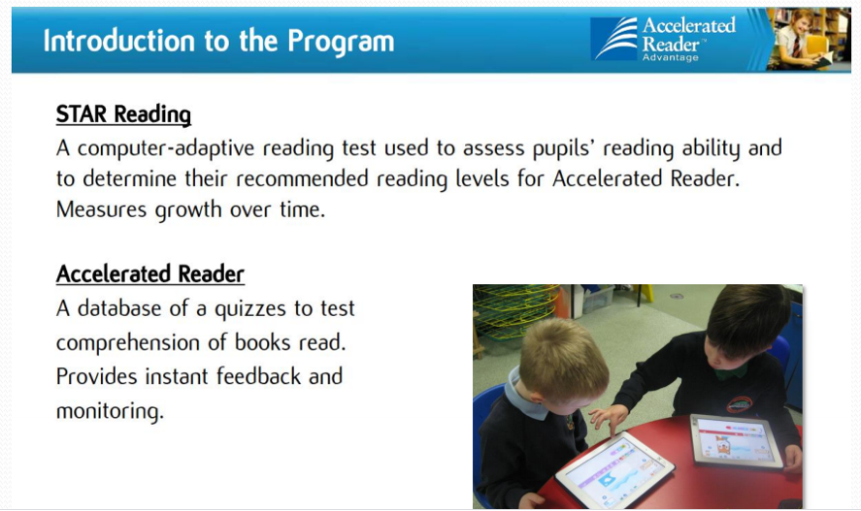

Slide 4
STAR Tests
At the start of the school year and at key assessment points throughout the school year, each student takes a Star Test, a computer-based adaptive test that measures a student’s reading ability through a series of 34 questions.
Every test for every student is different, and the computer selects different questions for each student dependent on how well they answer the previous questions. Essentially, the computer adapts the test to suit each pupil. It takes around 20 minutes to complete.
Once the student has completed the test, the programme calculates a ZPD range (Zone of Proximal Development) and approximate reading age.

Slide 5
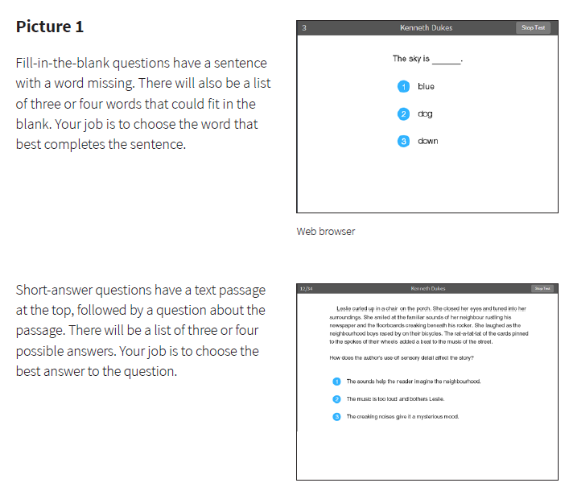
Example questions from Star Tests

Slide 6
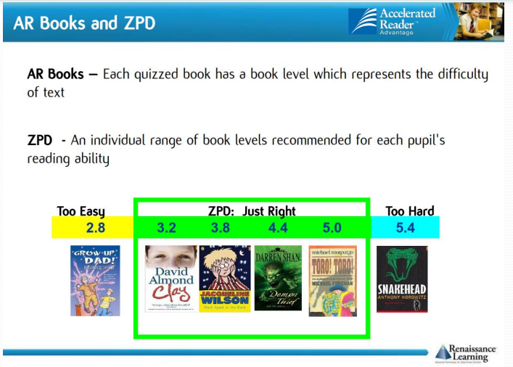

Slide 7
Reading quizzes
A quiz is different to a STAR test because students take a quiz each time after they have finished reading a book.
There are usually 5-10 questions on the book that has been read. At the end of the quiz the students are given a percentage to show them how well they have done.
There are some important rules for taking quizzes:
The book the child is quizzed on must be a book they have read in the last two weeks. AR is not a memory test but rather measuring reading ability.
A student cannot take a quiz until they have read the entire text.
Quizzes must be completed individually, not with anyone’s help.

Slide 8


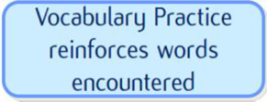



Example of a reading quiz question

Slide 9
According to Renaissance Learning’s research, children who read for at least 20 minutes a day and obtain a 90% or above comprehension rate on AR quizzes see the greatest progress.
Therefore, your child should have at least 20 minutes set aside for reading each day. Please make sure you sign your child’s Reading Record as every child from Reception to Year 6 has a chance to join the prize draw which is held termly.

Slide 10
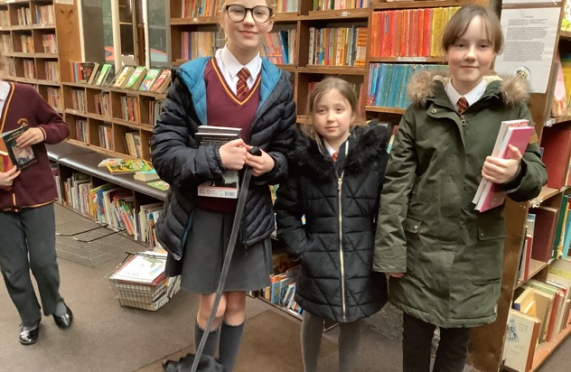
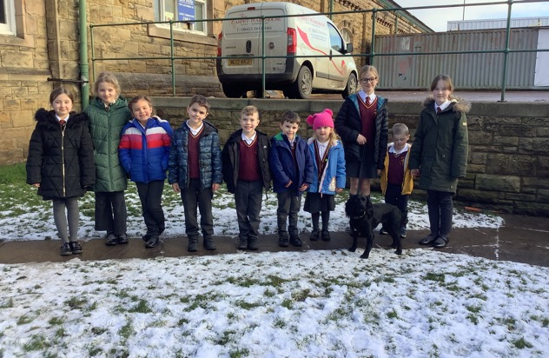
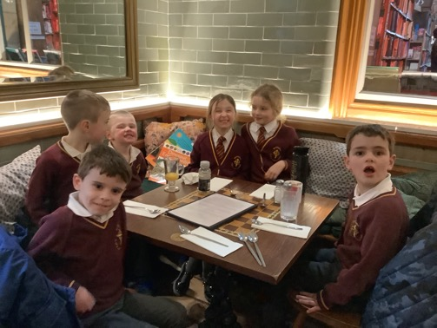
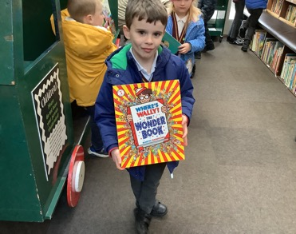
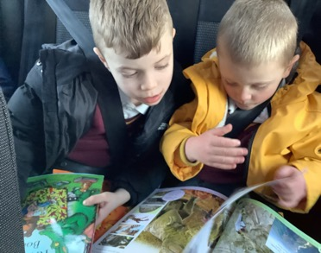

Slide 11
Supplementing schoolbooks at home
There is a fantastic resource which helps you check amongst 1000’s of books to see what Accelerated Reader level they are and whether the book is at the correct level for your child.
https://www.arbookfind.co.uk/UserType.aspx?RedirectURL=%2fdefault.aspx
More Useful Links:
https://www.renaissance.com/2016/09/09/parents-guide-renaissance-accelerated-reader-360/

Slide 12

Daily Read
Across the school class teachers and support staff regularly hear children read, this
may be individually or as part of a group. The children are also read to on a daily basis.
Books are carefully chosen to match topics, spark interest in recent events or for children
to immerse themselves in listening to a good book and for this class teachers access quality books from recognised sources, in particular Pie Corbett’s Reading Spine. The intention is that
over 7 or 8 years, children are read to, enjoy, discuss and work with around 82 core books.
These ‘essential reads’ are a store of classics, creating a living library inside a child’s mind.
This is the ‘Reading Spine’.
Great Books
Great books build the imagination. The more we read aloud expressively, and the more children are able to savour, discuss and reinterpret literature through the arts, the more memorable the characters, places and events become, building an inner world. Each great book develops the imagination and equips the reader with language.
Great Stories
Great stories speak to us as individuals and some children will return to certain books again and again.
Great stories also build our language because around 75 per cent of our vocabulary comes from our
reading. Reading develops the ability to think in the abstract; to follow lines of thought. Schools that have a reading spine, build a common bank of stories that bind the community together. These are shared and deeply imagined common experiences.

Slide 13
How can you help your child to be a better reader?
Encourage your child to read at home every day because they will get better
at reading if they practice.
Create a culture of reading in your household by reading with your child, having a collection of books at home, visiting your local library or bookshop regularly and by letting your child see you reading.
When reading with your child stop and ask them questions about the text to be sure your child is understanding what they have read.
Try to regularly discuss books that everyone in your family is reading or has read.
Helpful hints and tips for reading at home. If you copy and paste this link to your browser https://ourfp.org/supportingrah/book-chat-reading-with-your-child/
you will find three short films and support materials to help parents, families and
carers read books conversationally and creatively to children.
There is also a link to be shared which shows how we listen to readers at
school and can be found - https://youtu.be/-YkZaboS8DM

Slide 14
