Slide 1
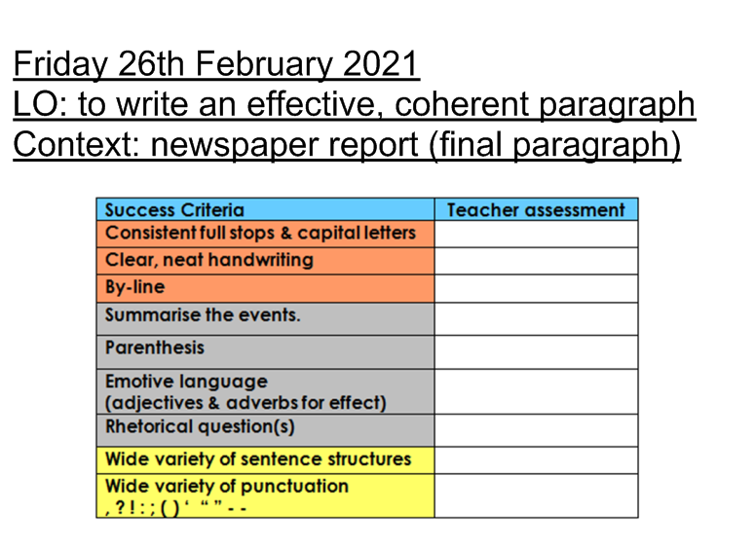

Slide 3
A final paragraph in a newspaper report:
rounds off/ concludes the article;
it explains what is happening now;
- it often poses thought on what might happen next.

