Slide 1

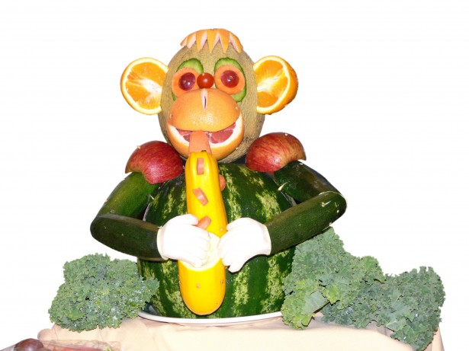



FIRST & PRIMARY SCHOOL
MENU 2024
WEEK ONE
Homemade Dish
 | Monday | Tuesday | Wednesday | Thursday | Friday
Main Course Choices
Potatoes Pasta/Rice
Vegetables
Salad Bowl
Starters or Sweets
Spaghetti Bolognaise
Fish Fingers
Roast of the day with Yorkshire Pudding
Curry of the day
Oven baked Sausage
Garlic Bread
Chips
Roast Potatoes
Brown and white Rice Nann Bread
Creamed Potaotes
Seasonal Vegetables
Seasonal Vegetables
Seasonal Vegetables
Seasonal Vegetables
Seasonal Vegetables
Seasonal Salad
Seasonal Salad
Seasonal Salad
Seasonal Salad
Seasonal Salad
Fruit Muffin with a Glass of Juice
Marble Cake
Homemade flapjack
Carrot Cake
Ice-cream and fruit
Fresh Fruit and a selection of Breads are always available daily
Drinking Water is Available Daily on the Dining Room Tables
Menus are Subject to Change

Slide 2
FIRST & PRIMARY SCHOOL
MENU 2024
WEEK TWO
Homemade Dish
 | Monday | Tuesday | Wednesday | Thursday | Friday
Main Course Choices
Potatoes Pasta / Rice |  |  |  |  | Chips
Vegetables
Salad Bar |  |  | Seasonal Salad
Starters or Sweets
Mince Cobbler
Pizza Wrap or Oven Baked Sausage s
Roast Of the day with Yorkshire Puddings
Tomato and Basil Pasta bake
Fish Cakes
Creamed Potato
Mini Waffles
Roast Potatoes
Crusty Bread
Seasonal Vegetables
Seasonal Vegetables
Seasonal Vegetables
Seasonal Vegetables
Seasonal Vegetables
Seasonal
Salad
Seasonal
Salad
Seasonal
Salad
Seasonal
Salad
Marshmallow Square
Sprinkle Cake
Jelly and Ice-cream
Biscoff Tray Bake
Frozen Yoghurt
Fresh Fruit and a selection of Breads are always available daily
Drinking Water is Available Daily on the Dining Room Tables
Menus are Subject to Change

Slide 3
FIRST & PRIMARY SCHOOL
MENU 2024
WEEK THREE
Homemade Dish
 | Monday | Tuesday | Wednesday | Thursday | Friday
Main Course Choices |  |  |  | Chicken Pie
Potatoes Pasta / Rice
Vegetables
Salad Bar
Starters or Sweets | Cheesecake
Chilli Beef or
Jacket Potato with a Choice of Fillings
Fish Portion
Roast of the day with Yorkshire pudding
Chicken Nuggets
Brown and White Rice
Doritos
Chips
Roast Potatoes
Creamed Potatoes
Mini Waffles
Seasonal Vegetables
Seasonal Vegetables
Seasonal Vegetables
Seasonal Vegetables
Seasonal Vegetables
Seasonal
Salads
Seasonal
Salads
Seasonal
Salads
Seasonal
Salads
Seasonal
Salads
Chocolate Brownie
Strawberry Shortcake
Sticky Toffee Pudding with Ice cream
Chocolate Mouse
Fresh Fruit and a selection Breads are always available daily
Drinking Water is Available Daily on the Dining Room Tables
Menus are Subject to Change

