Slide 1
PSHE consultation meeting
Tuesday 5th May 2026

Slide 2
What will this meeting cover
What is PSHE?
National Curriculum guidance
Latest government documents that influence PSHE
Our school’s PSHE curriculum and reasoning

Slide 3
What is PSHE?
PSHE is a curriculum subject that is taught across primary and secondary education.
It stands for personal, social and health education.
Units of work within this subject cover citizenship, relationship, safety, community, environmental and healthy living aspects so that children become confident, resilient and caring members of society.

Slide 4
National Curriculum guidance
All schools in England and Wales must teach the National Curriculum.
To support this, the National Curriculum is a public document from the government that shows the elements that must be taught (referred to as ‘programmes of study’).
However, for PSHE, there is no such guidance on the PSHE curriculum.
Instead, schools are directed to make provision for PSHE ‘drawing on good practice’.
As a school, this is met by following the PSHE Association’s guidance (the government’s source for PSHE) which shows how we can address the requirements of PSHE.
https://20248256.hs-sites.com/hubfs/Programme%20of%20Study%202026/PSHE%20Association%20Programme%20of%20Study%20for%20PSHE%20Education%20(Key%20stages%201%E2%80%935)%2c%202026.pdf?hsCtaAttrib=209372198691

Slide 5
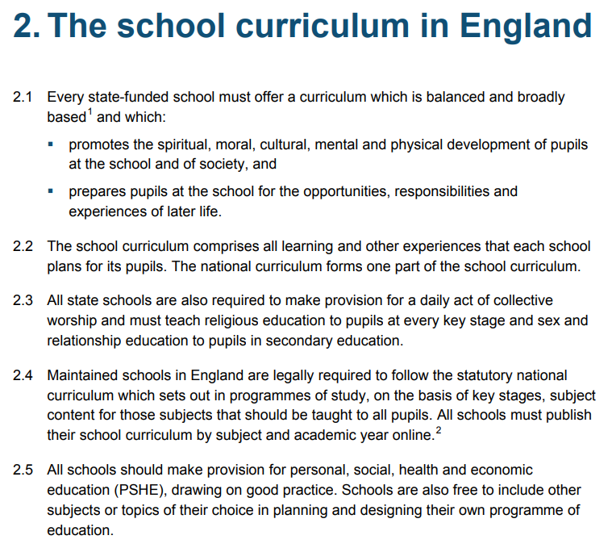

Slide 6
RHE
RHE stands for relationships and health education.
This is an aspect of PSHE that is required by the government for all schools to teach.
It is often linked or known as RSE or RSHE in schools which stands for relationships and sex education or relationships, sex education and health education.
https://assets.publishing.service.gov.uk/media/6970e7e67e827090d02d42e0/Relationships_education_relationships_and_sex_education__RSE__and_health_education__for_intro_1_September_2026_.pdf
With being a primary school, it is up to the leaders of the school to decide whether or not to include sex education. Taking into account the context of our school and our community, we do not feel this is needed or appropriate.
We still, however, meet the requirements for teaching the children about puberty when they reach the summer term in Year 5 so that they are prepared for physical and emotional changes that will take place when they reach this phase of their development.
For this, we use a video from ‘Operation Ouch’, a BBC programme that features two NHS doctors, ensuring that the content of our input is quality assured and appropriate to the children.
Operation Ouch! - Specials: Don't Panic About Puberty - BBC iPlayer

Slide 7
Influences to PSHE
There have been several changes/ adaptations to some of the documents and requirements within education that affect PSHE.
These are:
The new Ofsted Framework
Keeping Children Safe In Education 2025 (a document for all school staff and governors to guide and ensure certain knowledge and practices are in place for the welfare of children) https://assets.publishing.service.gov.uk/media/68add931969253904d155860/Keeping_children_safe_in_education_from_1_September_2025.pdf
Both the Computing and PSHE curriculums
The changes/ adaptations that have taken place for all the above relate to a greater focus on online relationships and preventing misogyny and coercive behaviours, grooming, extremism and radicalisation. They all also promote a greater inclusive practice across schools.

Slide 8
Whittingham C of E Primary School’s PSHE curriculum
Long before, the government’s updates were being published, we have been reviewing our PSHE curriculum in order to ensure that not only we were meeting the requirements but also to provide the children with real life-long learning opportunities that inspires and broadens their horizons.
With this, we have developed our new PSHE curriculum. This is currently being taught across school and it will be reviewed again and any necessary adaptations made at the end of the year to ensure that it delivers the very best in all that we aim and desire it to do. https://www.whittinghamprimaryschool.co.uk/pshe_rhse_mental_health_and_wellbeing

