Slide 1

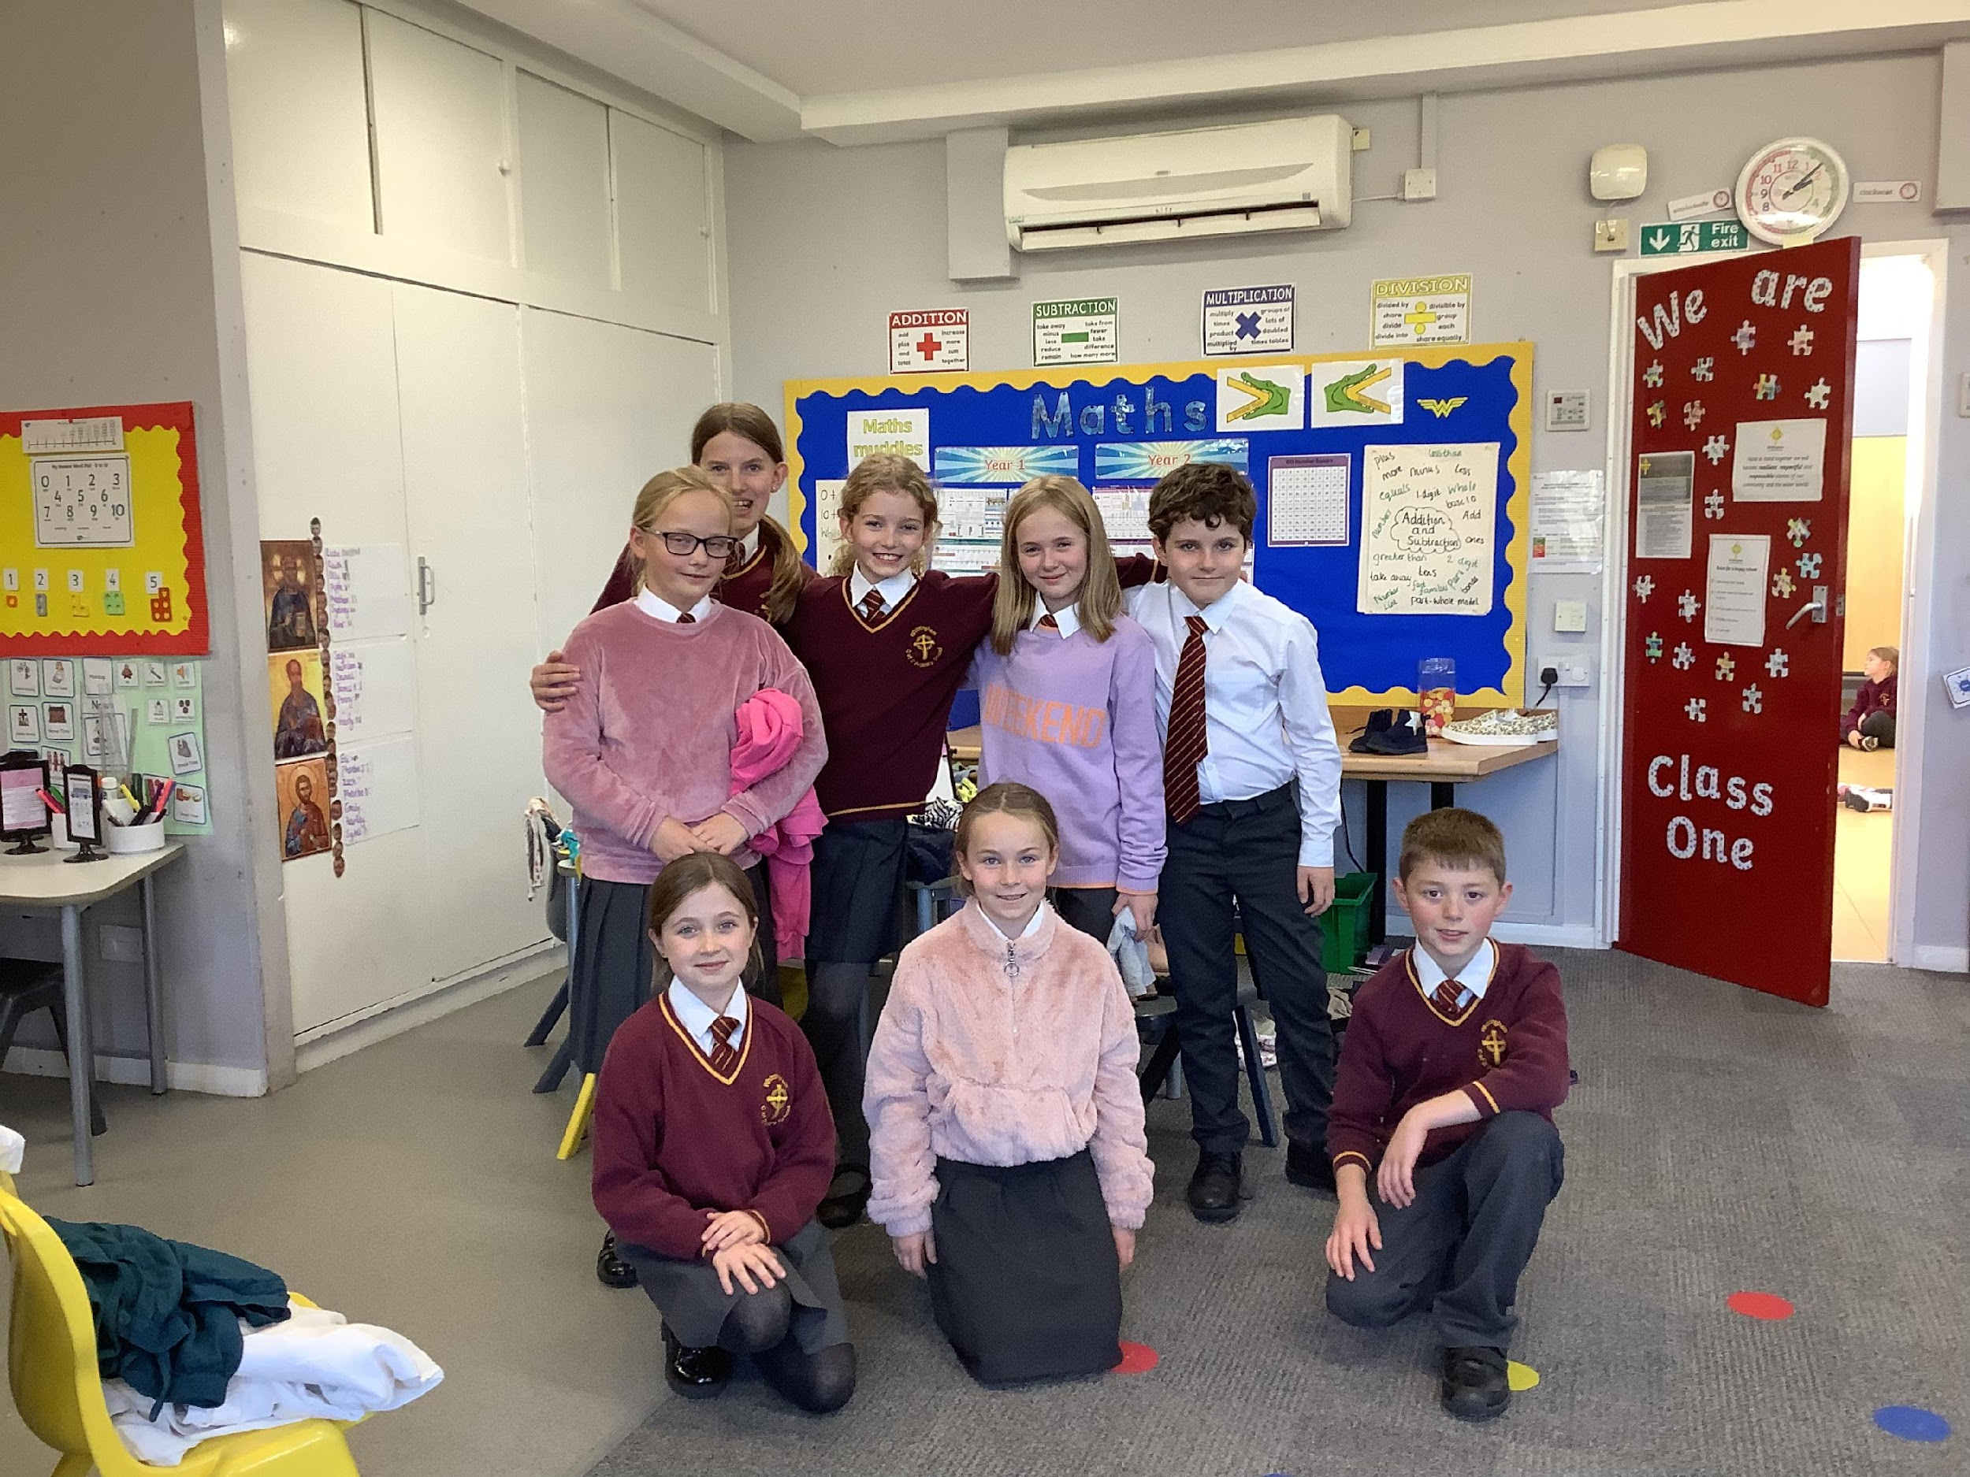
Rota Kids:
Dorothy, Florence, Laurence, Archie, Octavia and Bobbi. We need to recruit 2 new members because Lacey and Emily are at DCHS

Slide 3
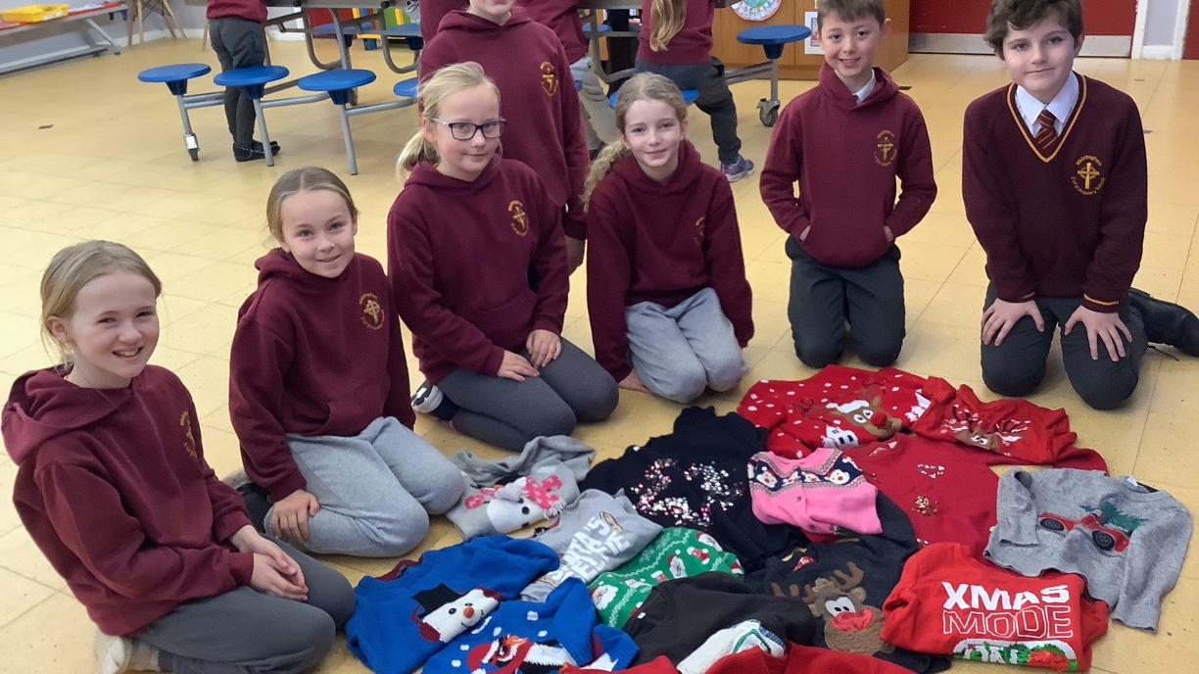
We started the school year 2023-4 by recruiting new members.
Pupils in Year 3-6 were invited to apply for the post and following an interview process Dorothy, Florence, Laurence and Archie were our successful applicants who joined our founder members.

Slide 4
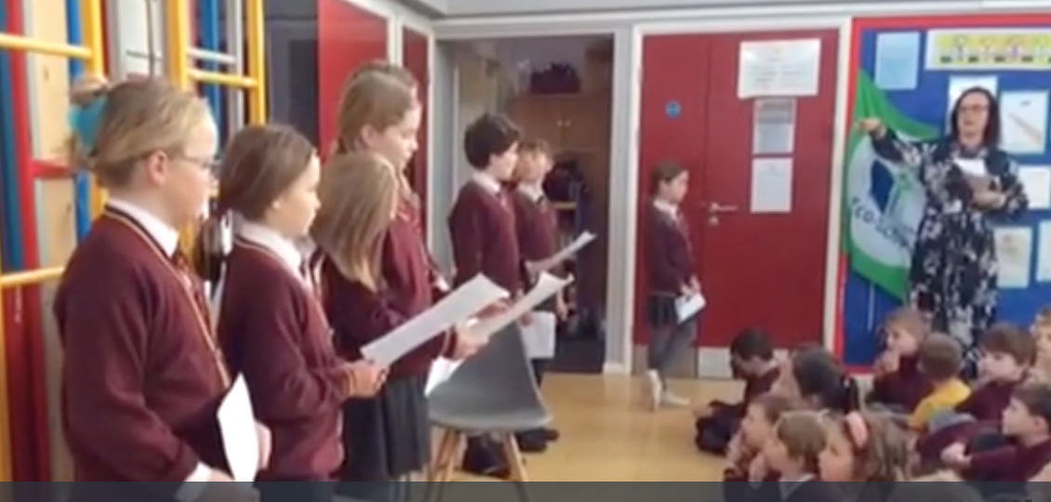
As part of the application and interview process we soon realised that the other children in school were not very sure of the role of the Rota Kids so as part of our first meeting we planned to deliver a child- led worship to the whole school to make everyone aware of our role.

Slide 5
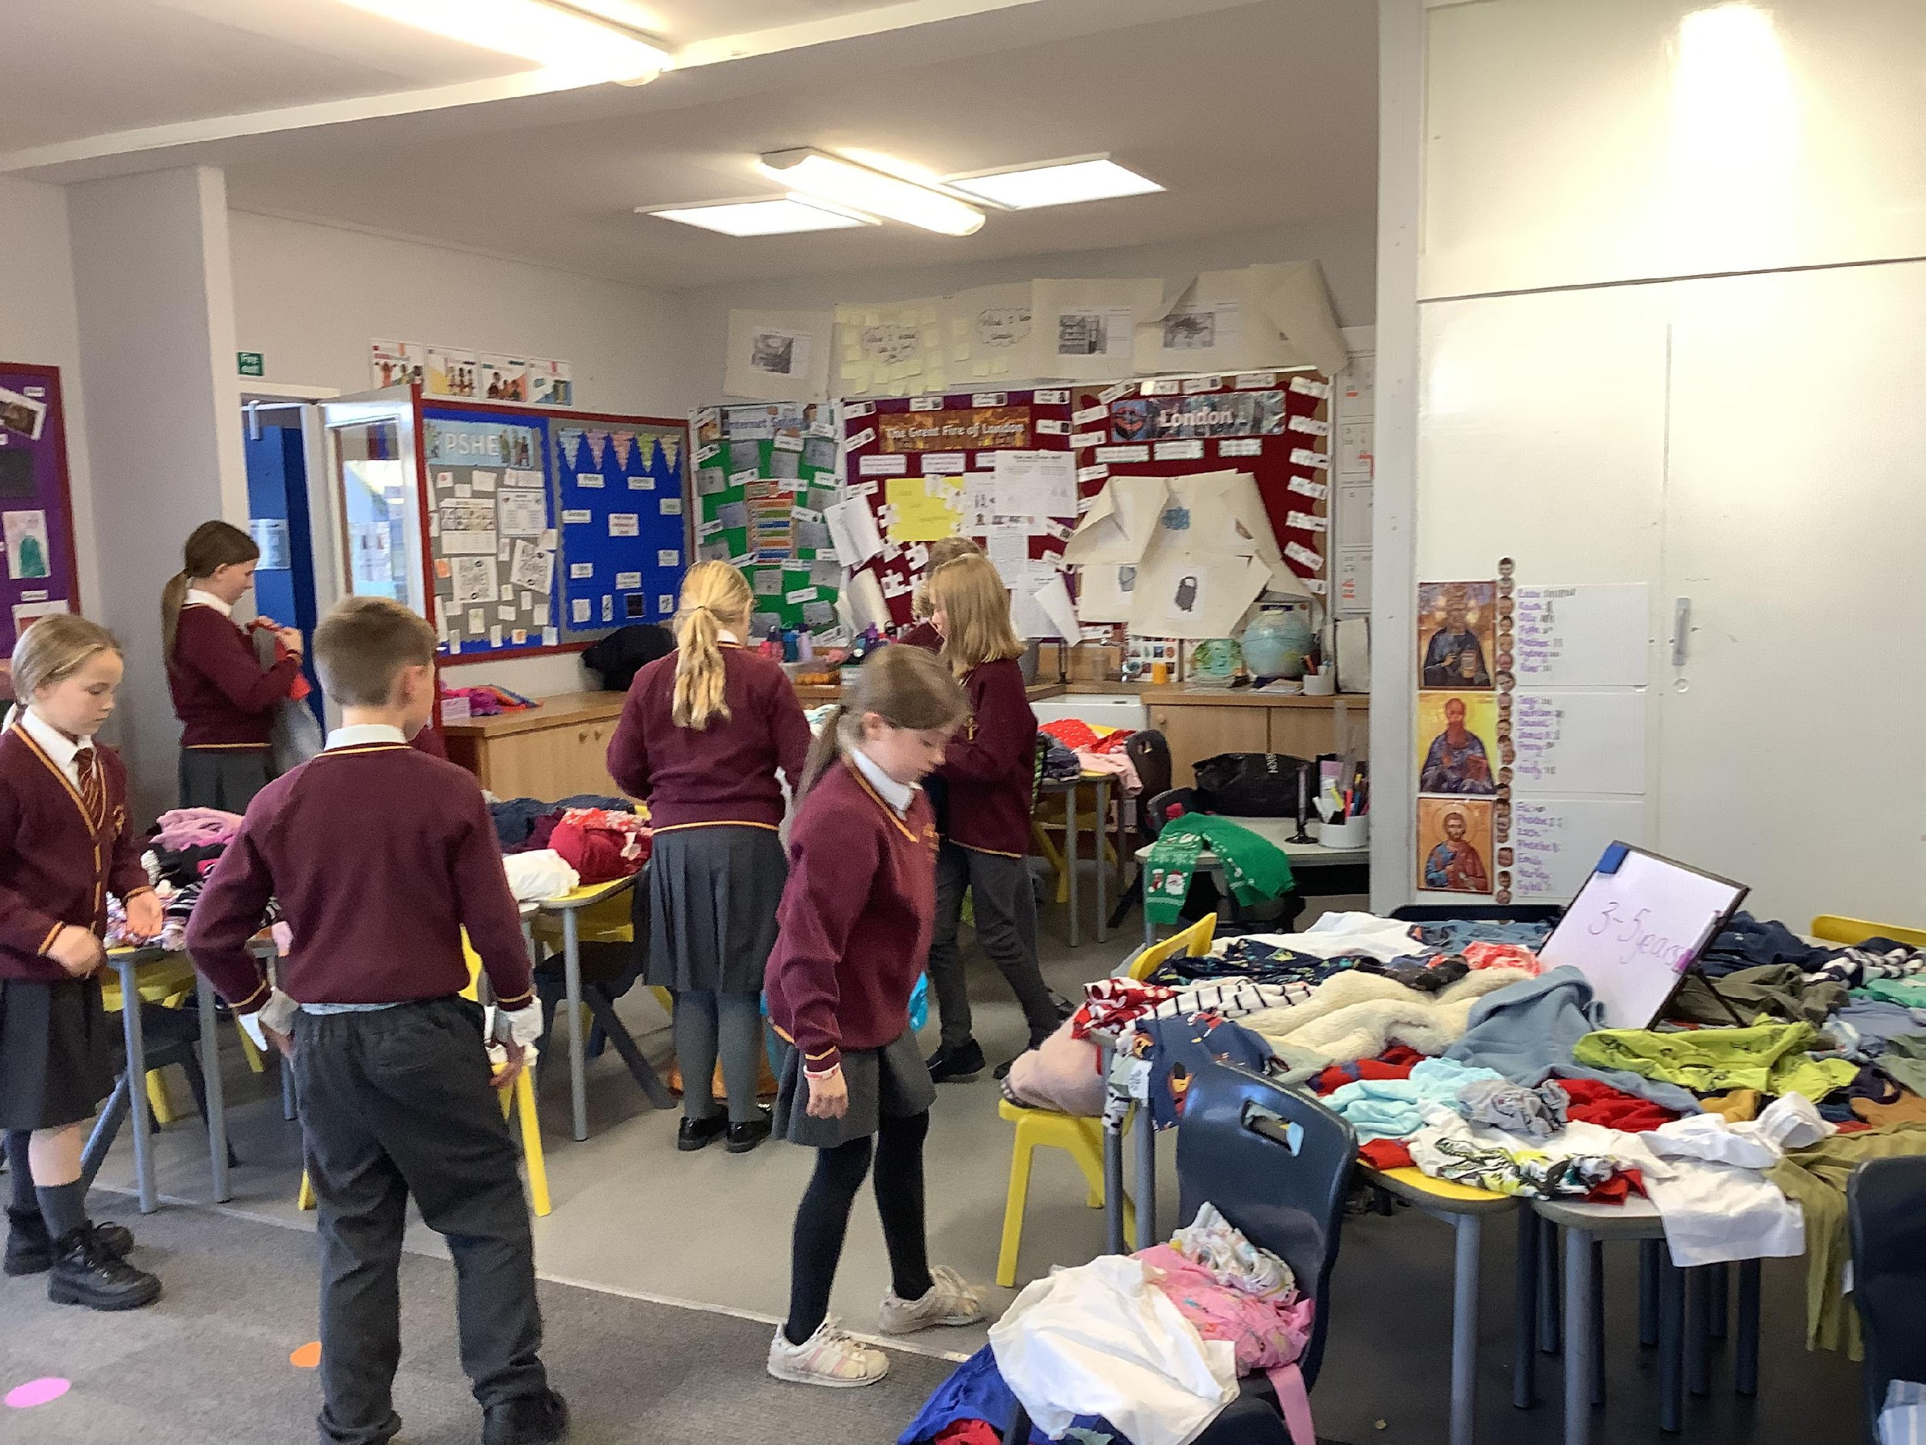
As a school we are developing our Courageous Advocacy. There are 5 ways in which we can do this through:
Awareness Raising.
Community Influencing.
Lifestyle Changes.
Consumer Power.
Engaging with Decision Makers.

Slide 6

We were each given the task of thinking of an environmental project or event that we would like to work on and also consider which element of Courageous Advocacy this would address.

Slide 7
Emily ( who unfortunately cannot be here tonight) chose for the class to do a litter pick demonstrating community influencing, raising awareness and lifestyle changes. Emily suggested we returned to Alnmouth Beach as this was one of the beaches we visited during our first Rota Kid project where we gained the John Muir Award and when we visited it back in 2021 it was the beach with the most litter.

Slide 8
Florence –
I live in Whittingham Village and I wanted to demonstrate lifestyle changes and engaging with decision- makers. We do not have many paths in our village making it dangerous to walk to school and therefore lots of children get dropped off by car. I wanted to be involved in creating paths so that more people would walk to school. I also know that hedgerows are an important habitat for birds, insects and other wildlife.

Slide 9
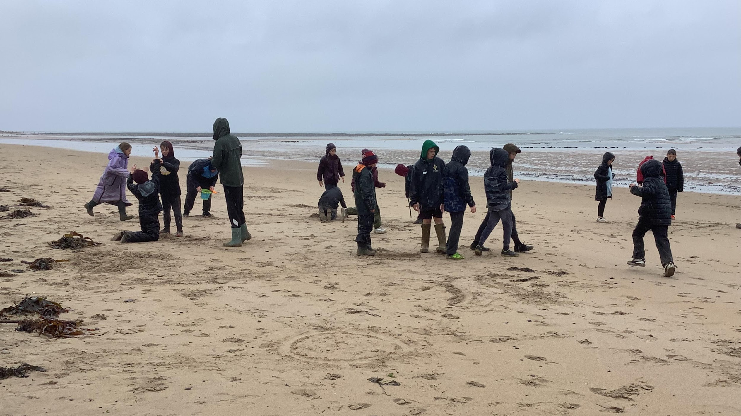

Slide 10
Archie – I chose to plant more trees in the school grounds. I wanted to demonstrate lifestyle changes and engaging with decision- makers. I know that trees are good at balancing the C02 levels in the environment and also provide habitats for wildlife.

Slide 11
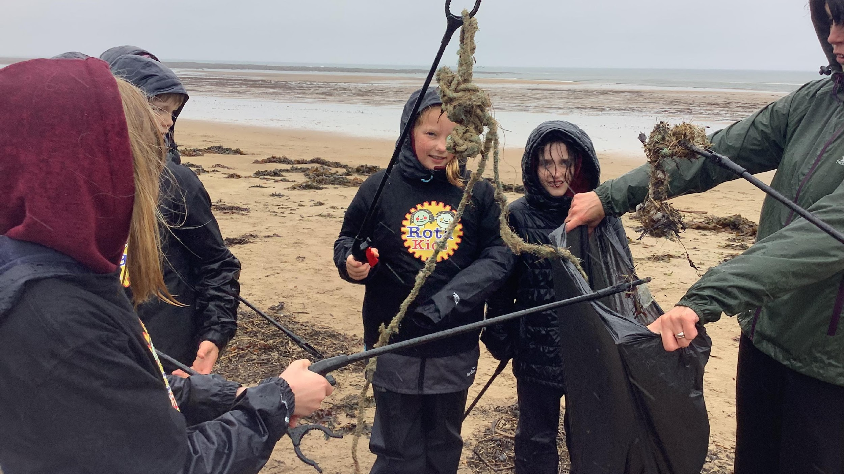

Slide 12
Dorothy – I chose to raise awareness, do community influencing, encourage lifestyle changes as well as trying to encourage consumer power. My idea was to have a section on Mrs Athey’s weekly newsletter where I would write about environmental issues.

Slide 13
Lacey – I chose the idea of designing posters with environmental messages on them which could be displayed around school, on village noticeboards and on social media as well as Mrs Athey’s weekly newsletter. This would enable me to raise awareness, do community influencing, encourage lifestyle changes as well as trying to encourage consumer power.

Slide 14
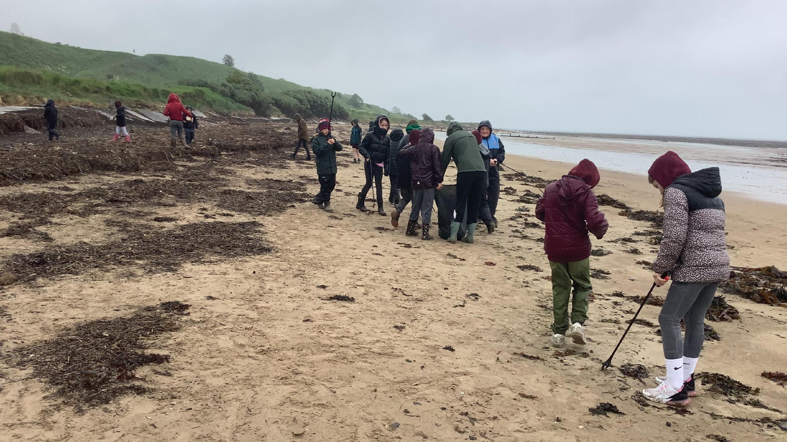

Slide 15
Bobbi. – My idea was to raise awareness of re-cycling and also to encourage lifestyle changes. I wanted school to join The Big Battery Hunt competition and encourage children to bring in their old batteries for re-cycling. My entering the competition I hoped to encourage more children and their families to re-cycle as we already have a battery collection point which is not very well used.

Slide 16
Laurence – My idea was to organise a sponsored walk to raise money for Eco Charities. I hoped to encourage lifestyle changes by encouraging people to walk more.

Slide 17
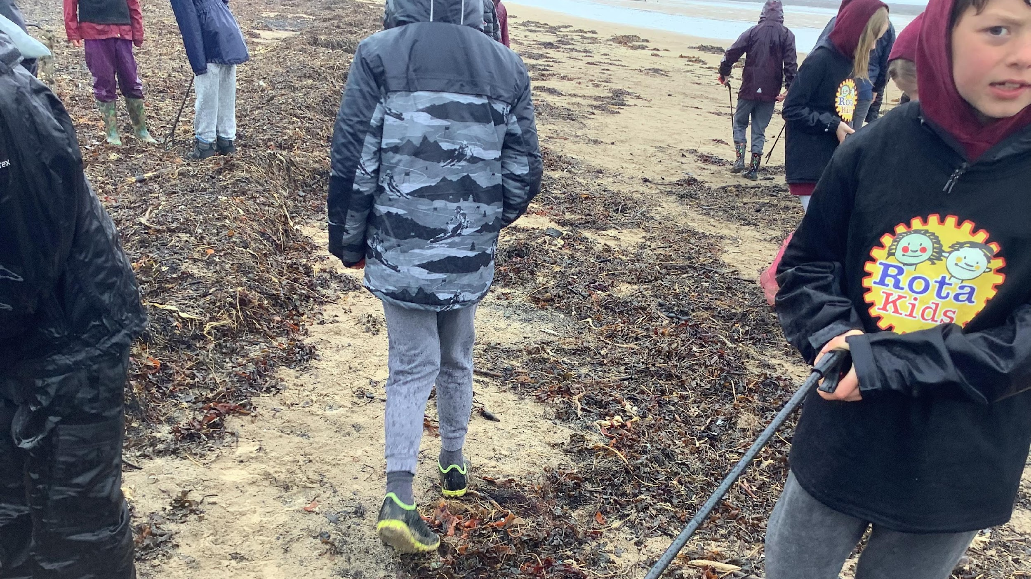

Slide 18
Octavia– My idea was organise a competition between the classes to see which class could save the most electricity across the school week. I hoped to encourage lifestyle changes by encouraging people to use less electricity and consumer power by persuading Mrs Athey to save electricity across the school for eternity.

Slide 20
During our worship with the whole school the children voted for which idea they wanted. The most popular idea was a litter pick at Alnmouth Beach. The Rota kids from Year 3 and 4 joined the rest of the Rota Kids and Year 5 and 6 for a VERY wet litter pick using our funding to cover the costs of transport and litter pickers.

Slide 21
We were pleasantly surprised to see that there was not a great deal of litter dropped onto the sand by visitors but were shocked by the amount of rubbish when we picked amongst the seaweed brought onto the beach by a high tide. This demonstrated how much plastic pollution there is in seas around the world.

Slide 22
