Slide 1

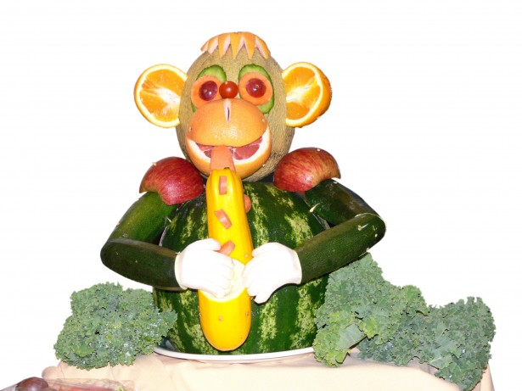




FIRST & PRIMARY SCHOOL
MENU 2023
WEEK ONE
Homemade Dish
 | Monday | Tuesday | Wednesday | Thursday | Friday
Main Course Choices
Potatoes Pasta/Rice
Vegetables
Salad Bowl
Starters or Sweets
Chilli Beef & Nachos
or
Jacket Potato with Cheese
All Day Breakfast
Chicken pie
Pasta
Bolognaise
Fish Fingers
or
Pasta Pot
Basmati rice
Oven baked waffles
Potatoes
Garlic bread
Chips
Seasonal Vegetables
Seasonal Vegetables
Seasonal Vegetables
Seasonal Vegetables
Seasonal Vegetables
Seasonal Salad
Seasonal Salad
Seasonal Salad
Seasonal Salad
Seasonal Salad
Muffin with Juice
Marble Cake
Orange or lemon Shortbread Biscuit
with a Glass of Milk or Juice
Chocolate fudge pudding &
Ice cream
School Pudding of the Day
Fresh Fruit and a selection of Breads are always available daily
Drinking Water is Available Daily on the Dining Room Tables
Menus are Subject to Change

Slide 2
FIRST & PRIMARY SCHOOL
MENU 2023
WEEK TWO
Homemade Dish
 | Monday | Tuesday | Wednesday | Thursday | Friday
Main Course Choices
Potatoes Pasta / Rice |  |  |  |  | Chips
Vegetables
Salad Bar |  |  | Seasonal Salad
Starters or Sweets
Curry of the day
Or
Casserole
Pizza wrap or sausage
Roast of the day
Pasta with tomato and basil sauce
Fish portion
or
Pasta pot
Rice
Potato wedges
Potatoes of the day
Seasonal Vegetables
Seasonal Vegetables
Seasonal Vegetables
Seasonal Vegetables
Seasonal Vegetables
Seasonal
Salad
Seasonal
Salad
Seasonal
Salad
Seasonal
Salad
Mousse slice
Chocolate Brownie & juice
Ice cream roll with fruit
Strawberry shortcake
School Pudding of the Day
Fresh Fruit and a selection of Breads are always available daily
Drinking Water is Available Daily on the Dining Room Tables
Menus are Subject to Change

Slide 3
FIRST & PRIMARY SCHOOL
MENU 2023
WEEK THREE
Homemade Dish
 | Monday | Tuesday | Wednesday | Thursday | Friday
Main Course Choices
Potatoes Pasta / Rice
Vegetables
Salad Bar
Starters or Sweets | Fruit smoothie
Mince & cobblers
Fish cake
Roast of the Day
Pasta with meatballs
In tomato sauce or gravy
Chicken nuggets or pasta pot
Potatoes of the day
Oven baked waffles
Potatoes of the day
Crusty Bread
Chips
Seasonal Vegetables
Seasonal Vegetables
Seasonal Vegetables
Seasonal Vegetables
Seasonal Vegetables
Seasonal
Salads
Seasonal
Salads
Seasonal
Salads
Seasonal
Salads
Seasonal
Salads
Fruit cheesecake
Sprinkle cake
School Pudding of the Day
Flapjack
Fresh Fruit and a selection Breads are always available daily
Drinking Water is Available Daily on the Dining Room Tables
Menus are Subject to Change

